Slide 1
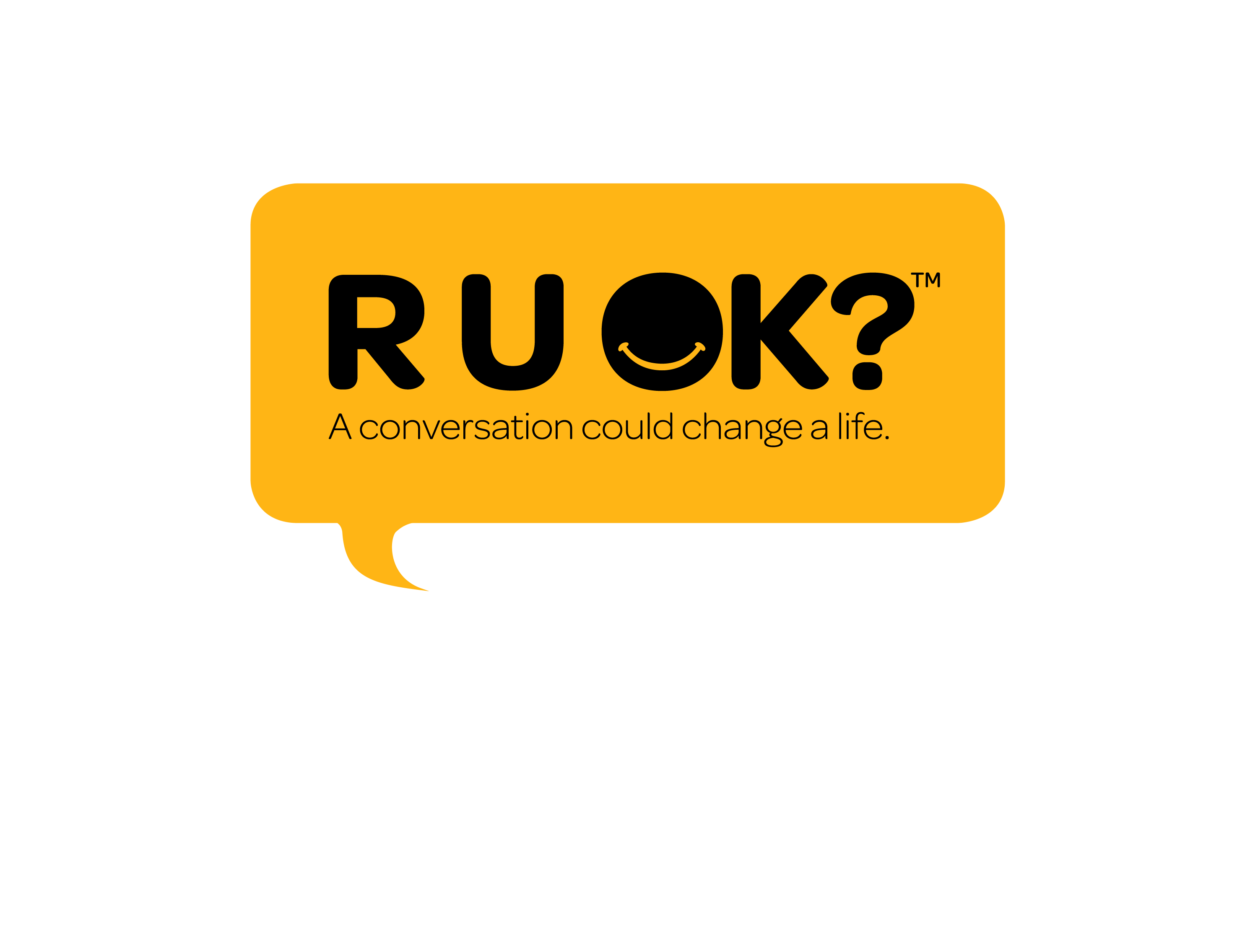
Notes:
Today I would like to talk to you about conversations. Not just ordinary ones but the ones that can change lives.
Inspiring these types of conversations is the reason R U OK? exists, and what I’ll be sharing with you today.

Slide 2
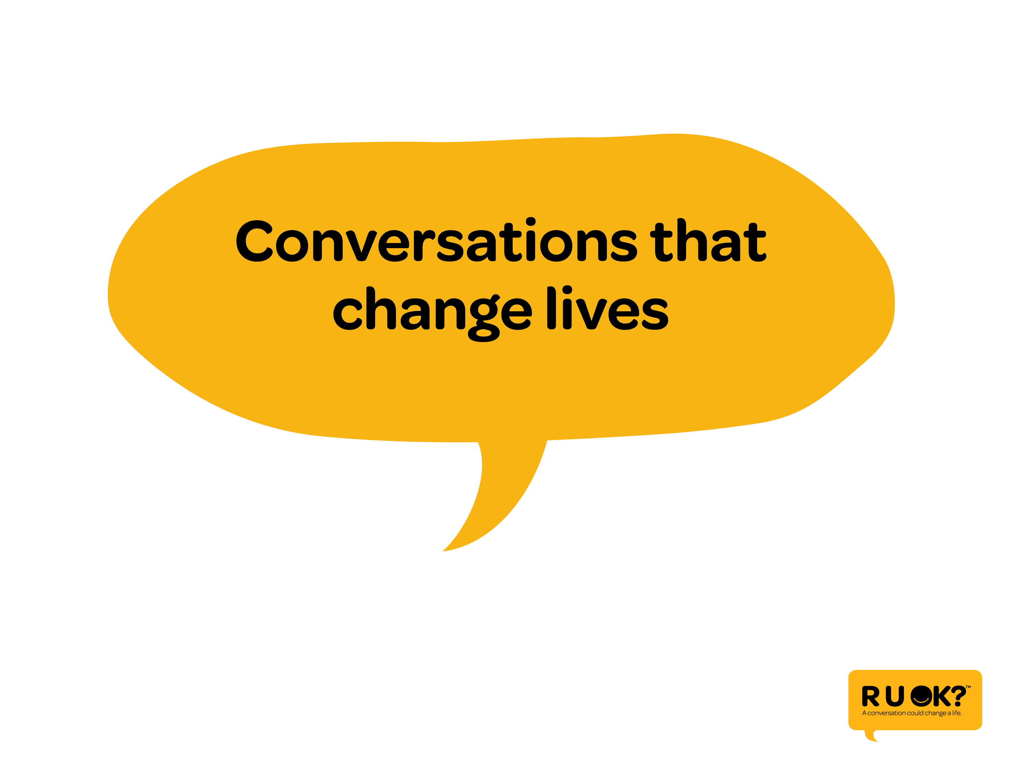
Notes:
So what are the conversations that change lives? Has anyone here had one that they can share?

Slide 3
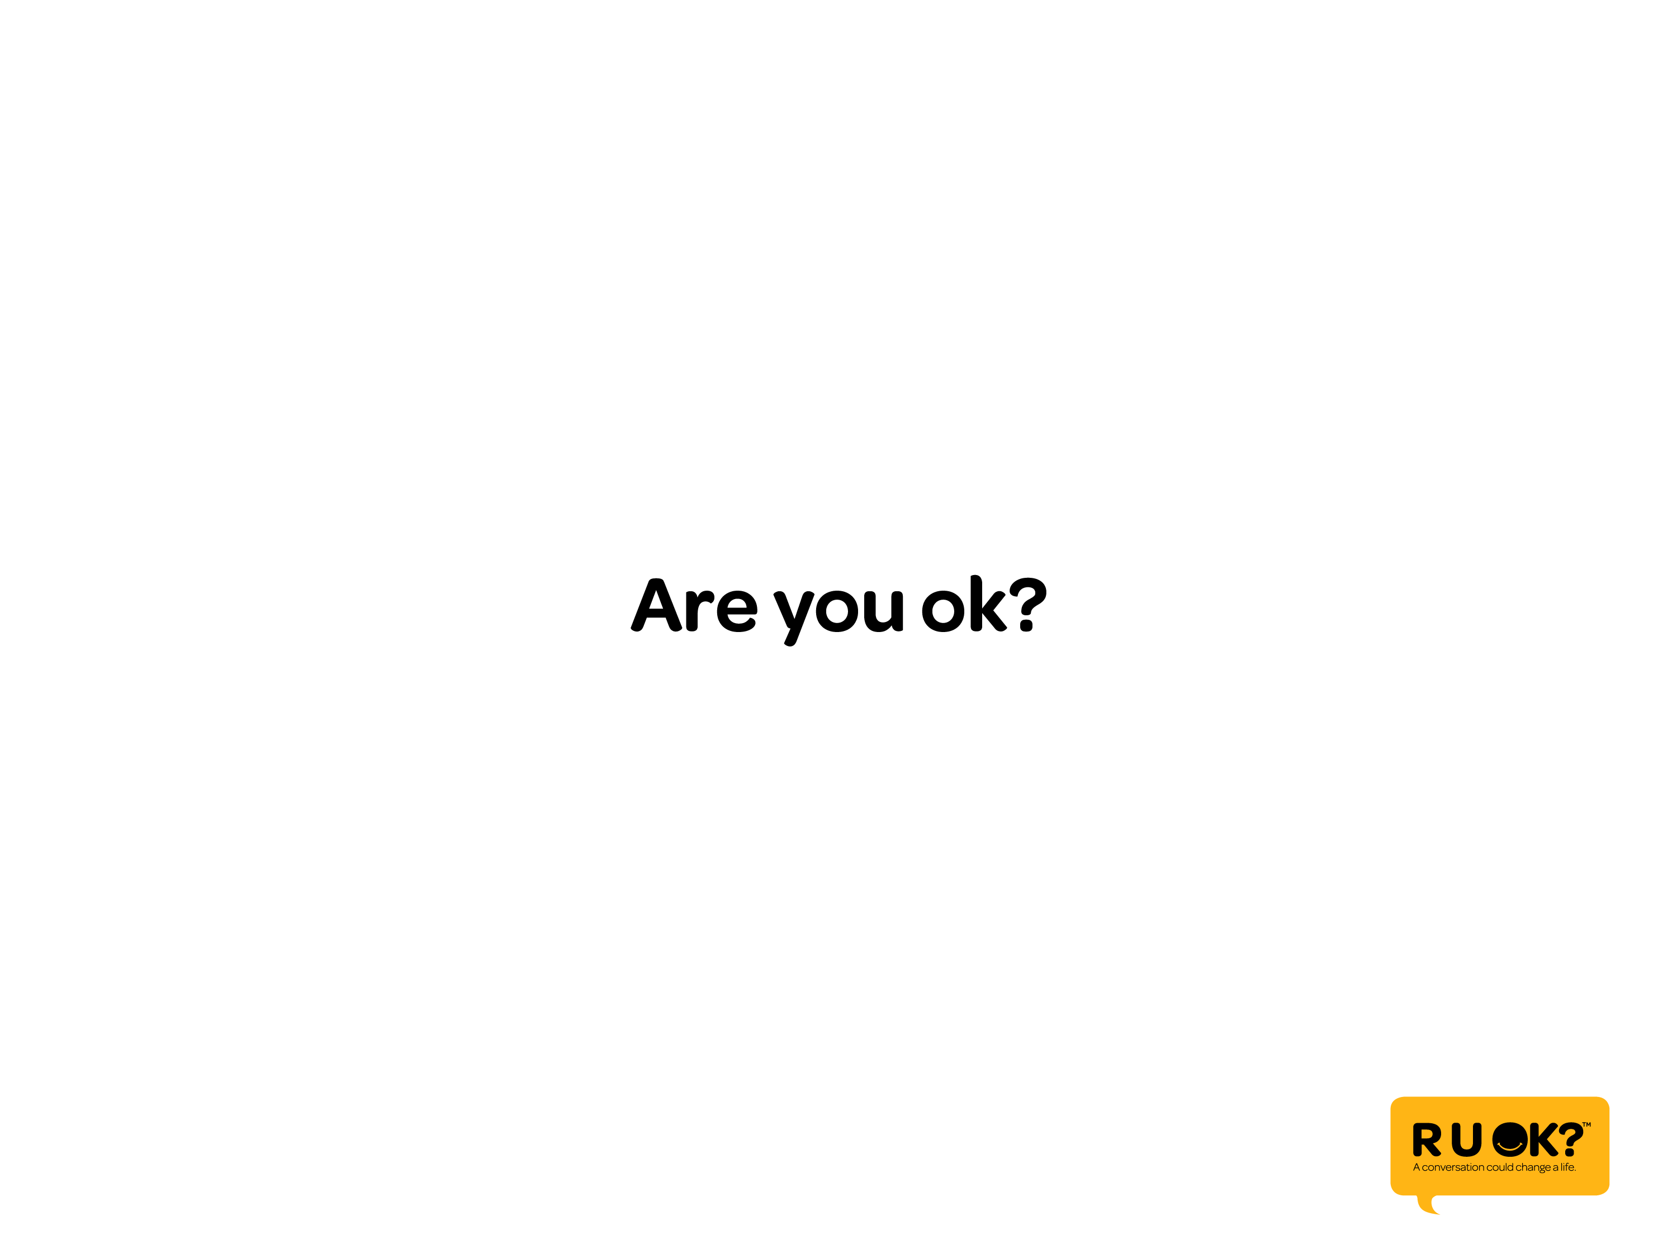
Notes:
Conversations that change lives are the ones that help people to open up about how they’re feeling and it all starts with 3 little words…

Slide 4
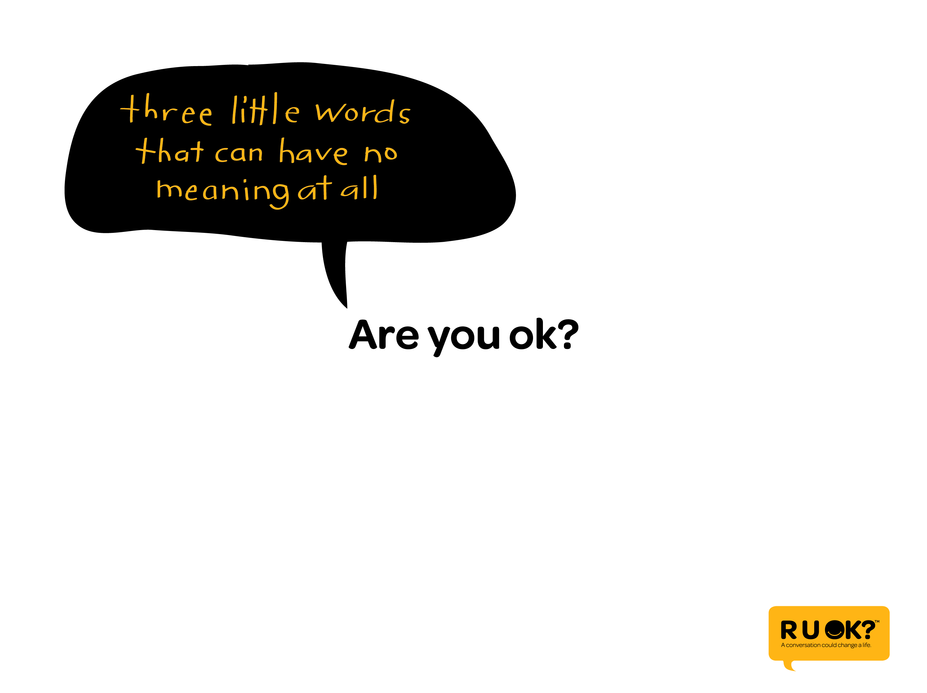
Notes:
It’s true that ‘Are you ok?’ is a phrase that is used every day with little or no thought at all. It’s sometimes more of a statement than a question.

Slide 5
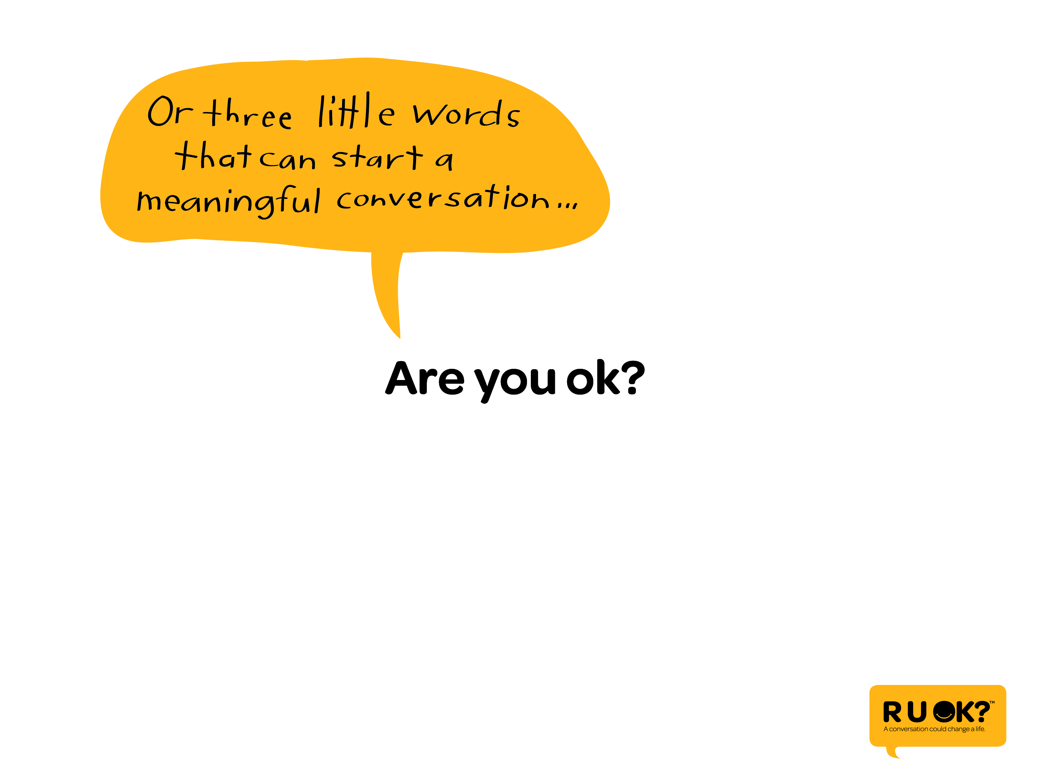
Notes:
But the truth is, these 3 little words can open up a conversation….

Slide 6
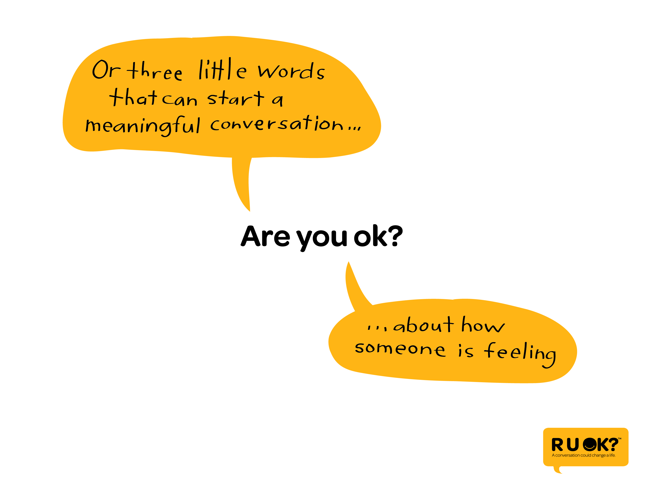
Notes:
And help someone admit that they’re over-whelmed, struggling with a problem or simply tired of life.

Slide 7
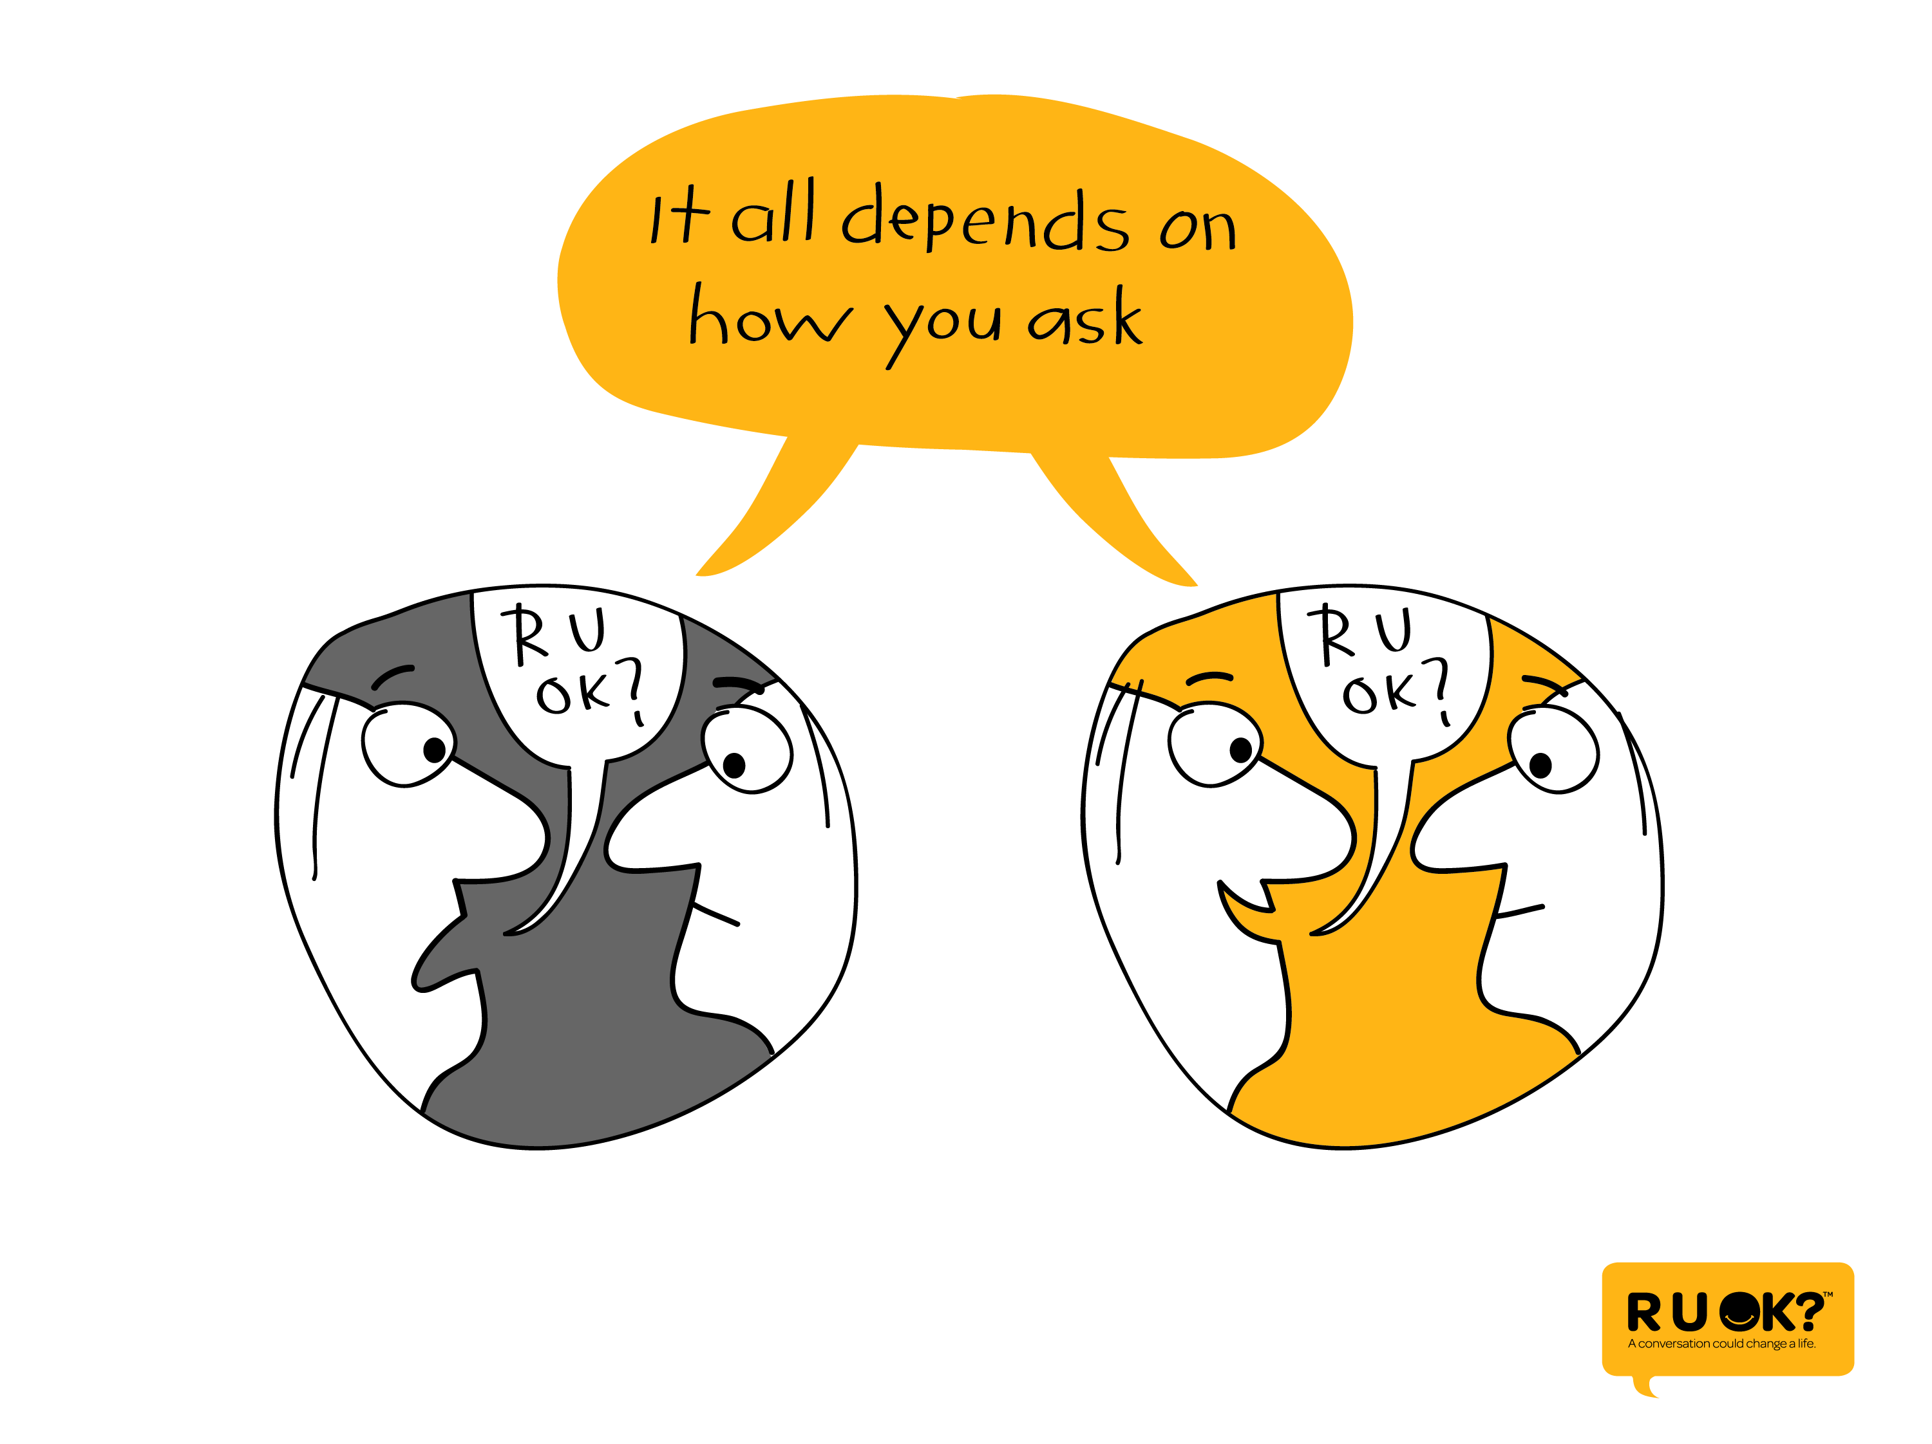
Notes:
But the conversation will only start if you ask the question with a real desire to listen, to be there and spend time with that person, and not judge. If you are quick to jump to conclusions, or rush the conversation, the friend or family member or workmate who might need your support will find it hard to open up. So be ready to ask the question and be ready to hear ‘I’m not ok’.

Slide 8
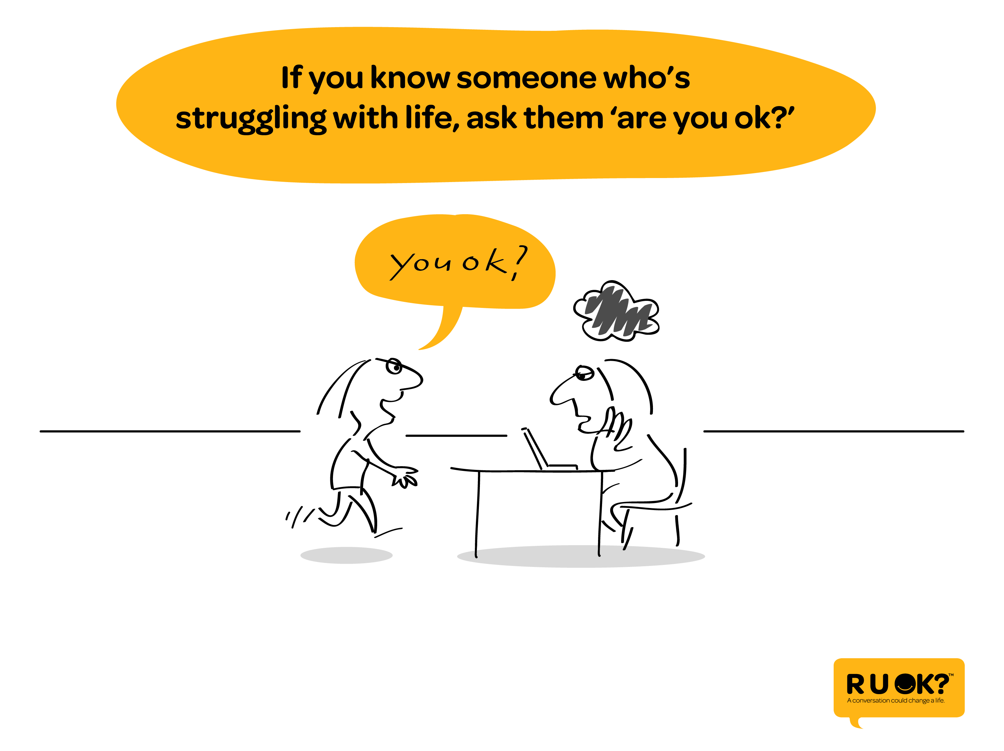
Notes:
Who do you know that might need to be asked that question?

Slide 9
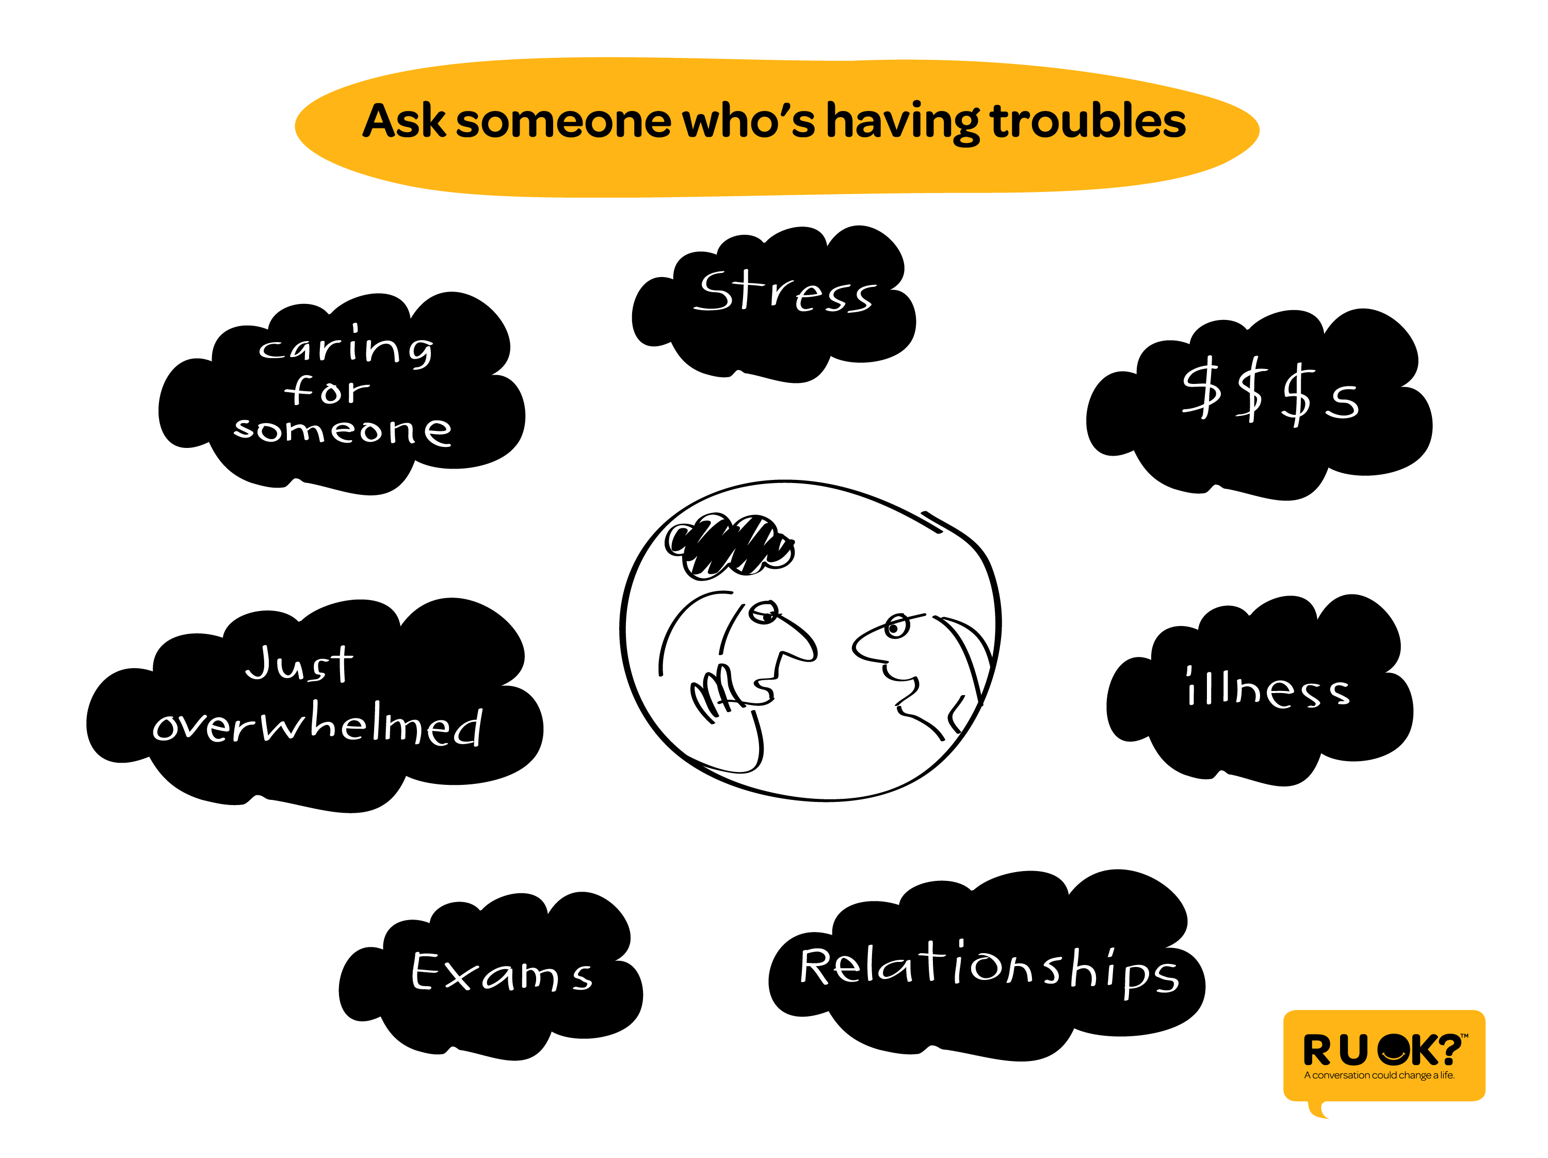
Notes:
It could be someone you know who’s struggling with any number of life’s problems

Slide 10
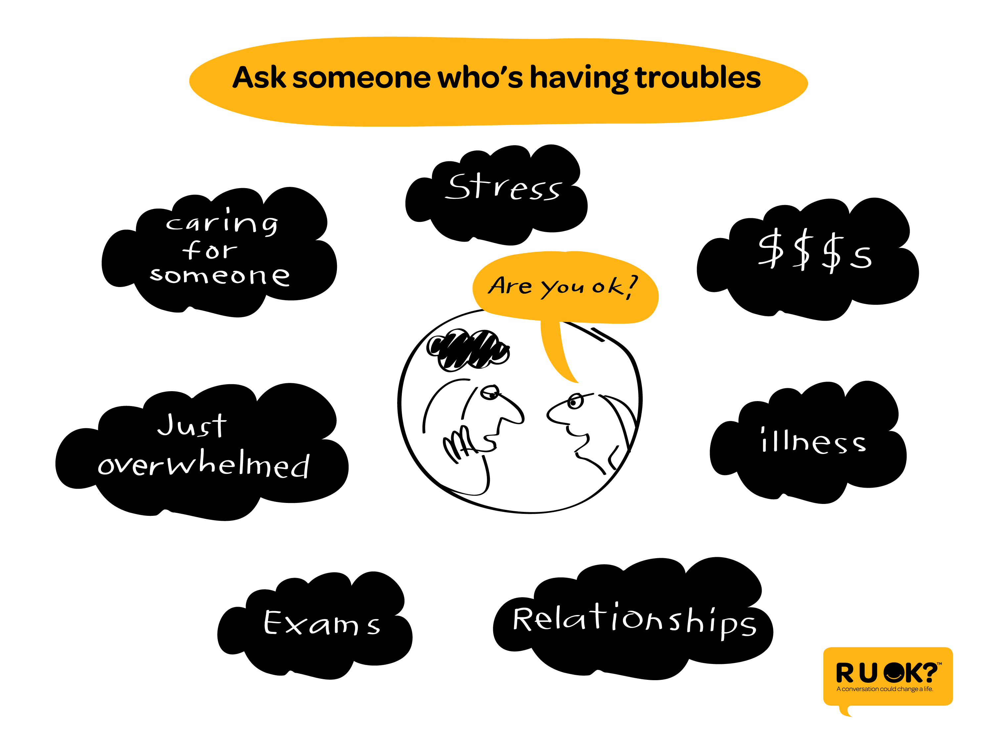
Notes:
And you giving them an opportunity to talk about what’s on their mind…

Slide 11
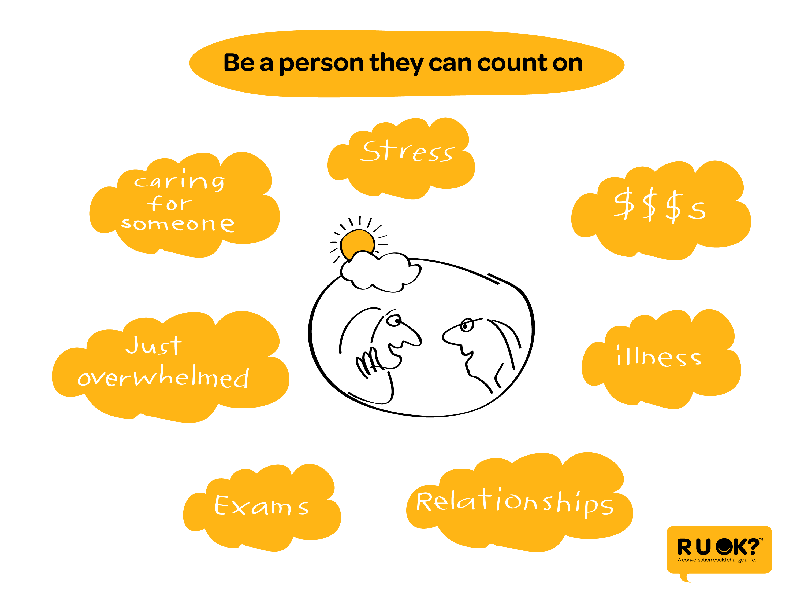
Notes:
Shows that you care…

Slide 12
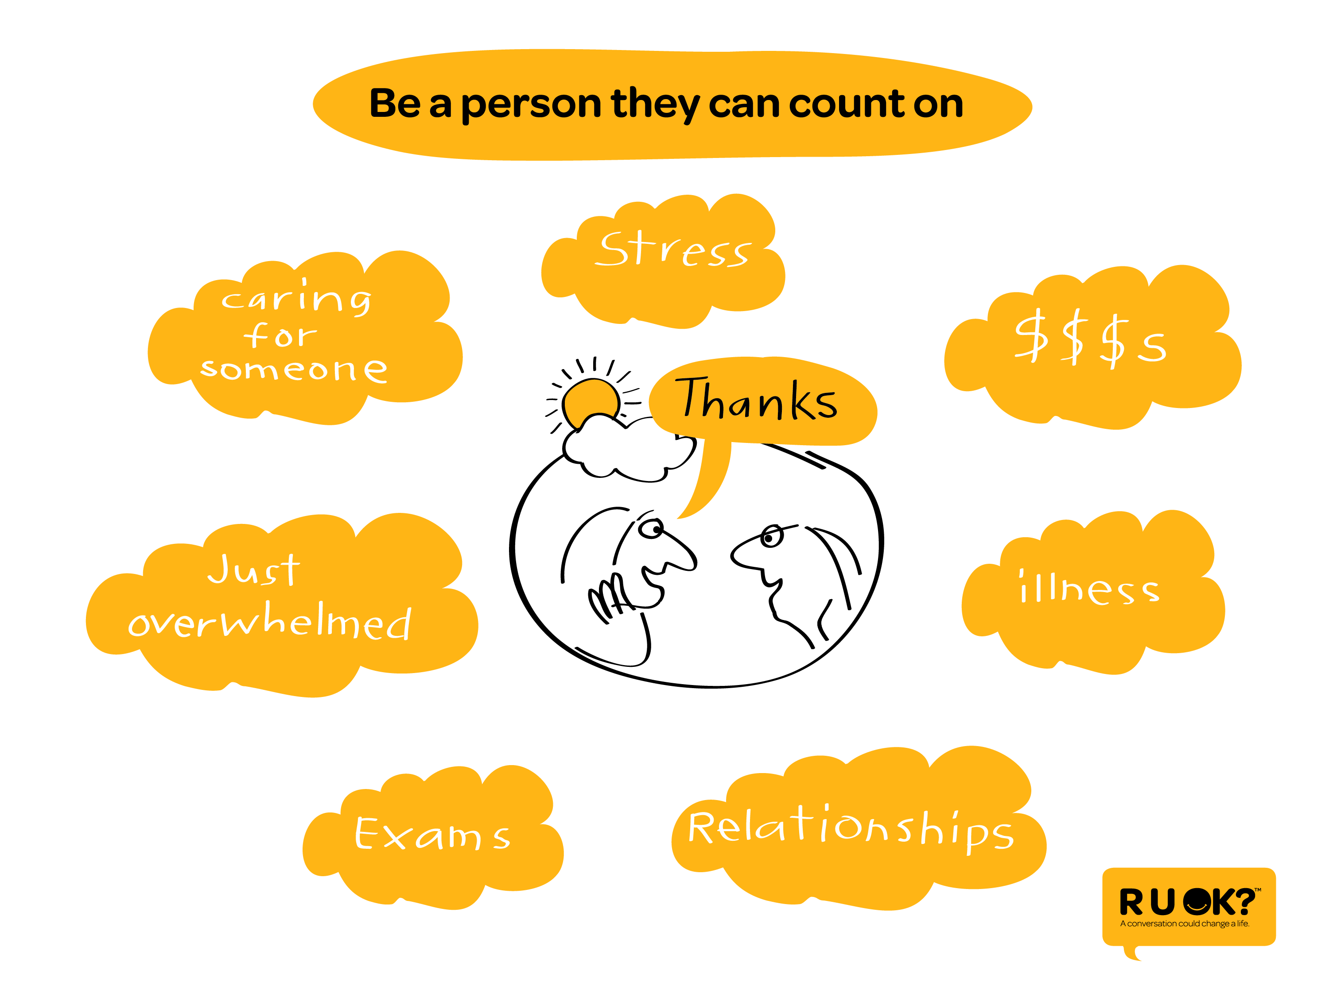
Notes:
And that you’re someone they can count on.

Slide 13
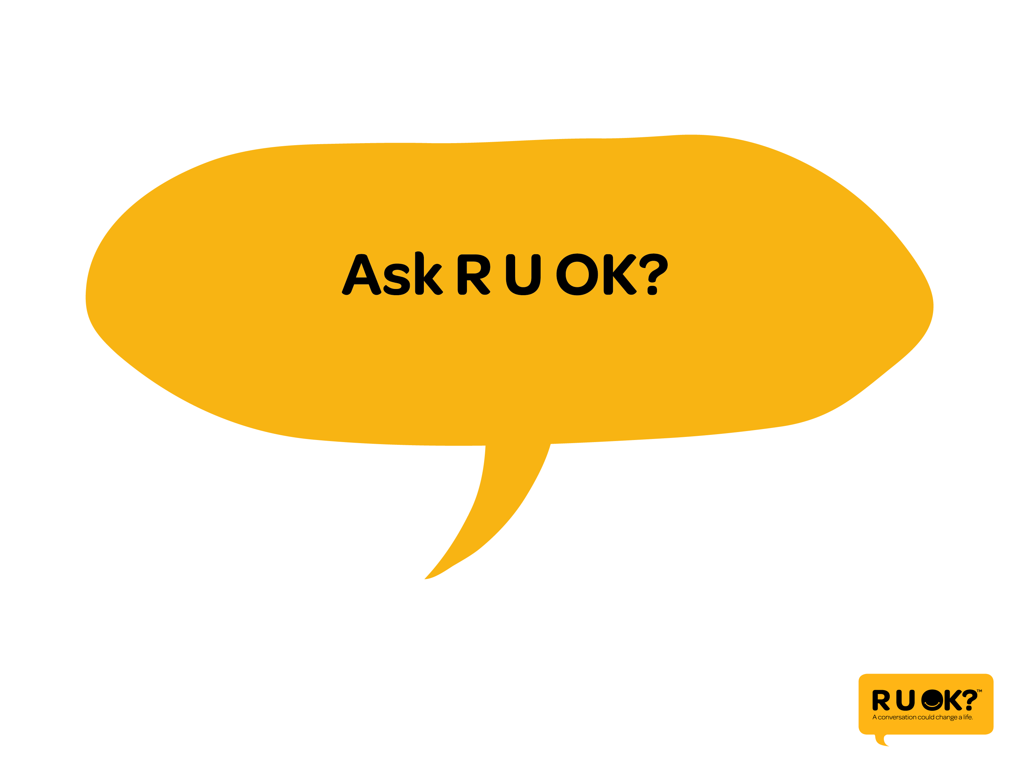
Notes:
But what if you ask ‘are you ok?’ and the person isn’t? Here are some steps to help you keep the conversation going…

Slide 14
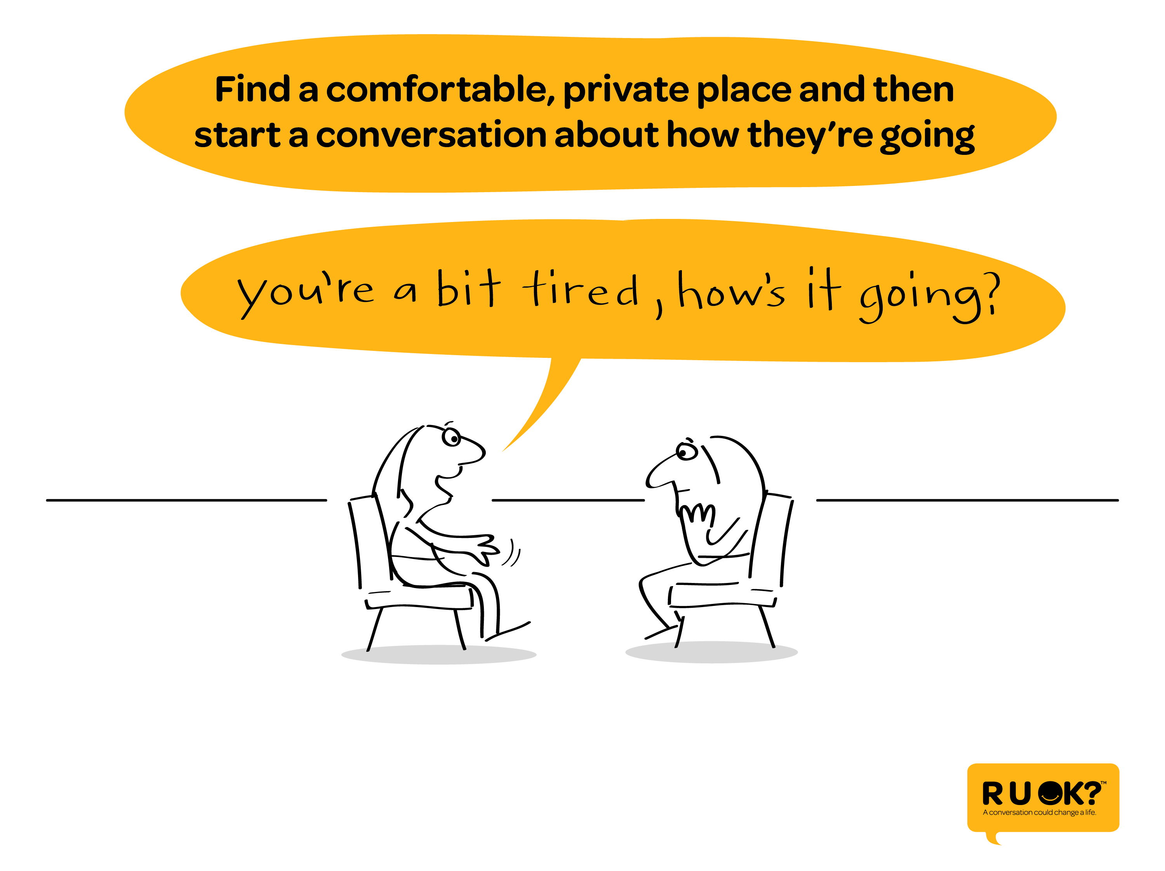
Notes:
Find somewhere to chat that’s private and comfortable for you both. Somewhere where there’ll be no pressure to end the conversation quickly.

Slide 15
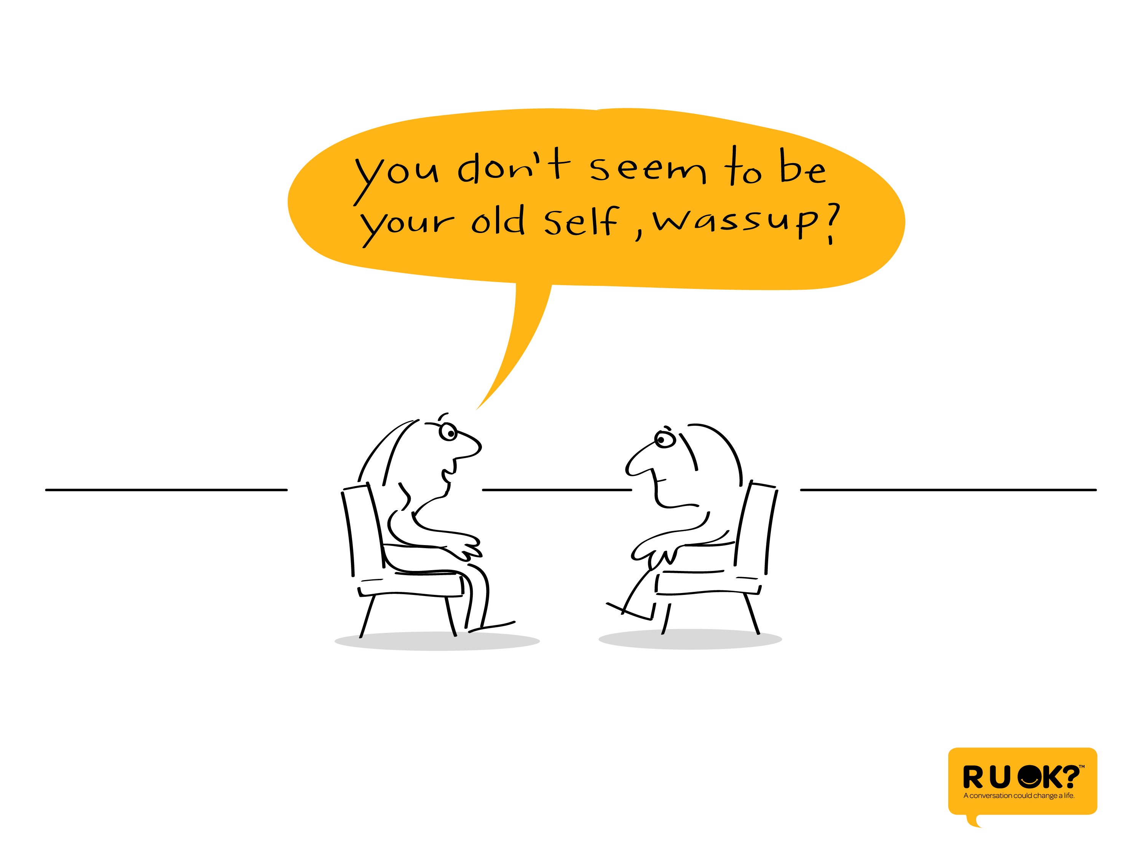
Notes:
Open questions are a great way to guide the conversation… Questions that start with ‘how long’ or ‘what has been happening’ or ‘why do you think that is’ can help the person open up.

Slide 16
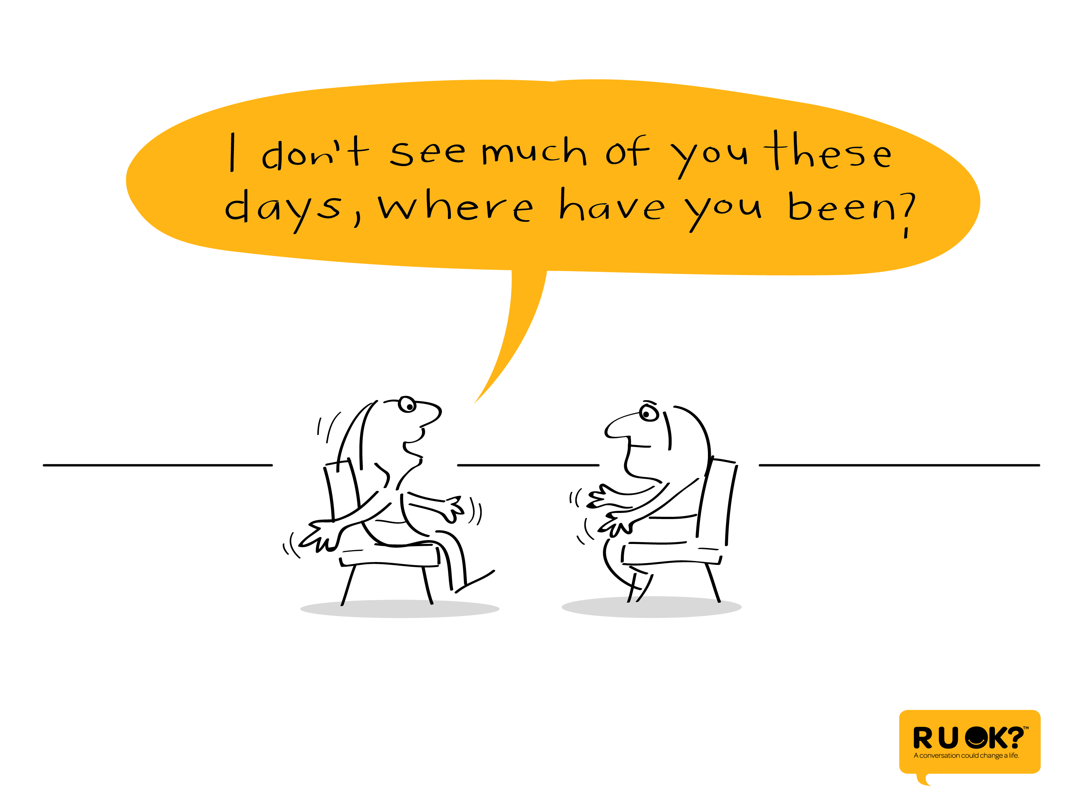
Notes:
You can also ask them about changes in their behaviour – as long as the person knows you aren’t criticizing them.

Slide 17
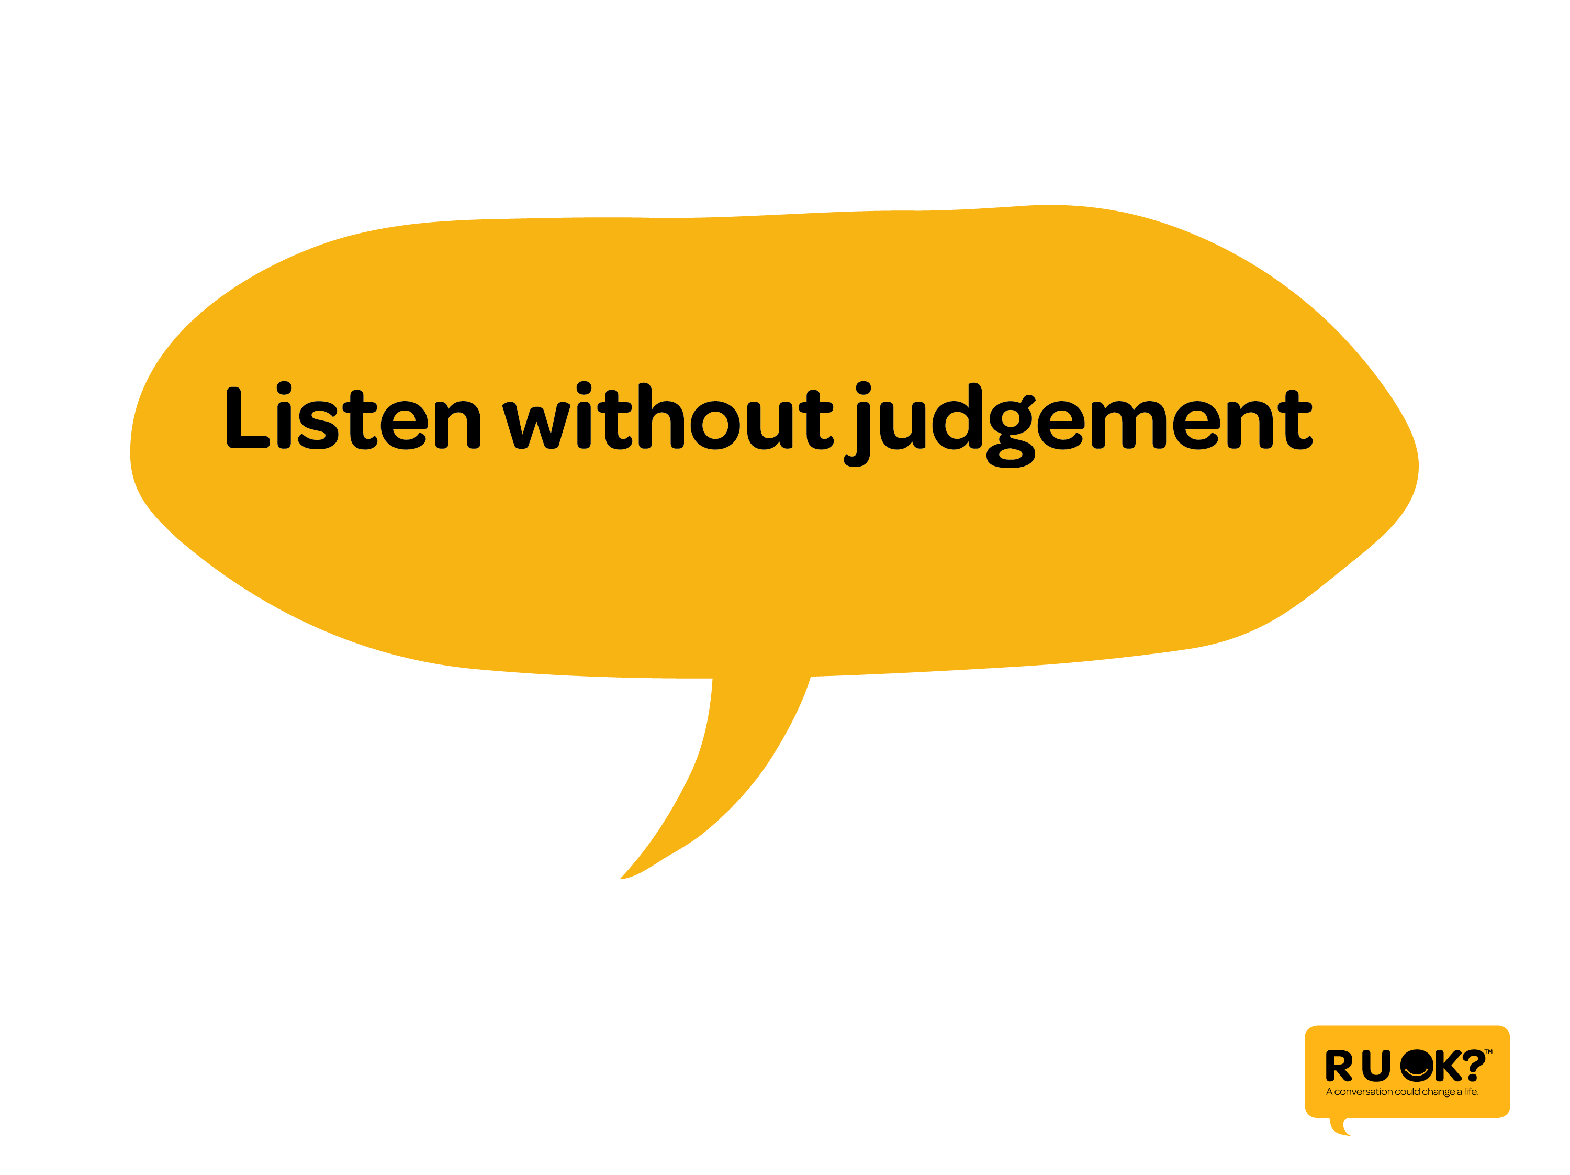
Notes:
Next step is to listen to what they have to say without judging what they’re going through.

Slide 18
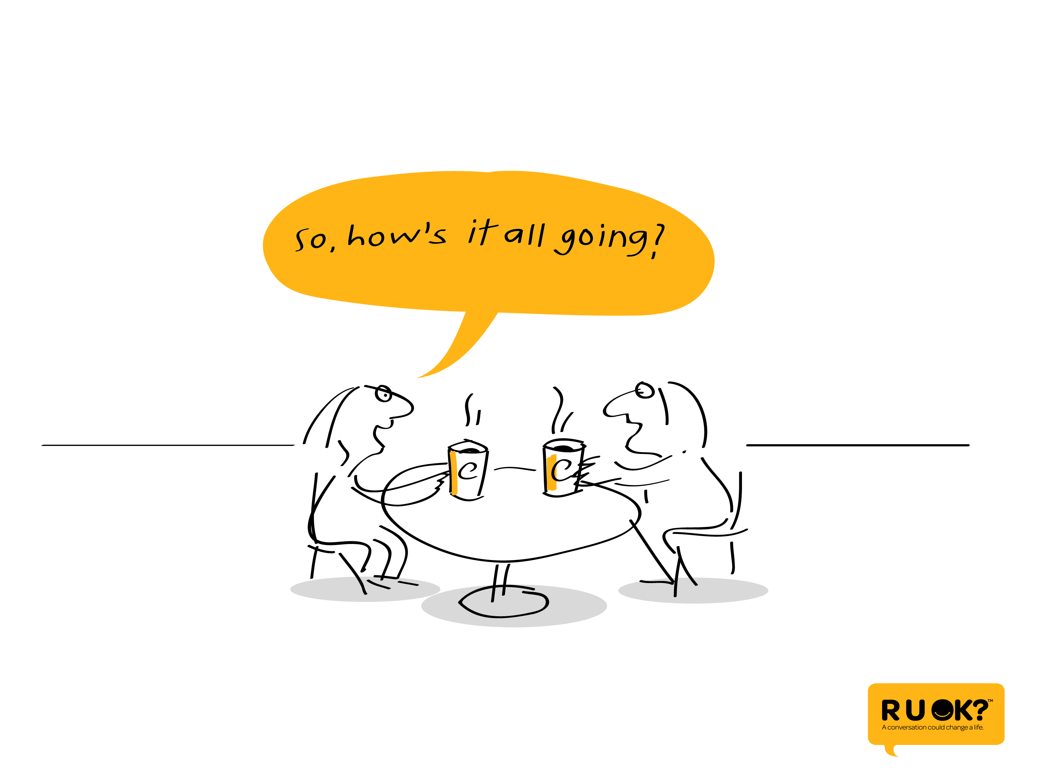
Notes:
Sometimes when we ask how someone’s going…

Slide 19
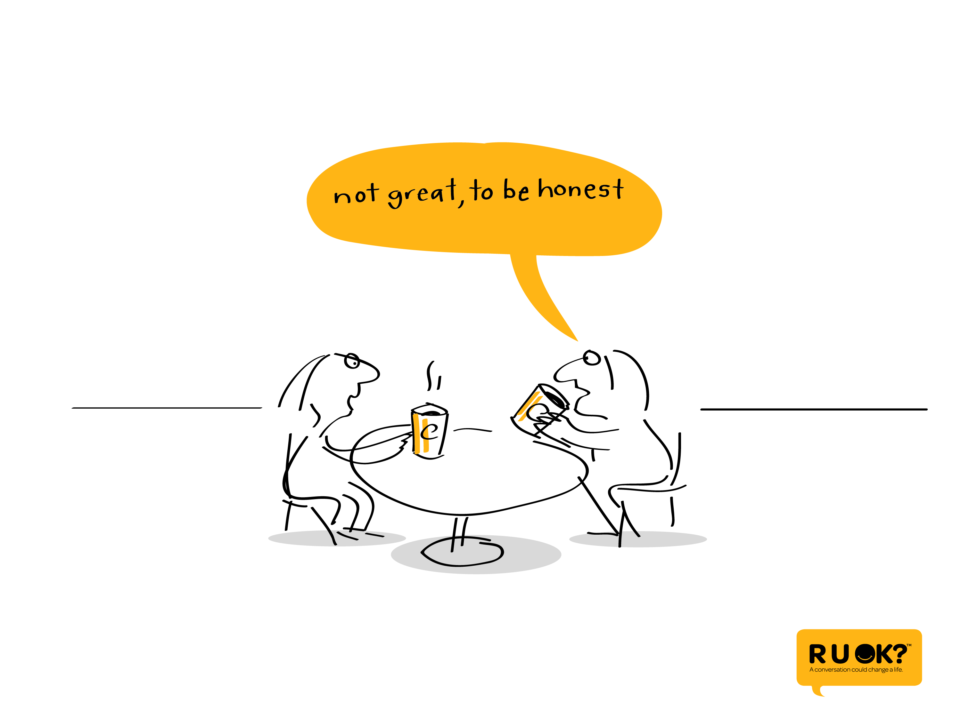
Notes:
… and they start to open up…

Slide 20
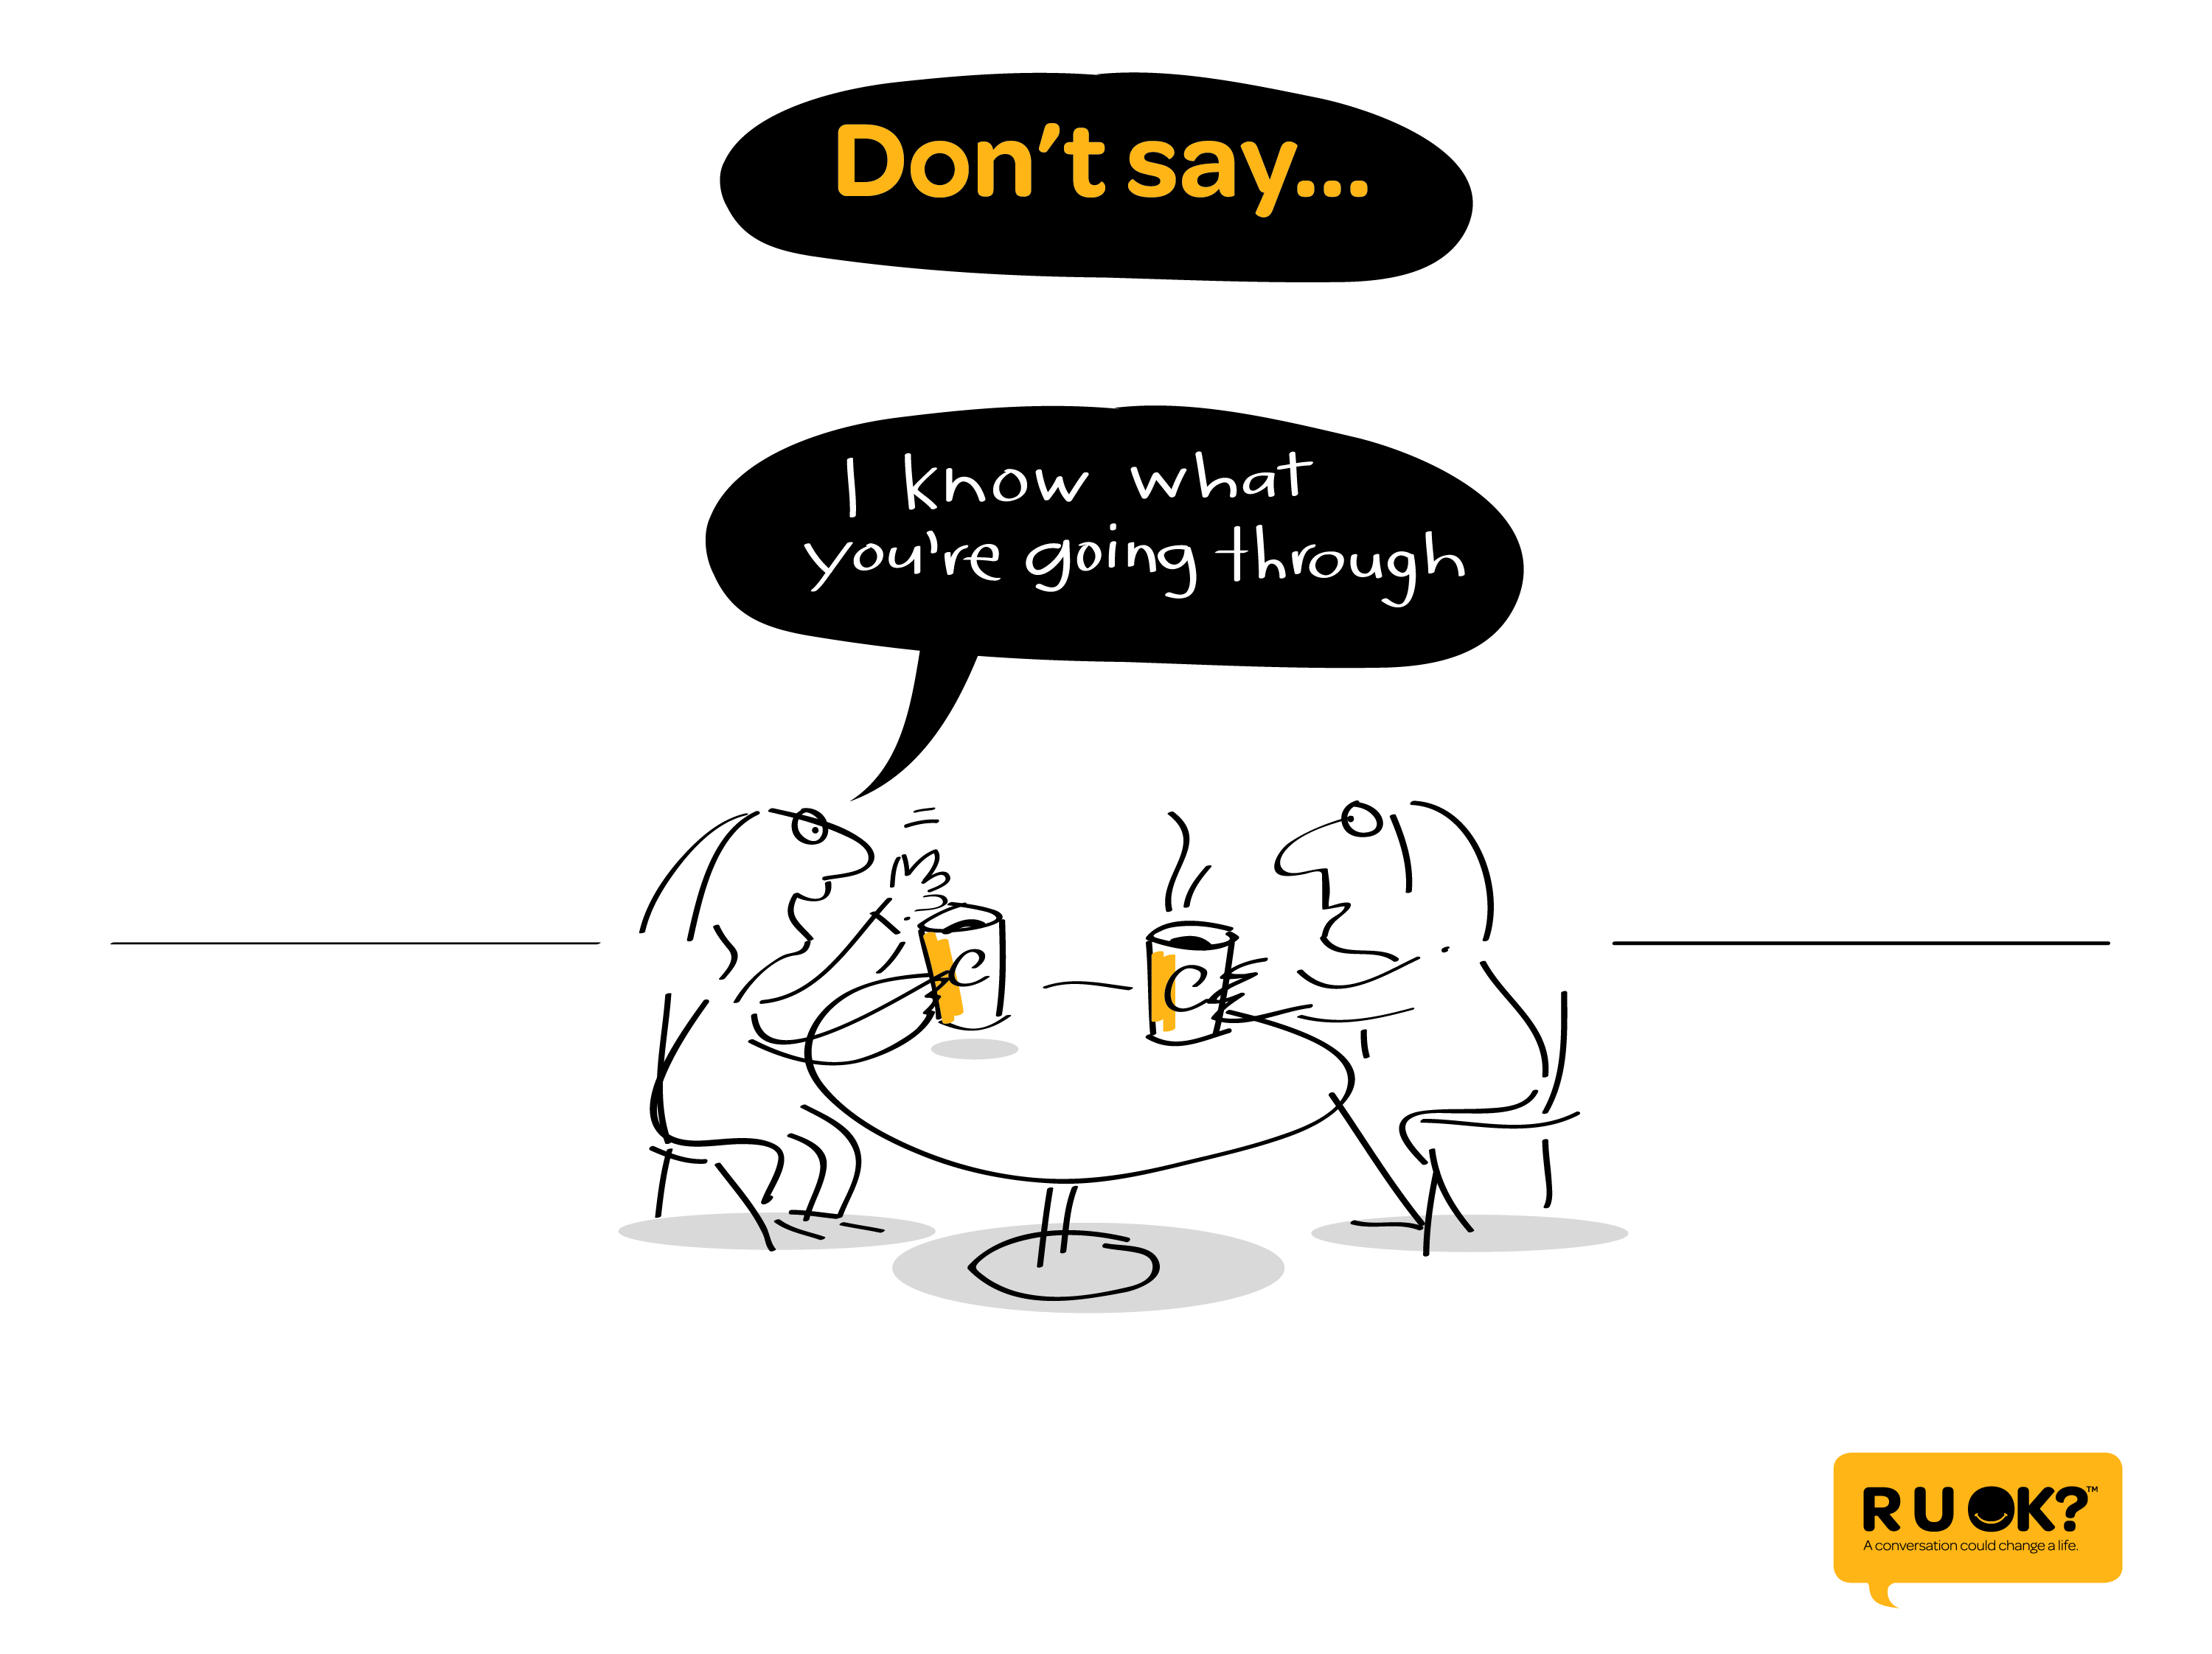
Notes:
It can be tempting to give quick answers.
However, we should avoid saying ‘I know what you’re going through’…

Slide 21
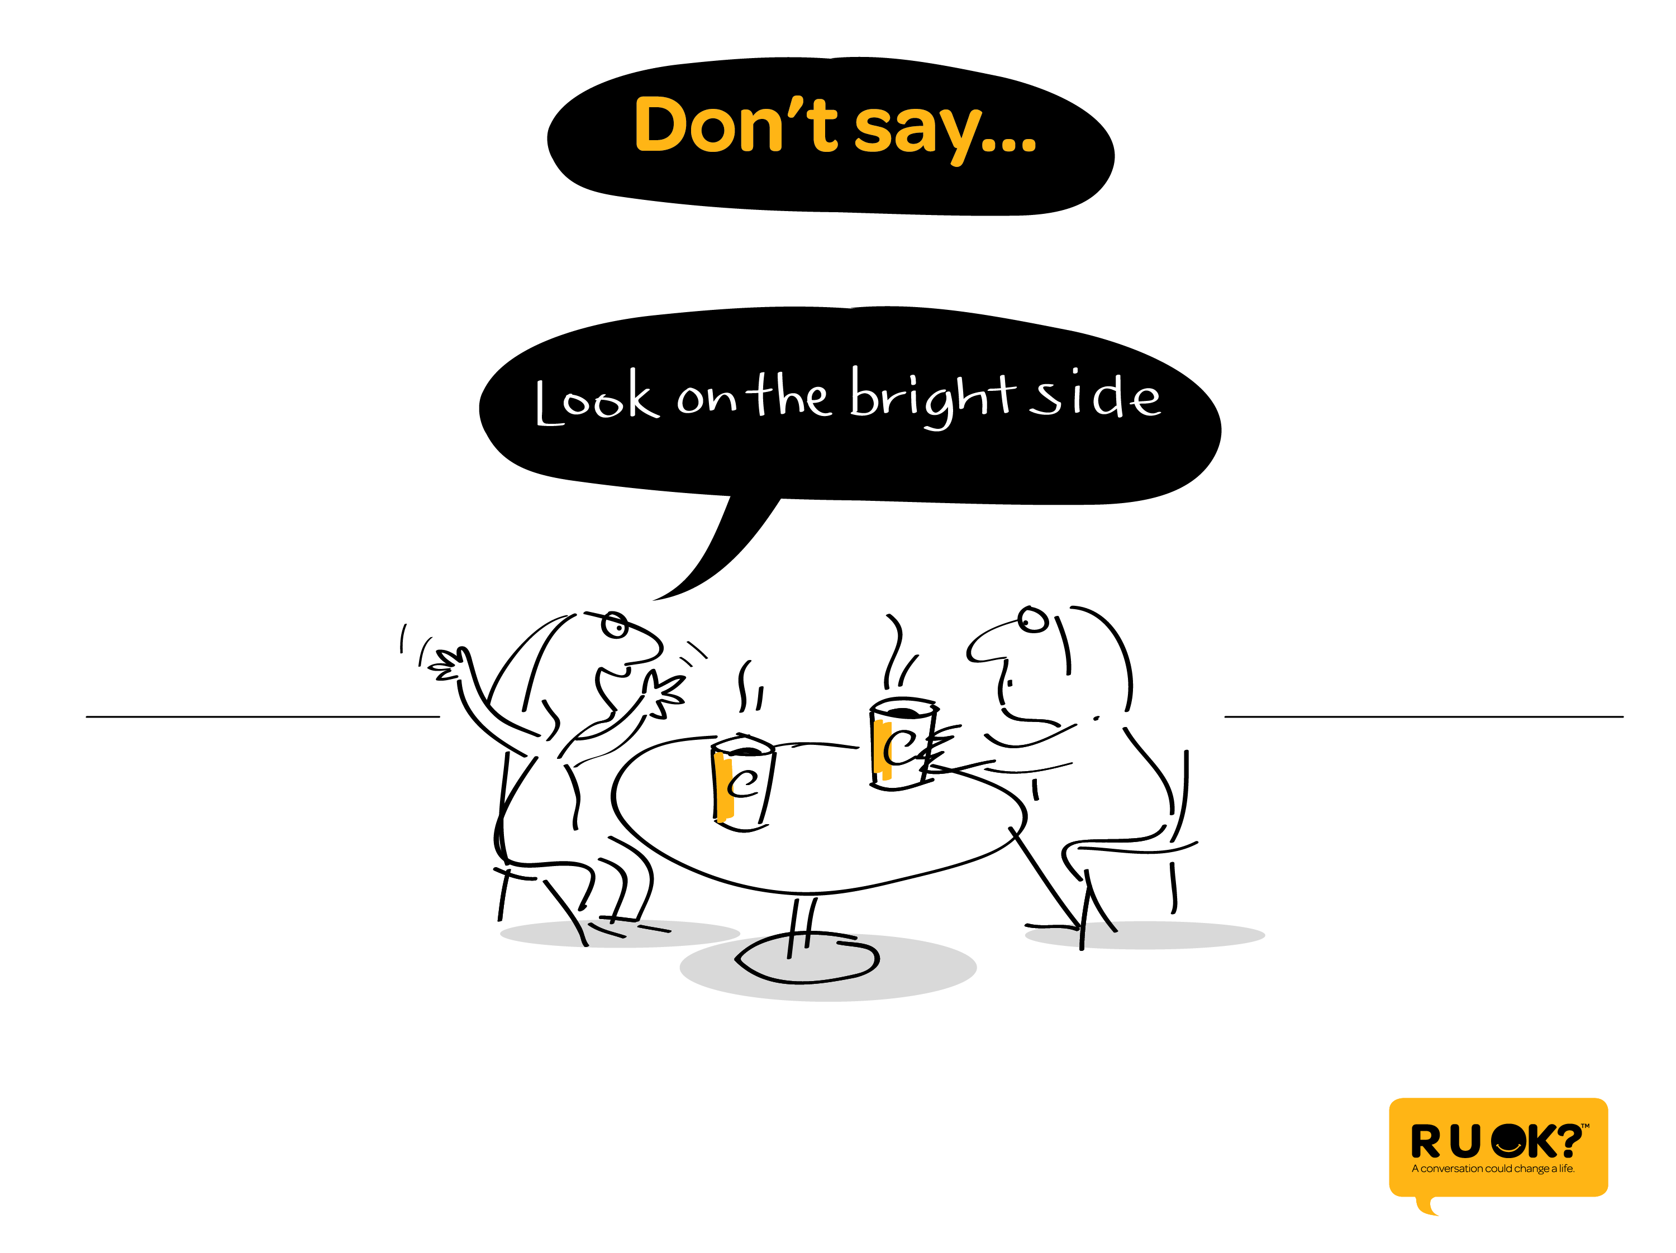
Notes:
Or ‘Look on the bright side’

Slide 22
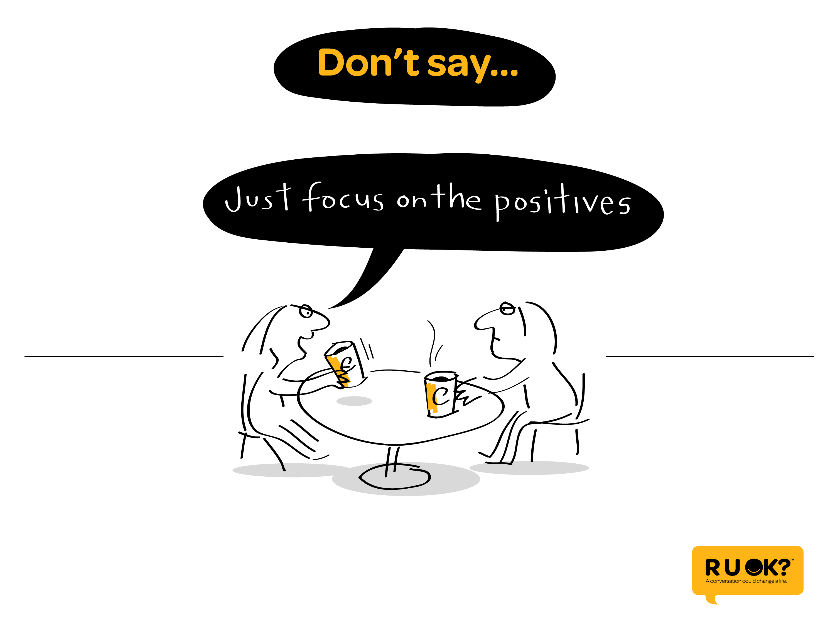
Notes:
Or ‘just focus on the positives’….

Slide 23
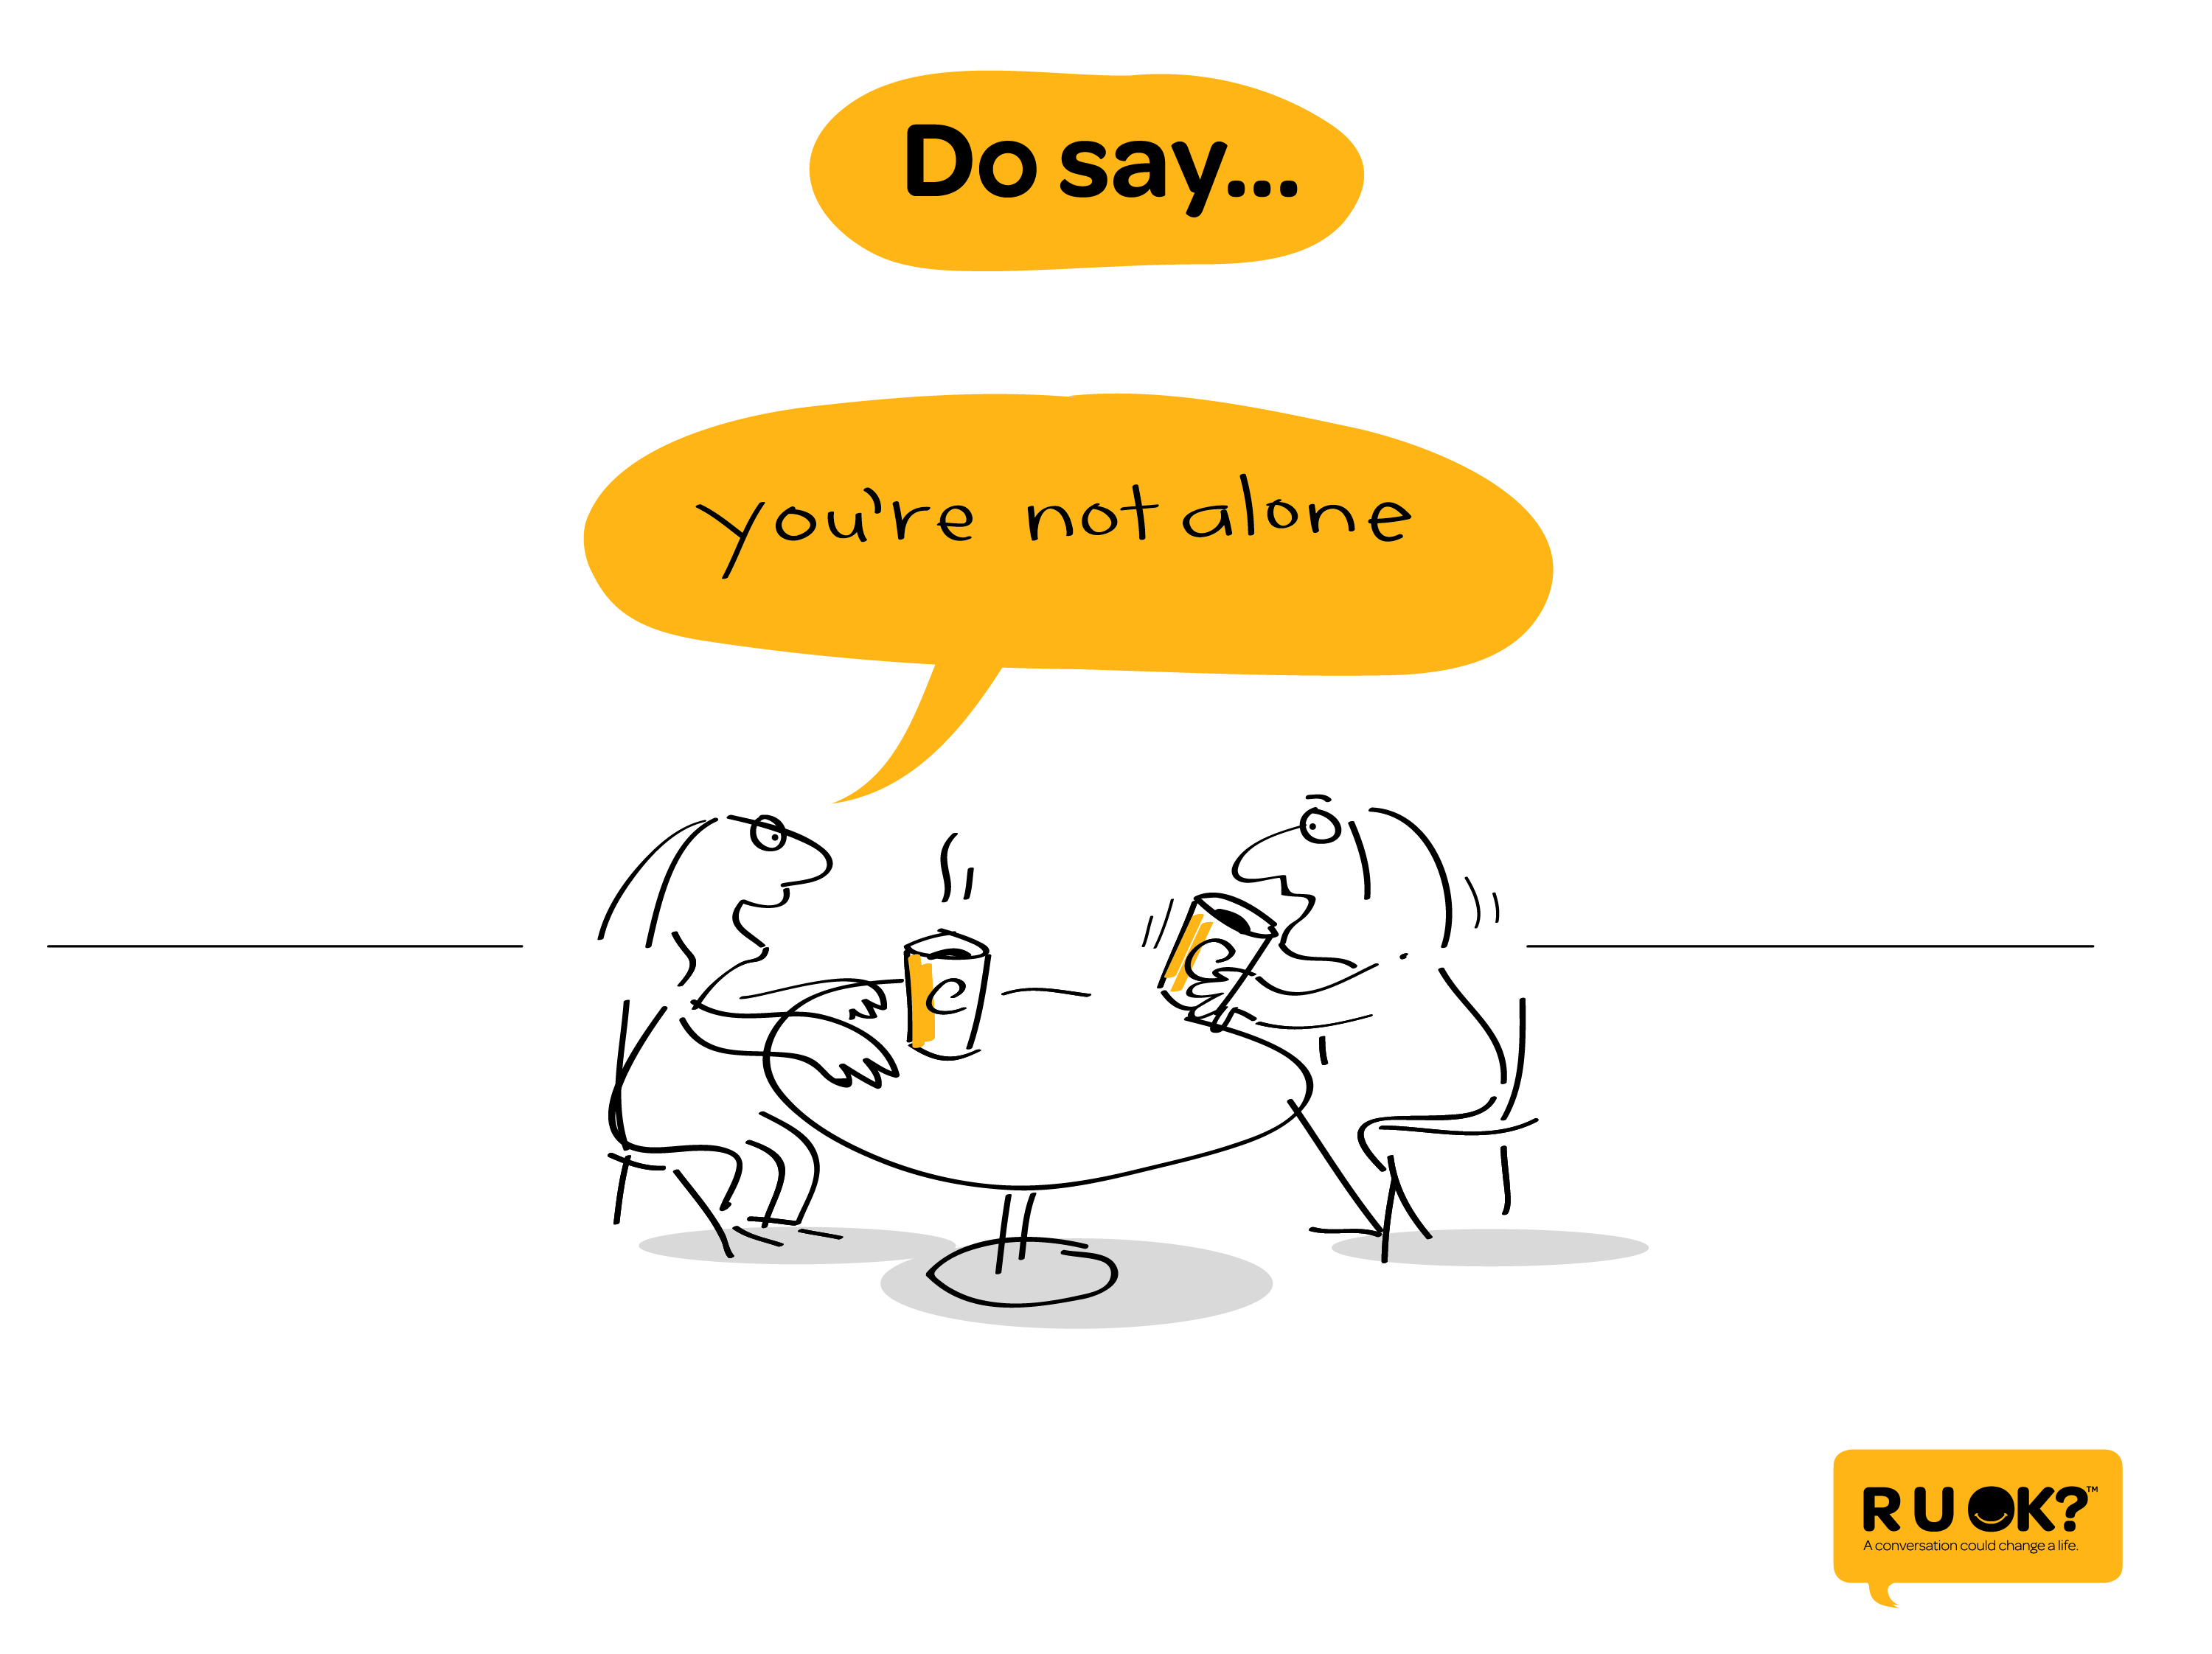
Notes:
Instead, what we should say is ‘you’re not alone’

Slide 24
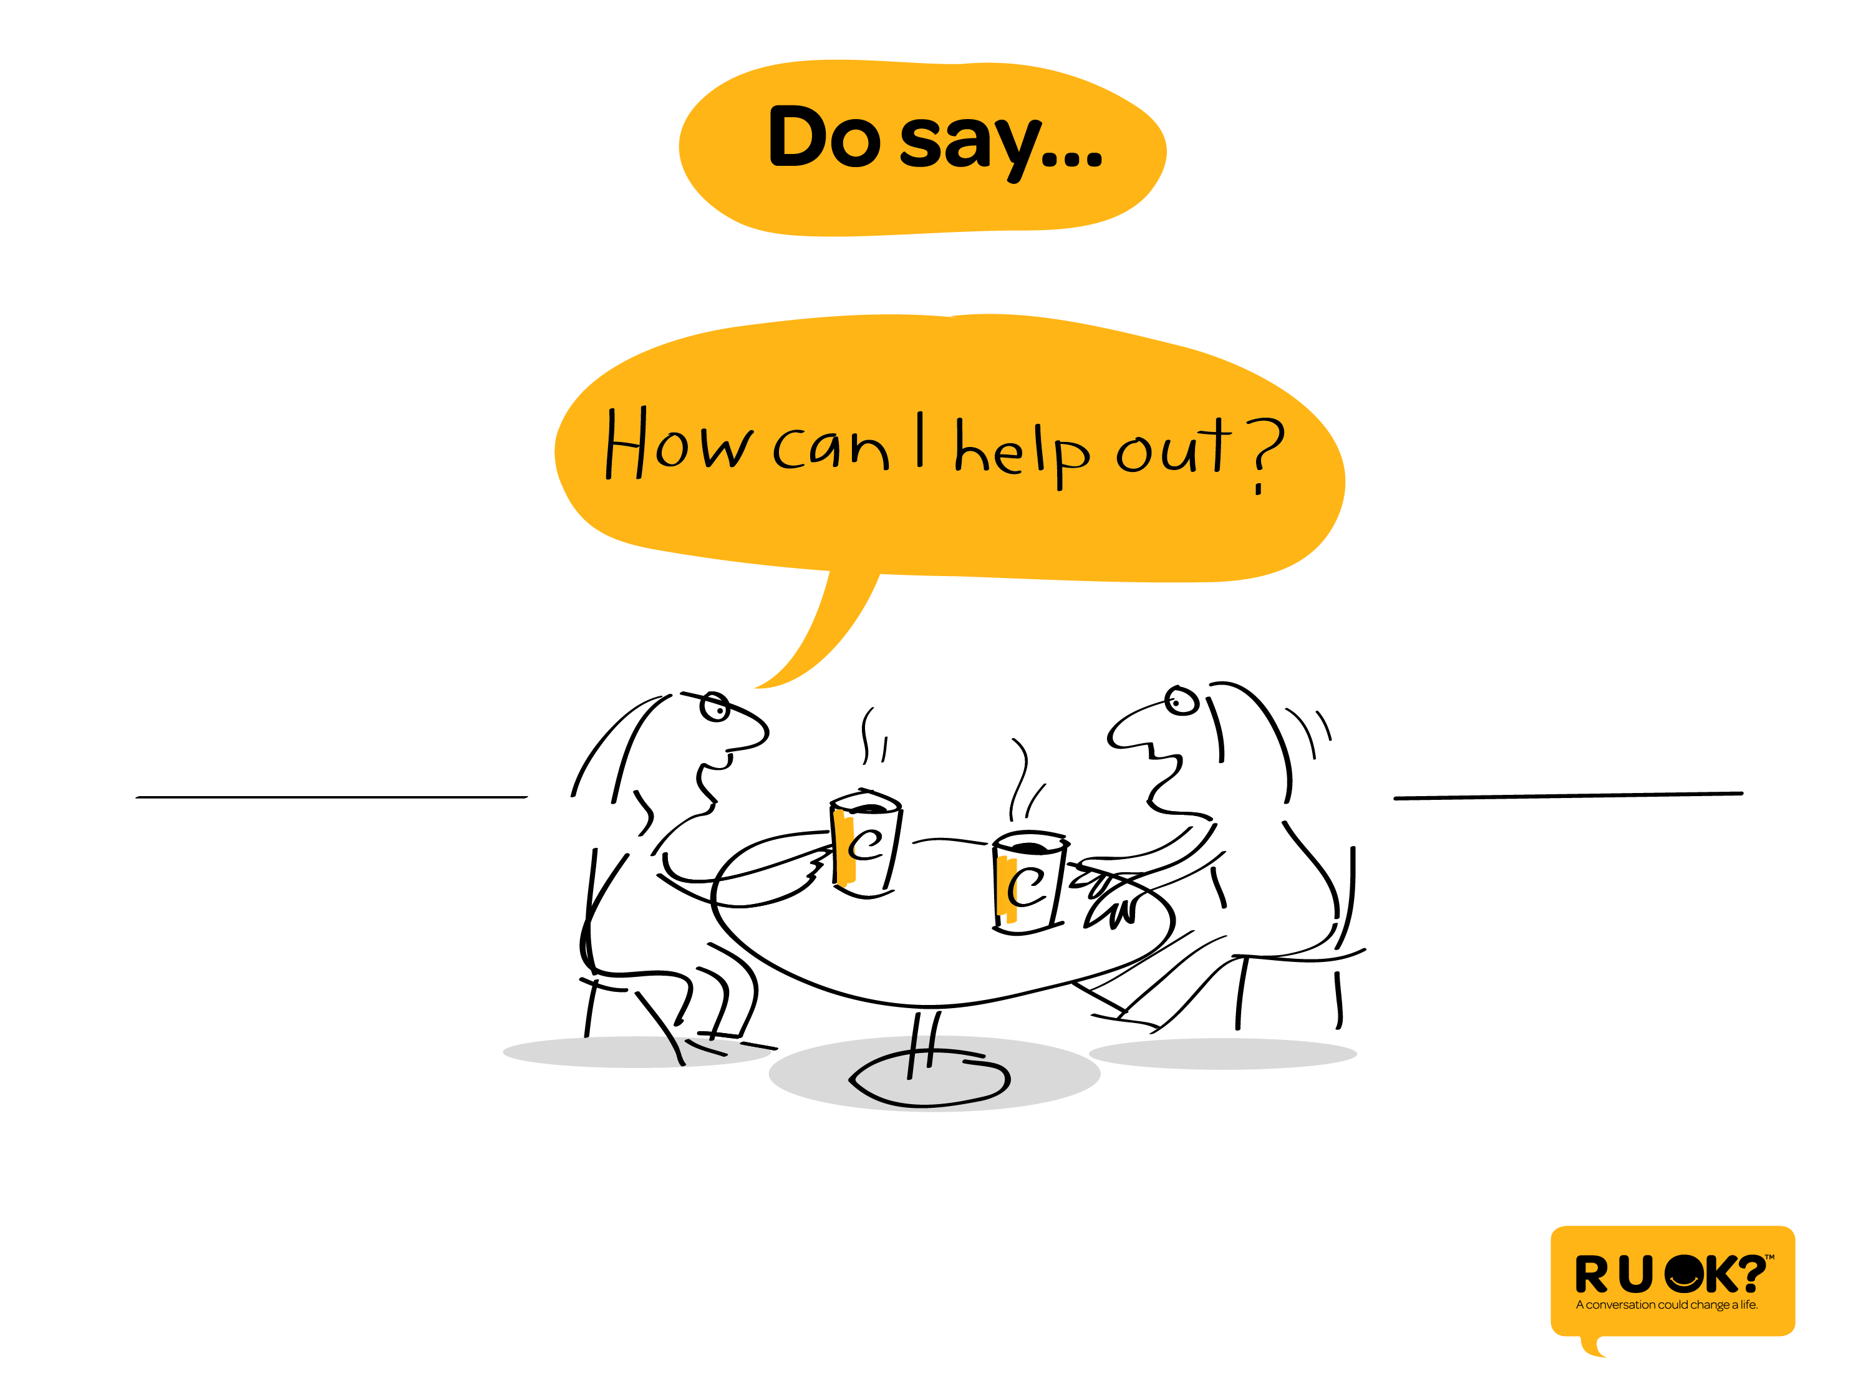
Notes:
Or… ‘How can I help you?’

Slide 25
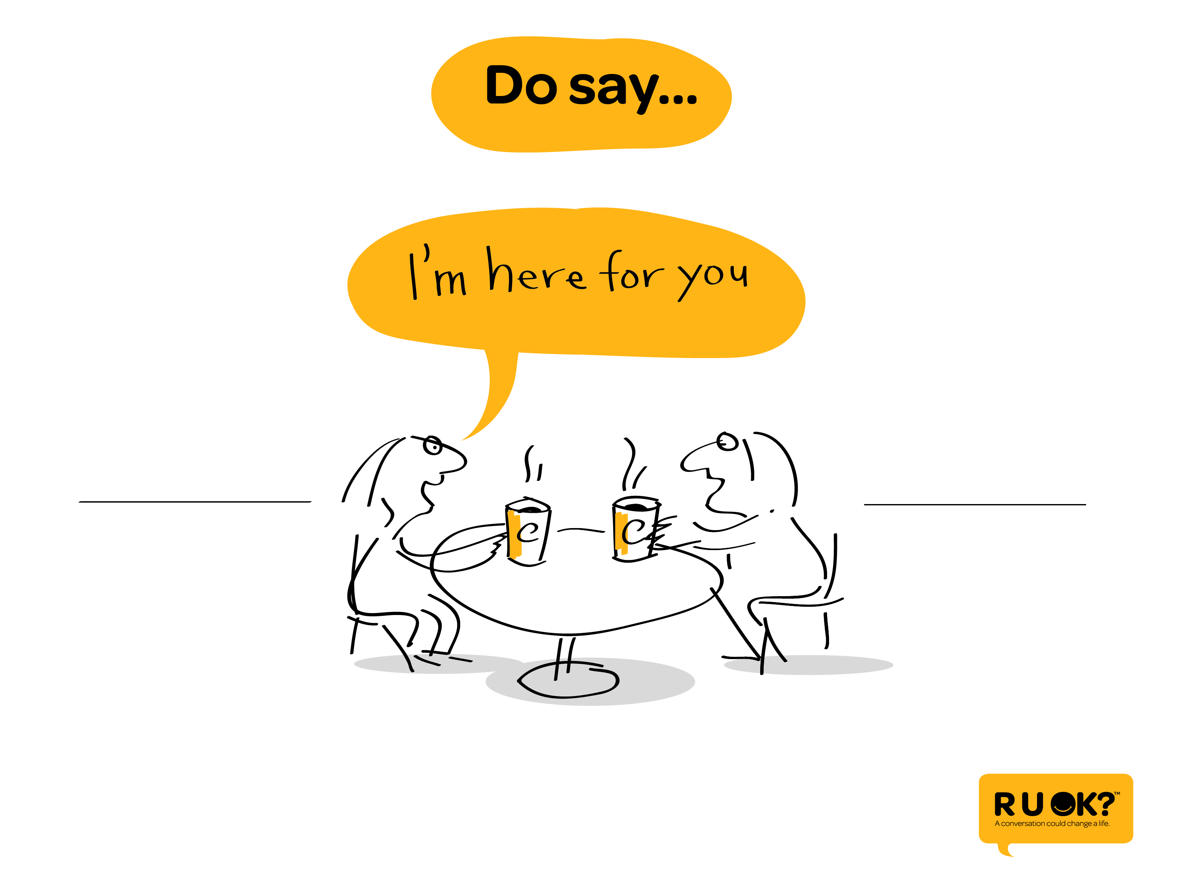
Notes:
Or… ‘I’m here for you and I want to listen to what you have to say.’

Slide 26
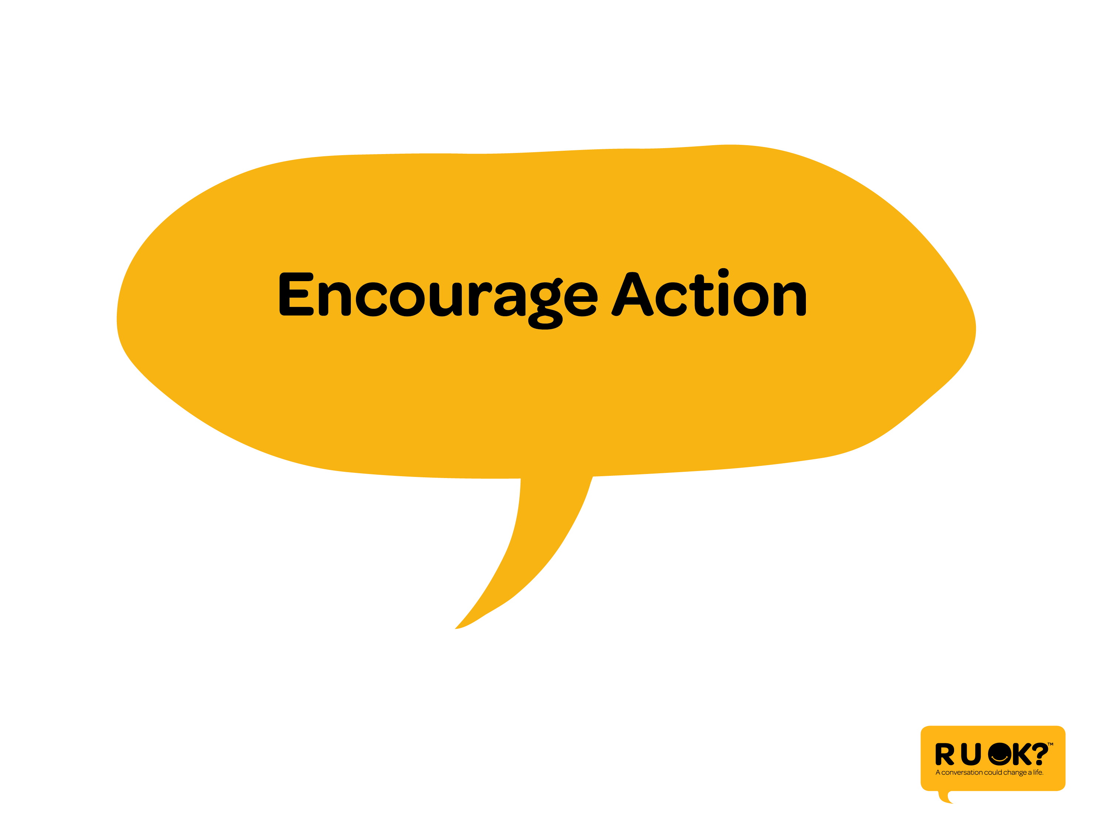
Notes:
Once they start to admit they’re struggling, help them take one small step to improve their situation.

Slide 27
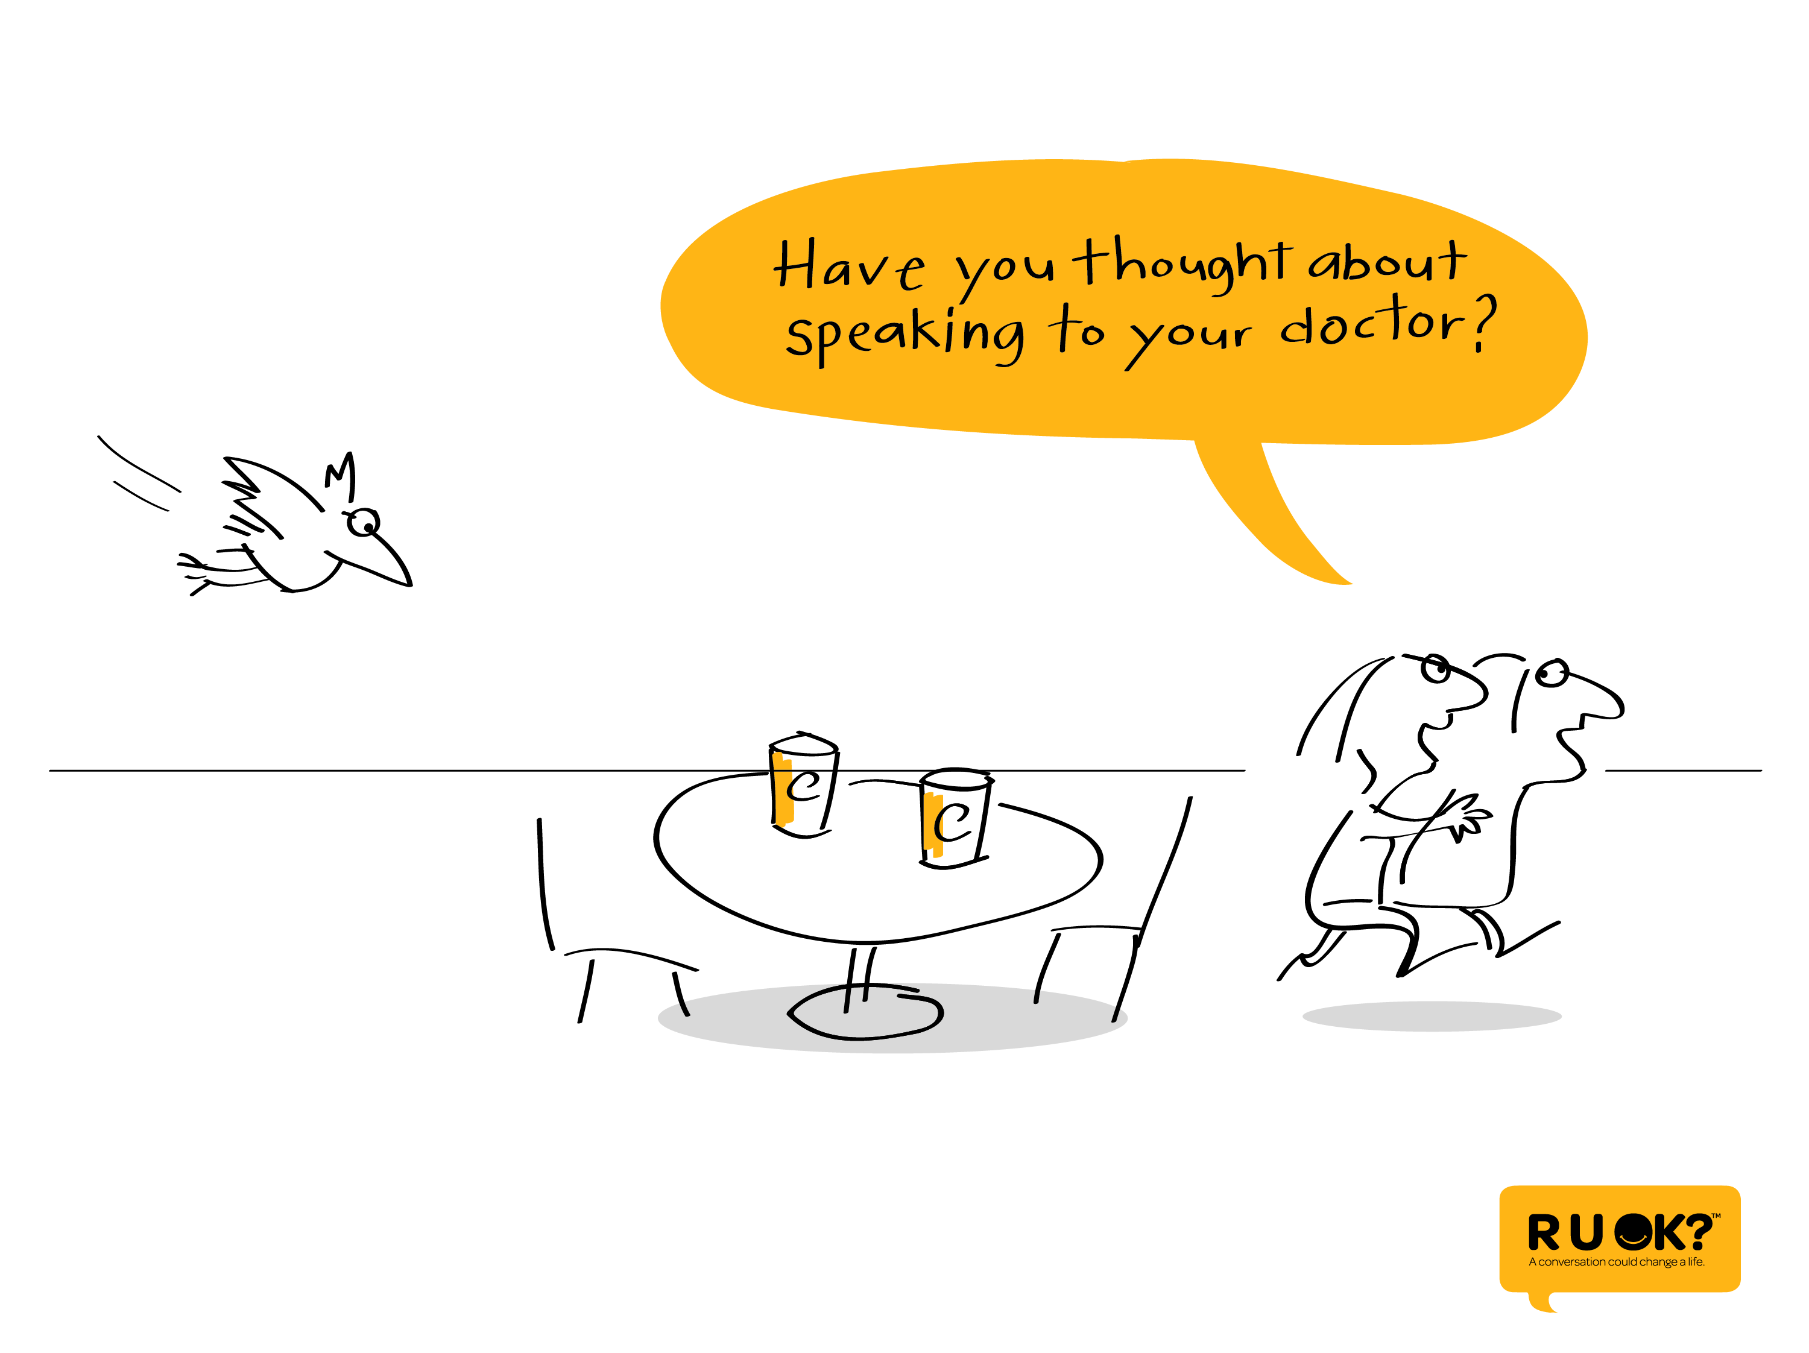
Notes:
It could be they need see their doctor, the company EAP or the school counsellor if they’ve been feeling really low for more than 2 weeks.

Slide 28
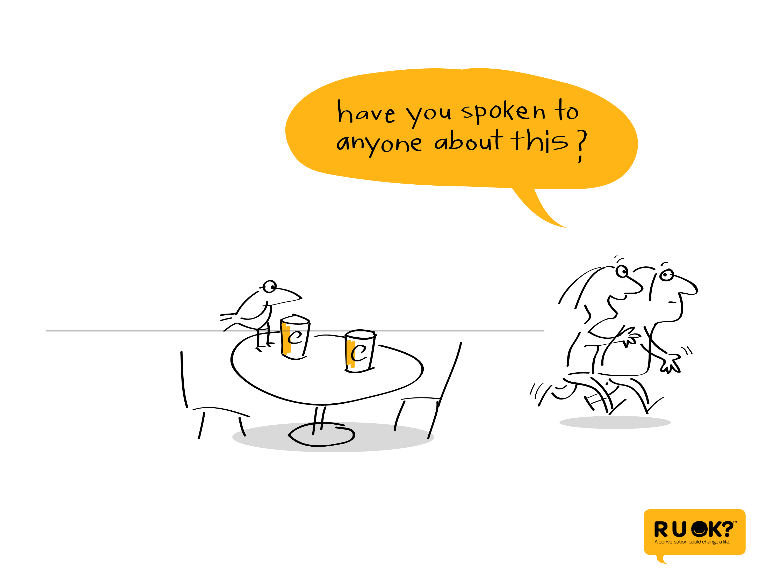
Notes:
They might need to talk to their boss, a teacher or a coach about an issue that’s been taking place at work, school or at the sports club.

Slide 29
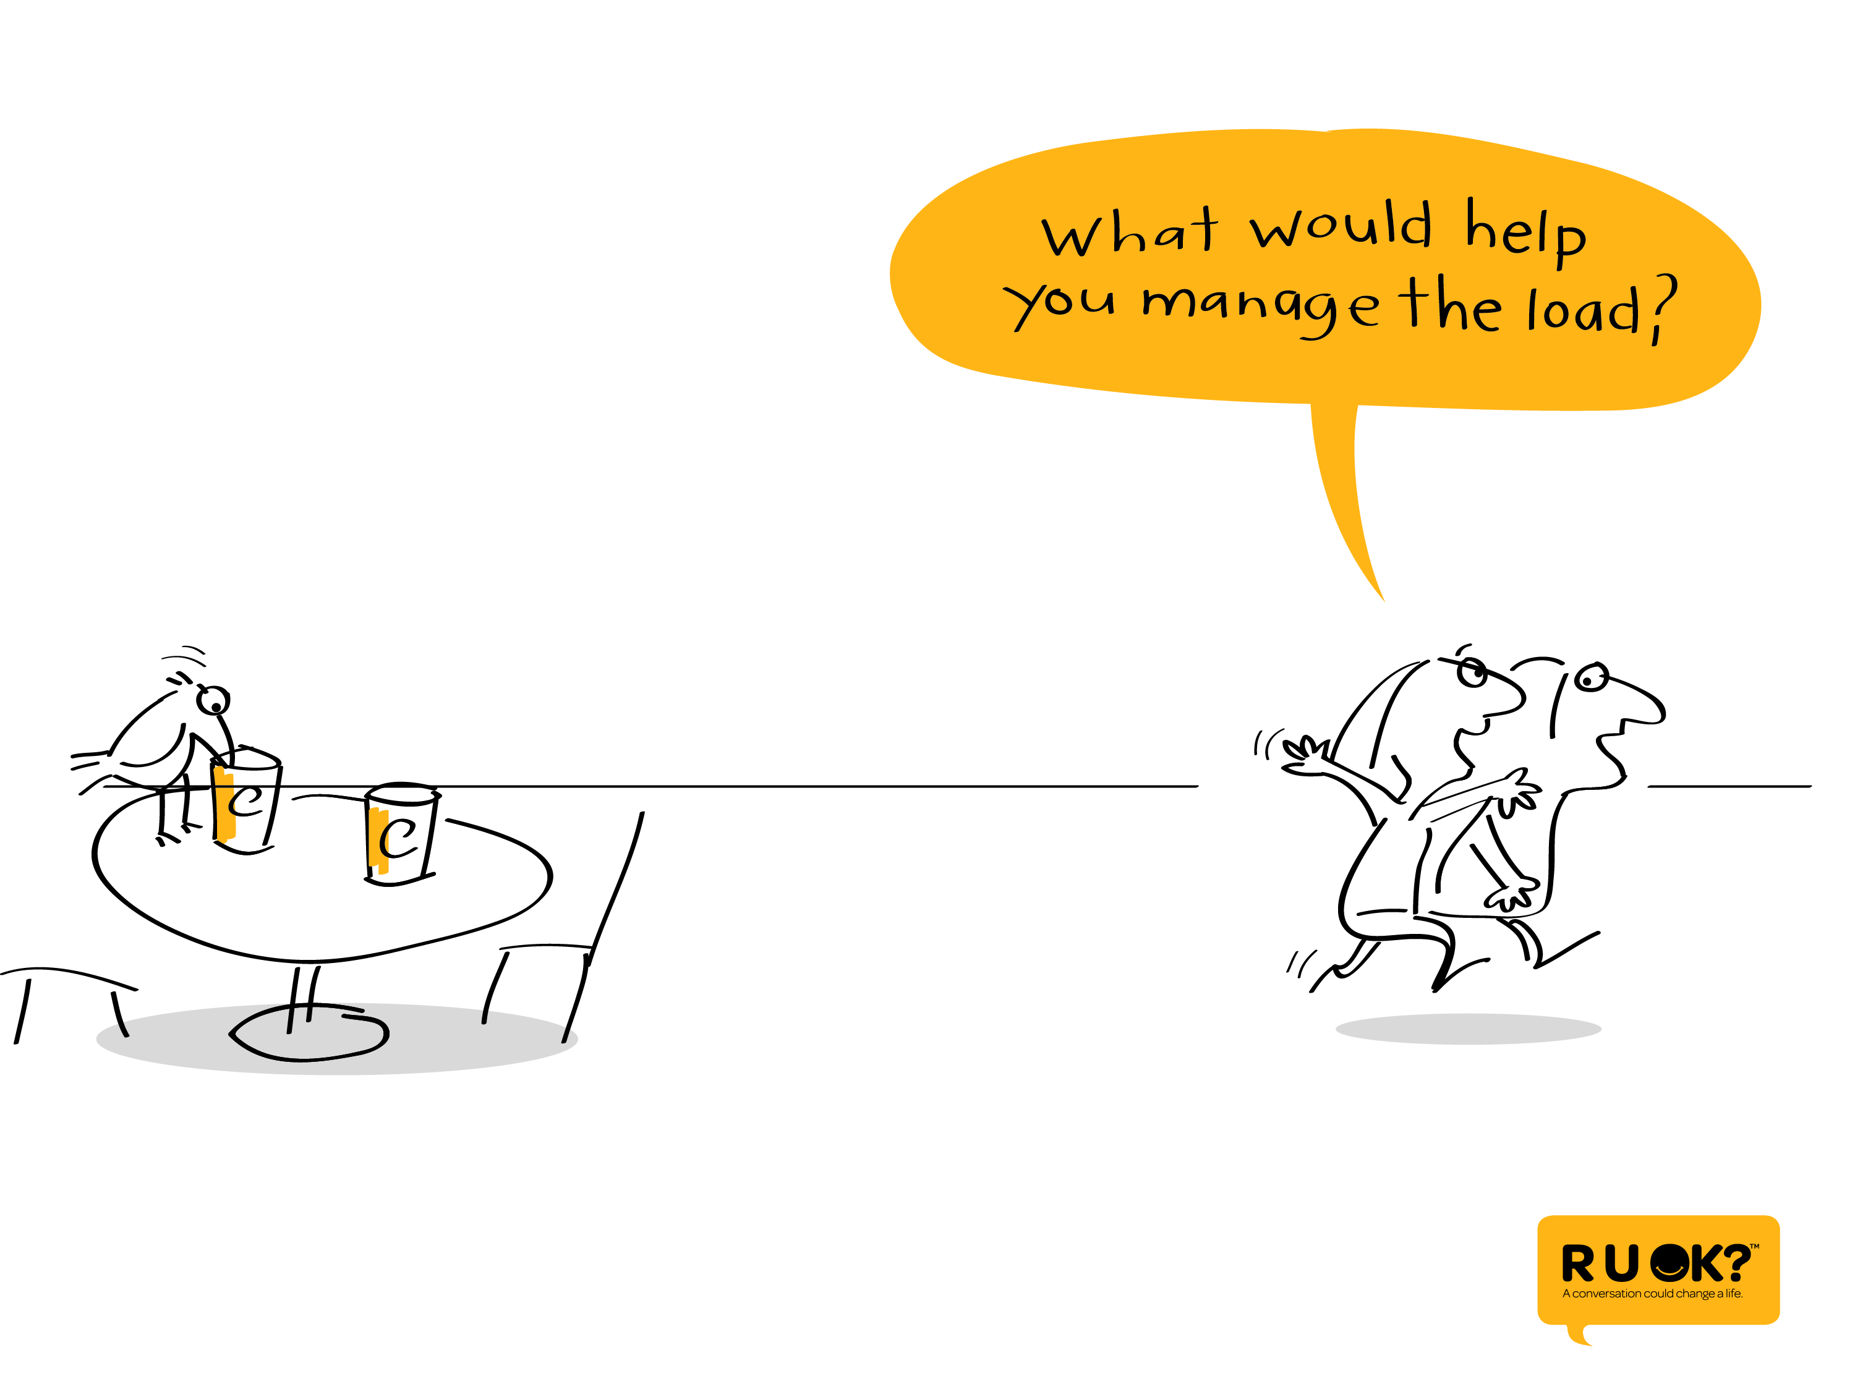
Notes:
They might need encouragement to think about what they can do differently …

Slide 30
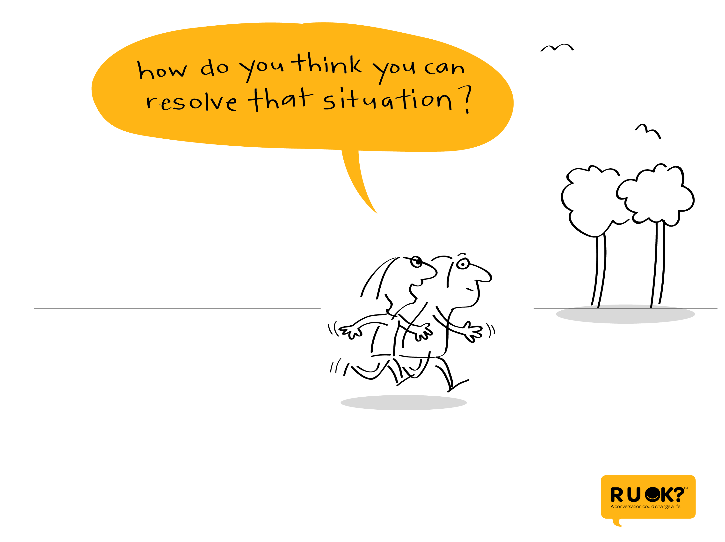
Notes:
… or some help thinking about what’s causing their troubles…

Slide 31
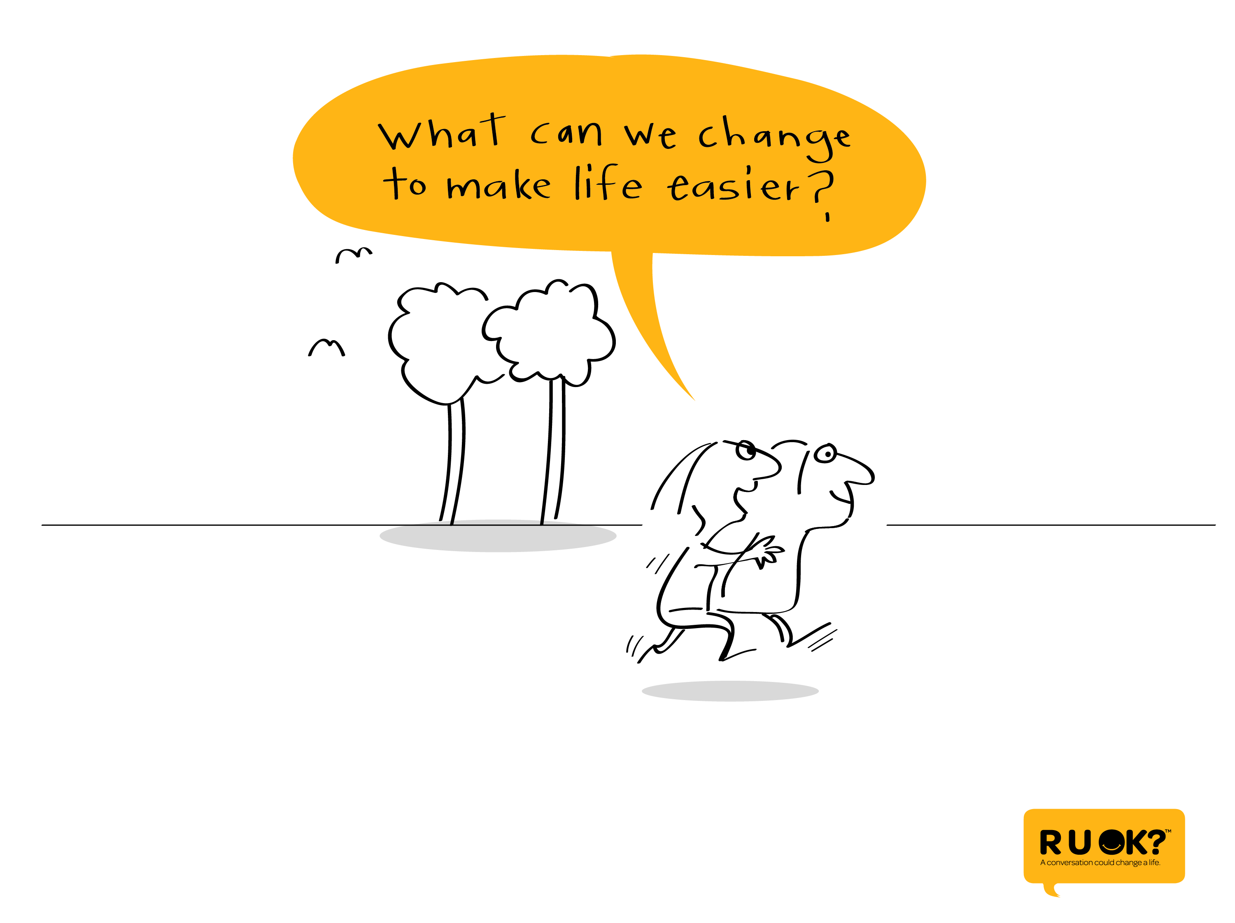
Notes:
…. or some help to figure out what would make life easier.

Slide 32
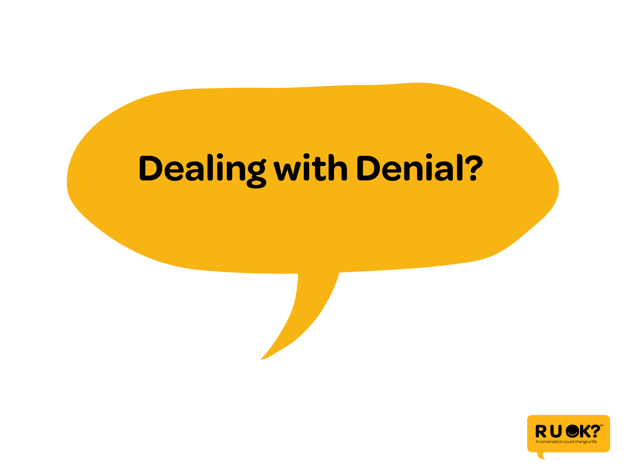
Notes:
Sometimes we can be ready to have that conversation and the person just doesn’t want to talk.

Slide 33
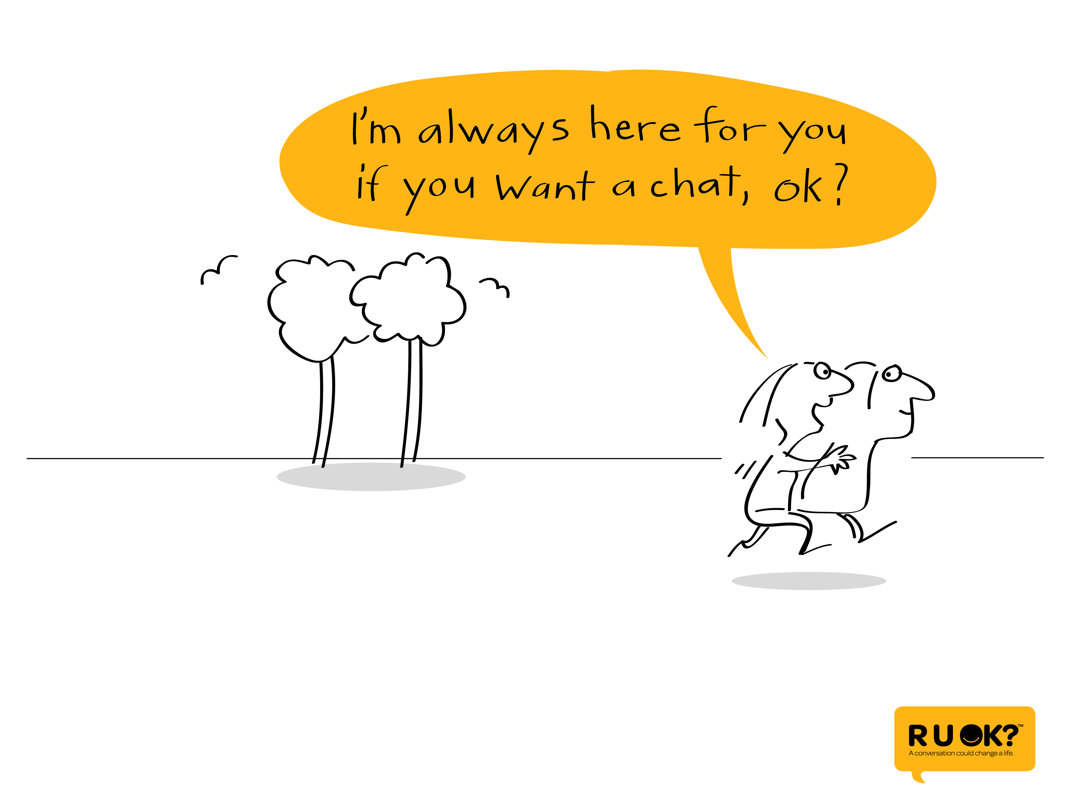
Notes:
That’s ok. Just let them know that you are always ready to have a chat when they’re ready.

Slide 34
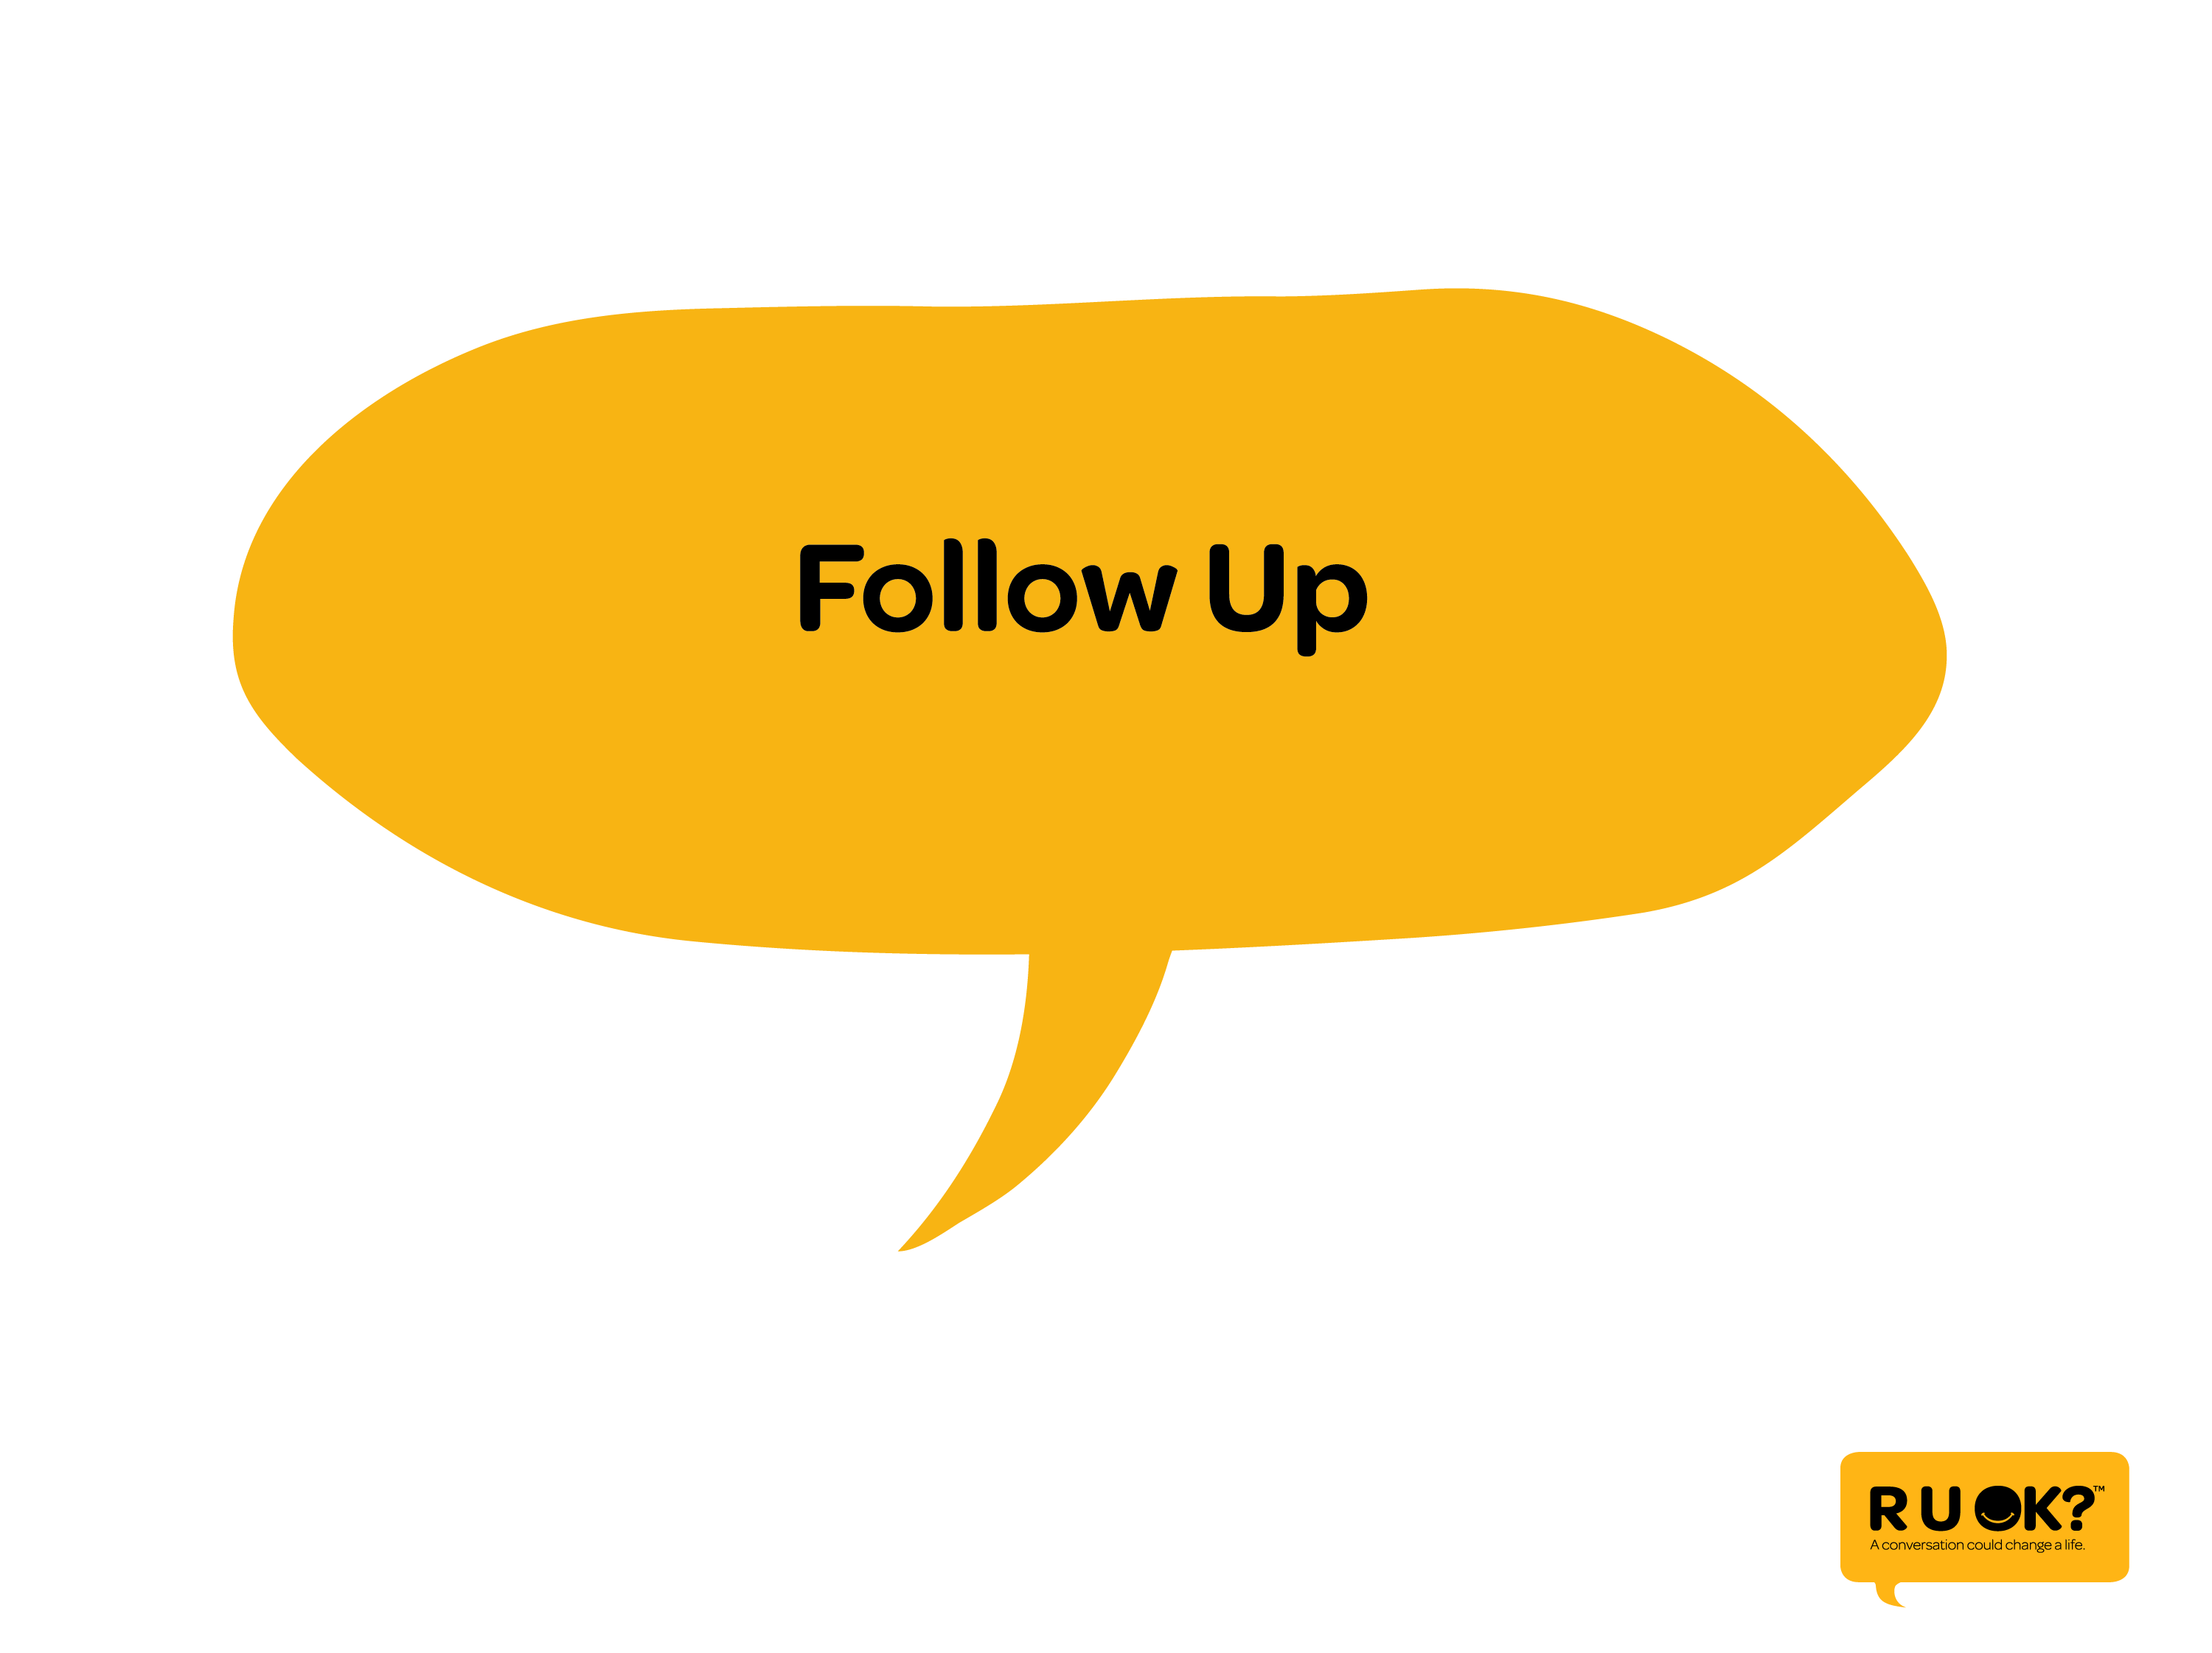
Notes:
But whether the conversation takes place or they would rather not talk just yet, make sure you follow up with them.

Slide 35
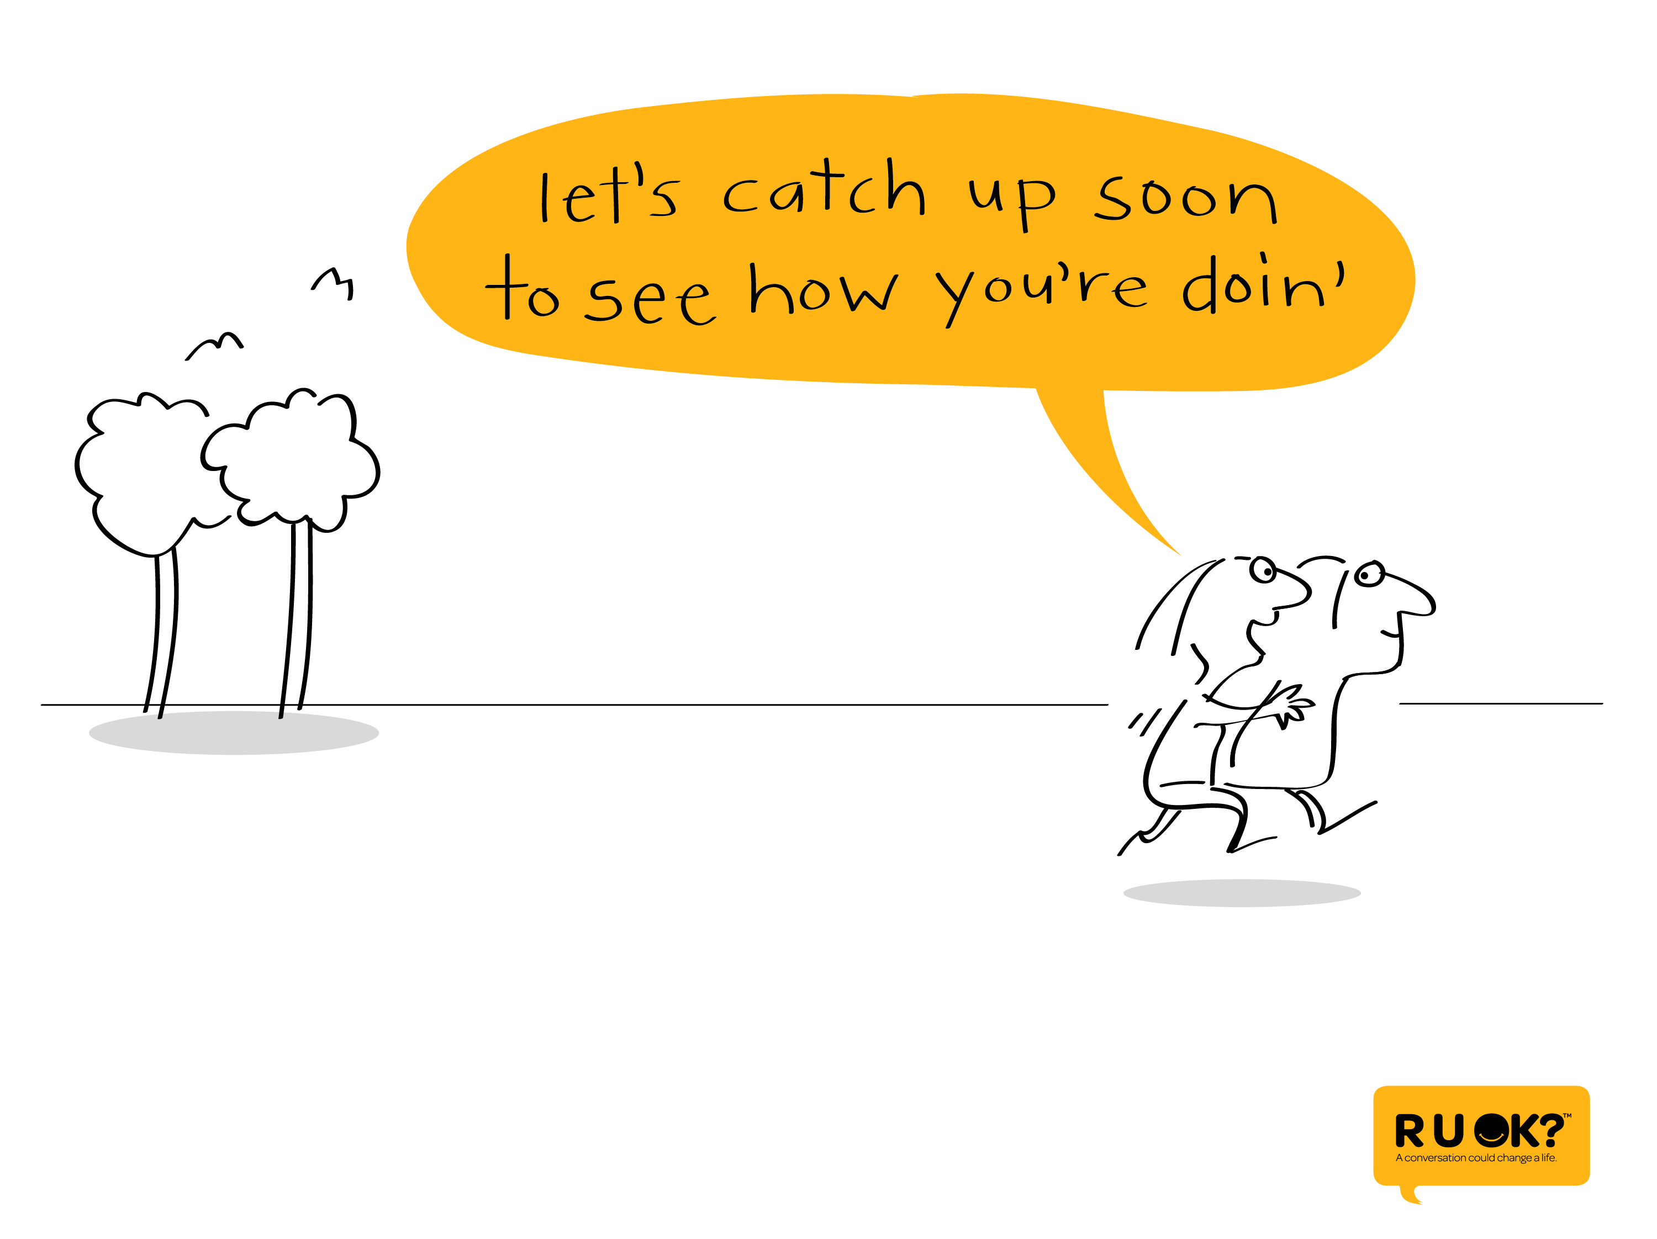
Notes:
Make a joint decision to spend some time with them in the near future and see how they’re going.

Slide 36
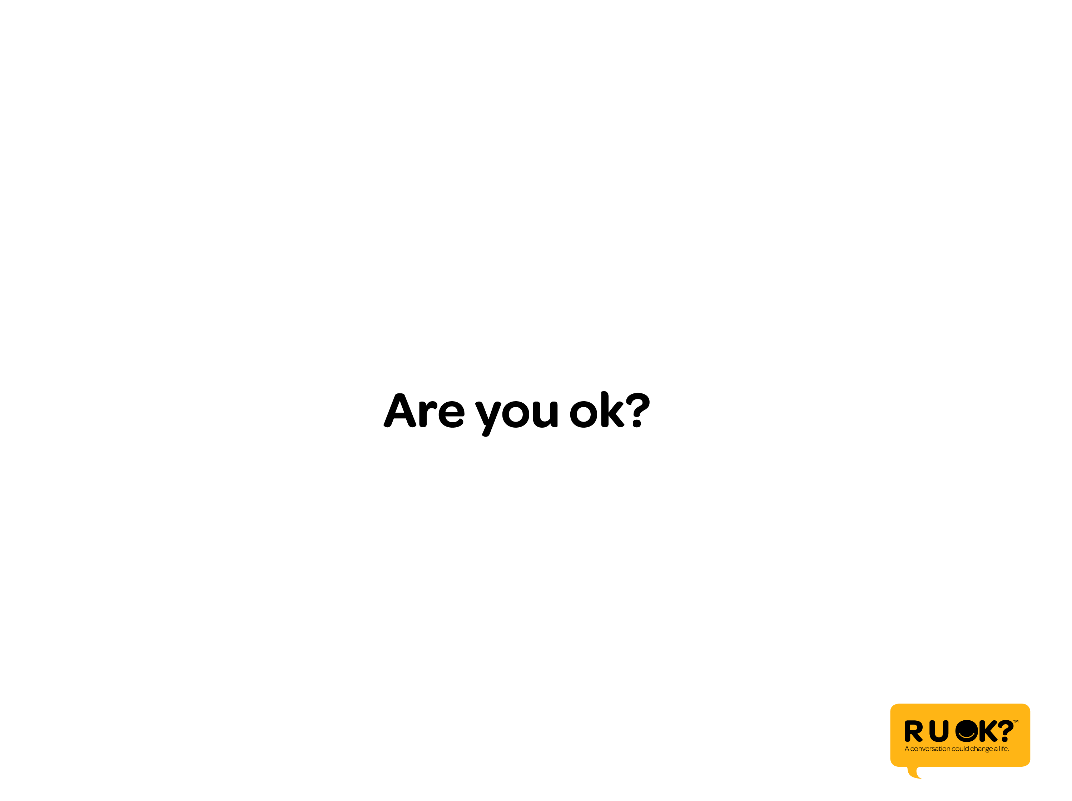
Notes:
Are you ok?

Slide 37
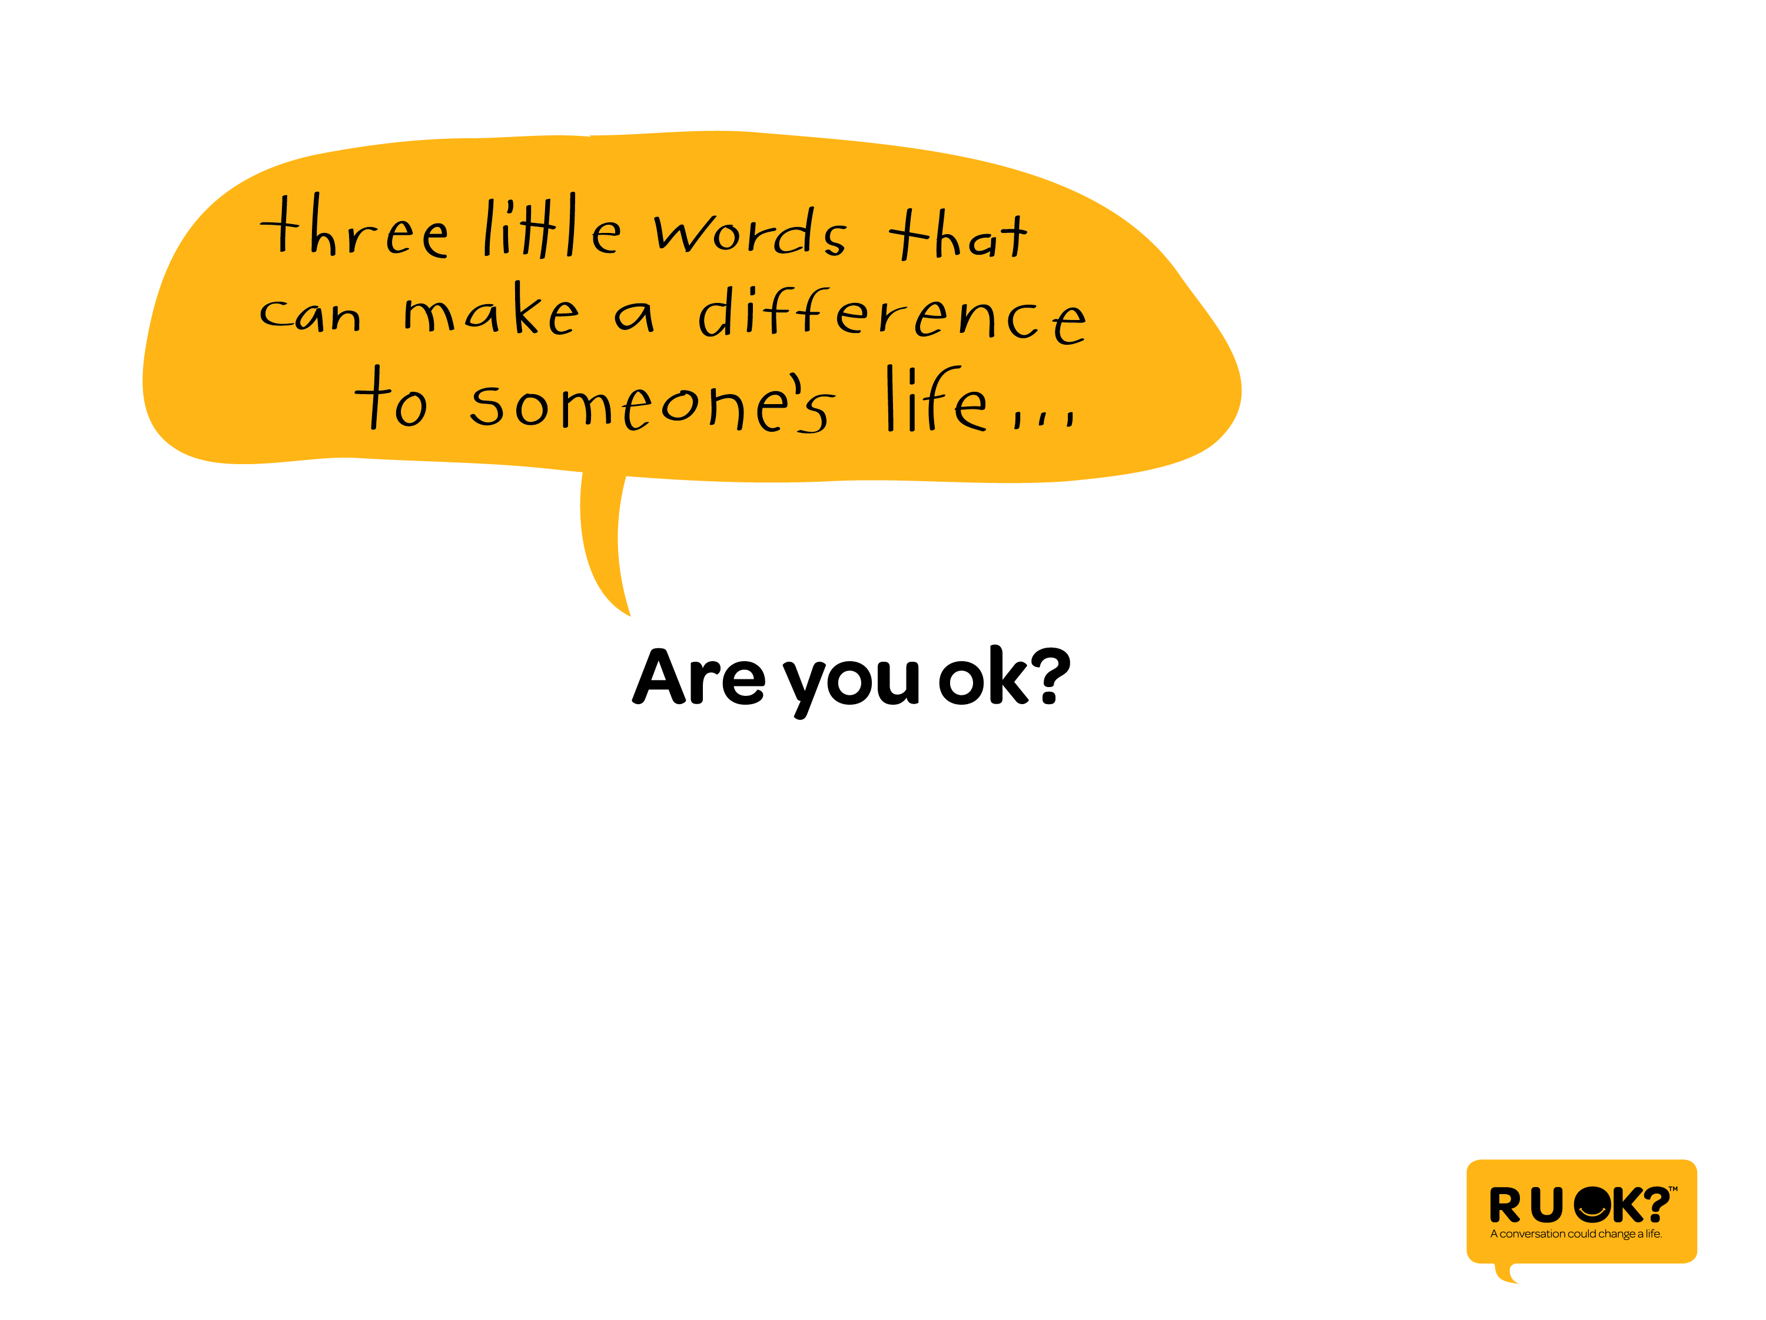
Notes:
3 little words that we can all ask to make a difference…

Slide 38
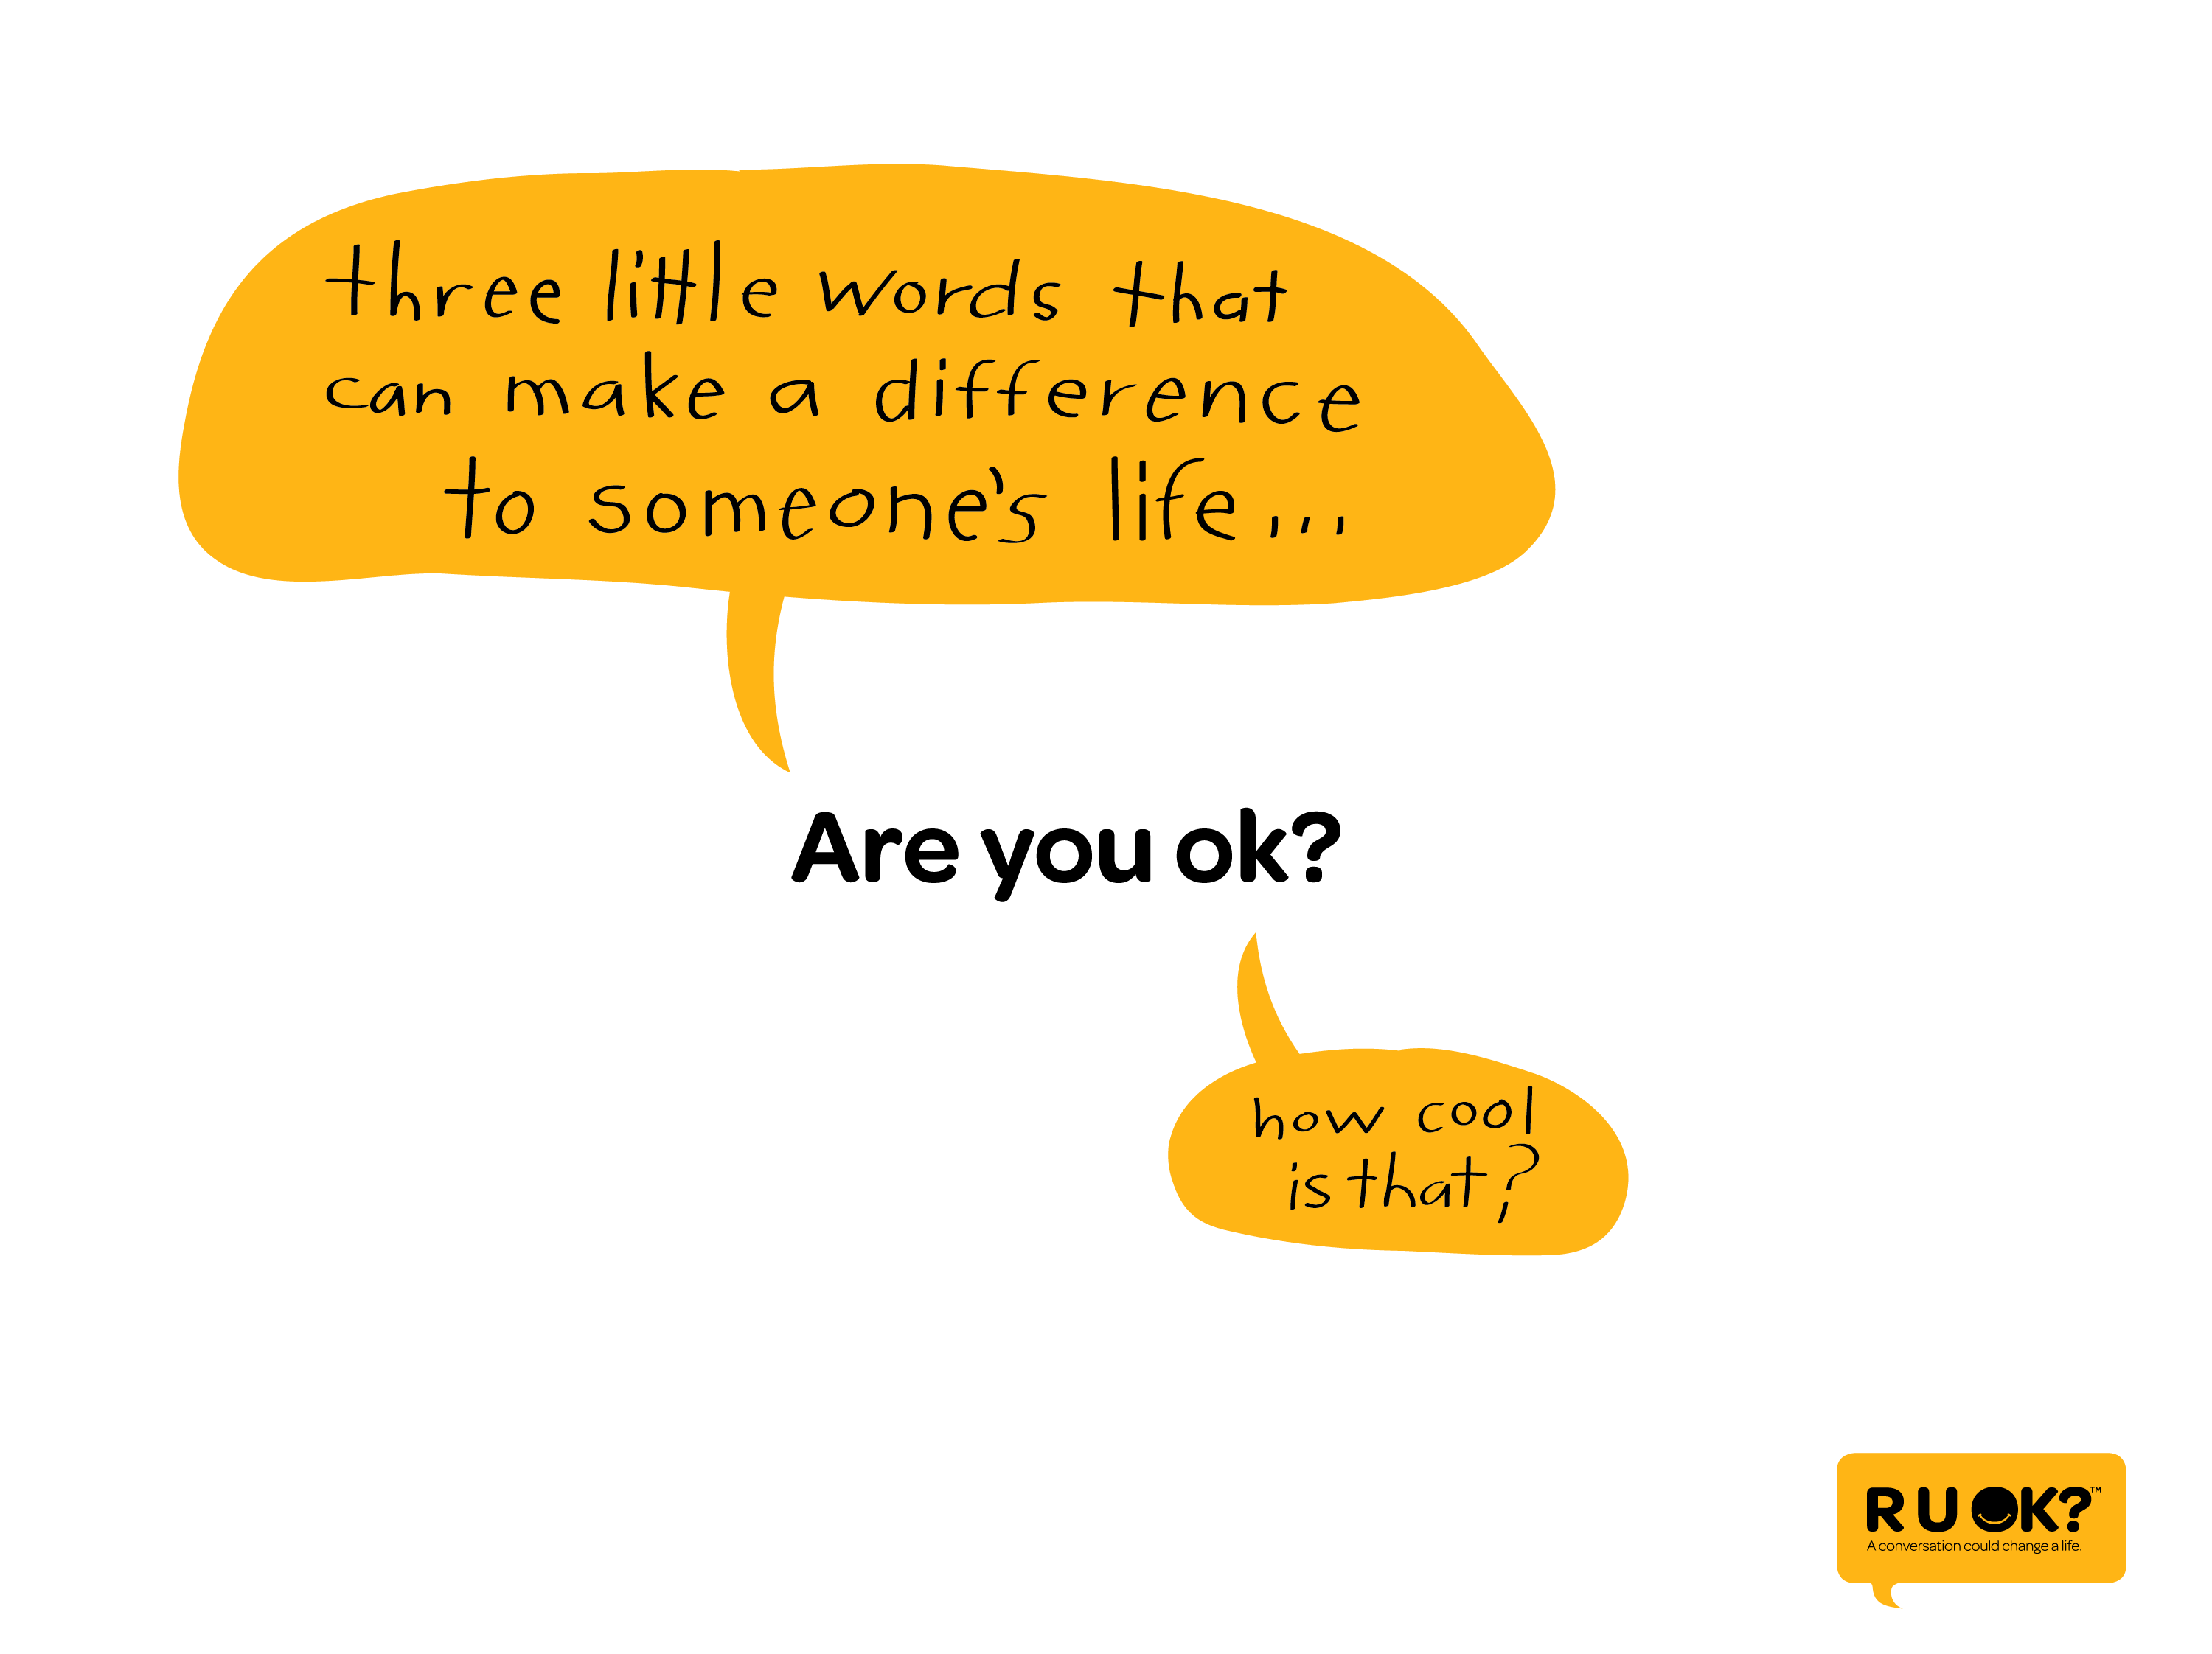
Notes:
3 little words that can change a life…

Slide 39
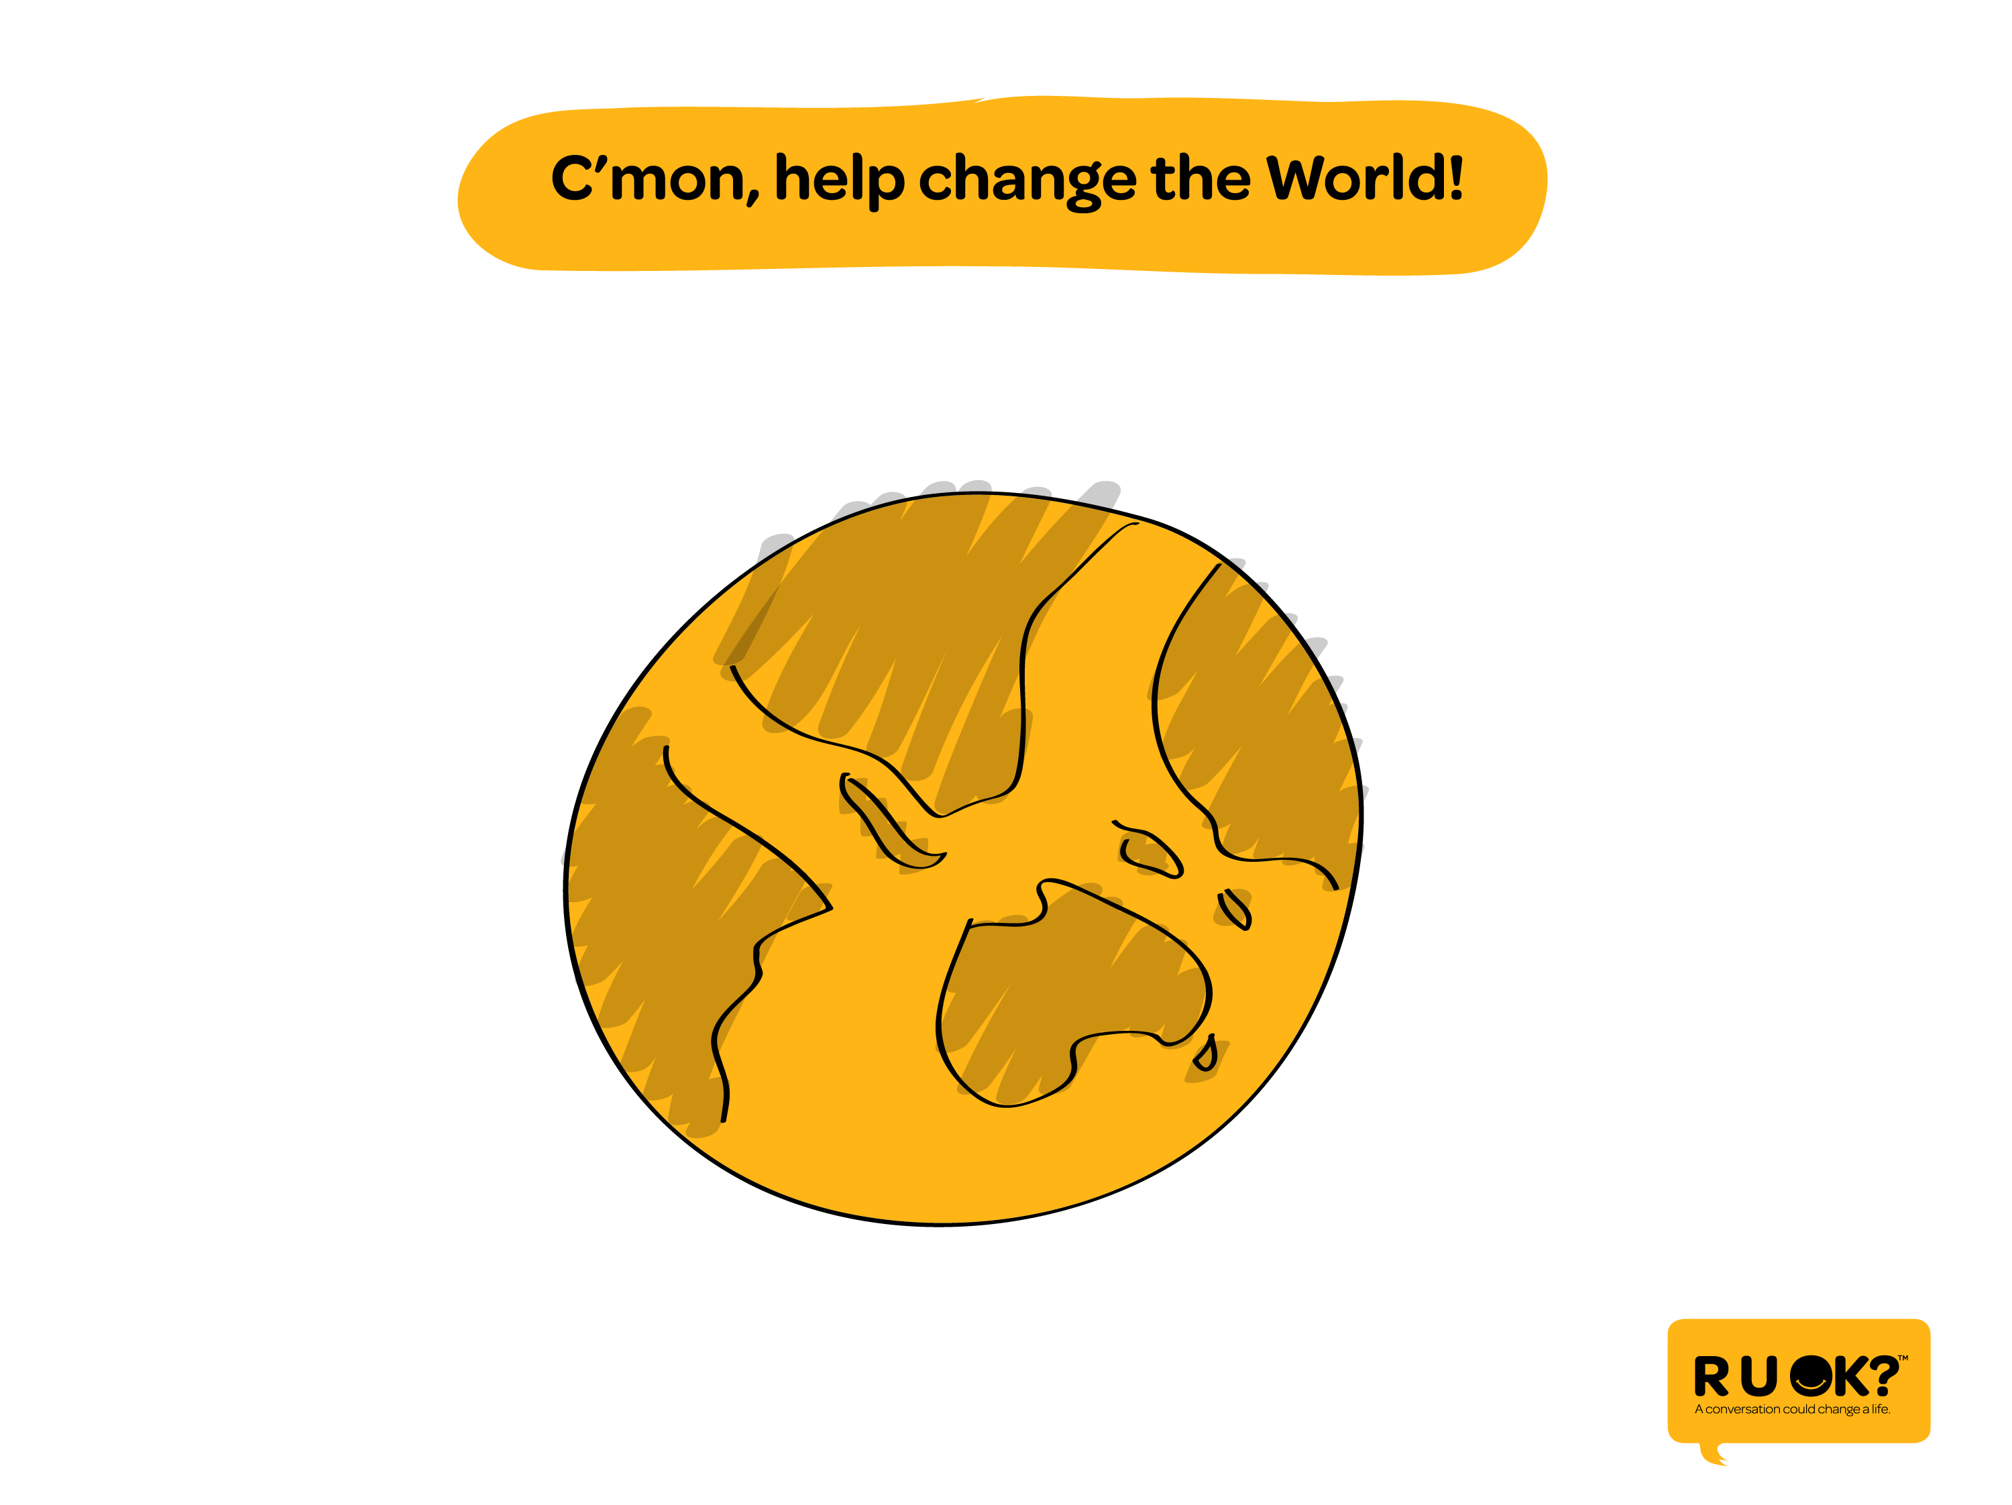
Notes:
And if we all do it regularly….

Slide 40
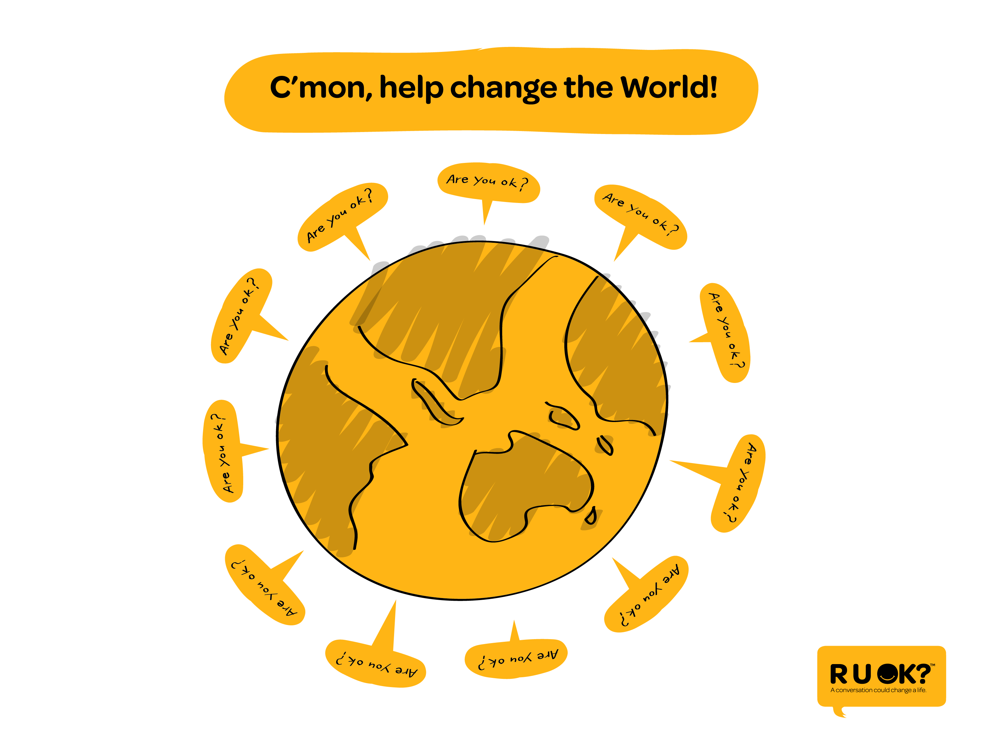
Notes:
We can change the world.

Slide 41


