Slide 1
Plan and Conduct Sport and Recreation Sessions
SISXCAI303A

Slide 2
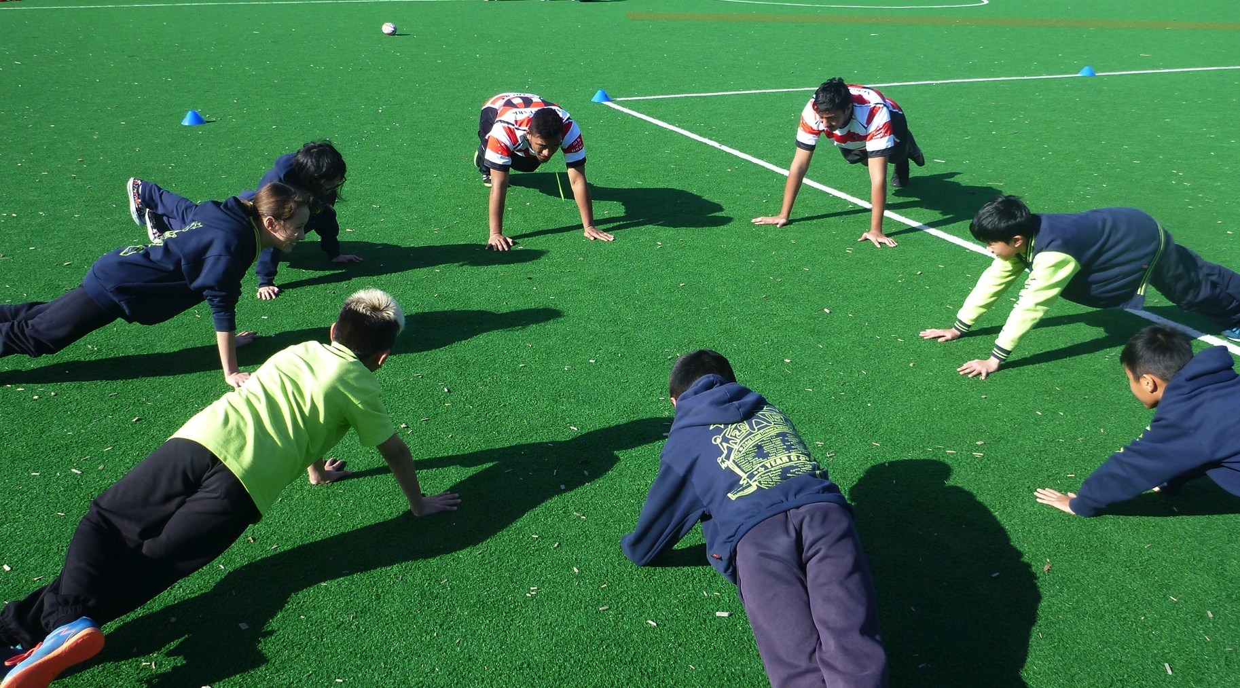
Plan and Conduct Sport and Recreation Sessions

Slide 3
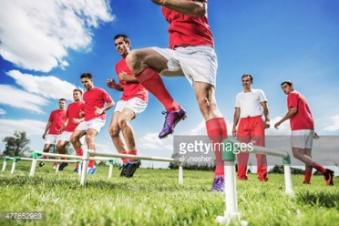
Plan and Conduct Sport and Recreation Sessions
https://youtu.be/vnE9Ob9iwdI
https://youtu.be/ml6MGVy4oO4
https://youtu.be/IBbdEmSZFEM
https://youtu.be/kTJ5b0RkKX8
https://youtu.be/bsXqH8Vt2ZY
https://youtu.be/05fMad4NbIo

Slide 4
SESSIONS
Before we plan and conduct a session we need to establish what sport and recreation is.
There are 4 sectors of the S & R industry:
Fitness: aim of achieving fitness, health benefits or improved performance (bike ride, run, gym class)
Sport: formal and informal activity for exercise or pleasure (sporting comps, tournaments, 5 on 5 soccer)
Community recreation: retail outlets relating to S & R, community-based sport (Rebel Sport, footy at a local park)
Outdoor recreation: activities completed outdoors (rock climbing, bushwalking, skiing)

Slide 5
SESSIONS
A Sport & Recration session can be classified as:
Task, game, activity or exercise
Tasks: any S & R activity with the aim of meeting a desired outcome e.g. teambuilding, dribbling in basketball
Games/activities: any activities that promote enjoyment and fun e.g. dodgeball
Exercise: rec sessions focusing on a particular exercise including, weight training, cardio
Component of a sequenced program
Classes or sessions that make up a group or collection of sessions
E.g. 10 week program, multisport session run every Wednesday
Activities of up to a day’s duration
Hiking trips, surfing trips, scuba diving

Slide 6
CONSULT WITH PARTICIPANTS TO DETERMINE NEEDS
PARTICIPANTS:
Working in the Sport & Recreation industry, you will need to plan & conduct a variety of different sessions for a variety of people.
Sessions run for groups or individuals
As an instructor you need to understand each of your participants
Building a rapport with participants and finding out what appeals to them

Slide 7
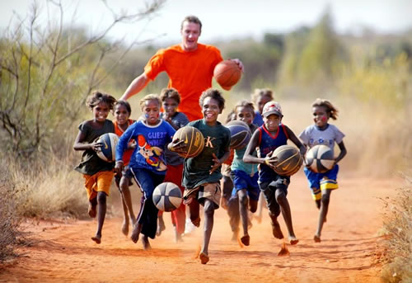
CONSULT WITH PARTICIPANTS TO DETERMINE NEEDS
Participants will be either of the following:
-Experienced
-Inexperienced
-Adults
-Children
-Individuals or groups
*Most participants will be a combination of two or more of these types of participants
COMPLETE ACTIVITY ON PAGE ?? OF IVET

Slide 8
CONSULT WITH PARTICIPANTS TO DETERMINE NEEDS
People participating in Sport & Recreation sessions as individuals or groups.
Individuals: work one on one with an instructor or coach e.g. personal training, private tennis coaching
Groups: vary depending on the environment e.g. swimming class, local footy team
Harder for an instructor to work with
Variety of participant needs
Usually cheaper
http://www.primemotiontraining.com.au/ (Group training and fitness testing clips)
Complete Activity 3.0 – page 98

Slide 9
PARTICIPANT NEEDS & AIMS
Before planning your session, you need to establish your objective.
This may mean you need to source information from the participants, parents, schools etc.
What do the participants expect? What are they hoping to gain from the session?
Participants will have different needs and aims, it is your job as the instructor to meet these.

Slide 10
PARTICIPANT NEEDS & AIMS
Participants needs and aims may include:
Fill out Participants Needs and Aims table using pg. 98-99 of IVET
Complete Activity 3.1 pg. 100
Competitive or performance targets
Self improvement
Fitness targets
Lifestyle adjustments
Technical https://youtu.be/2MNaq8N0lvETactical
Social

Slide 11
NEEDS AND AIMS
COMPETITION OR PERFOMANCE TARGETS
Aim of the session is to achieve performance targets and win games or matches.
Performance target: for a footy club might be to achieve forty tackles per game
Competition target: achieve a number of wins for the season
SELF IMPROVEMENT
- Aims may be related to a persons dimensions of health as well as their perception of themselves including weight loss, muscle toning & improvements in skin health
LIFESTYLE ADJUSTMENT
Aim of achieving health benefits through being active regularly
People might make lifestyle adjustments after putting on weight e.g having a balance diet
FITNESS TARGETS
Aim is to improve fitness levels and achieve fitness targets
Fitness targets may relate to endurance, speed and agility

Slide 12
NEEDS AND AIMS
TECHNICAL
Technical: need to learn and refine skills to be able to play a specific game
A surfer might need to learn the technical steps
involved in standing on a surfboard
SOCIAL
-aim is to socialise and meet new people
-group based session
-can also occur in informal sports or activities where winning is not the
primary aim for participating
TACTICAL
-Tactical skills: most likely to occur in an experienced participant who has been participating for a long time.
- e.g learning how to set up a zone in football to better control the game

Slide 13
RELEVANT LEGISLATION
It is important to understand the laws that you need to be aware of as an instructor in the Sport & Recreation industry:
Equal Opportunity
WH&S
Privacy
Working with children

Slide 14
RELEVANT LEGISLATION
WH&S
Privacy
Law through the WH&S Act
Ensures workplaces are making it their priority to identify hazards in the workplace
Planning a S & R session must foresee any potential hazards that may occur
Changing the environment or adapting a game are ways an instructor could reduce the risk of injury
Illegal in Australia under the Privacy Act to pass on a person’s information without their permission
Information about your participants should be kept confidential & stored in a secure and safe location
https://youtu.be/SgJuwsvtRNU

Slide 15
RELEVANT LEGISLATION
Working with children
Equal Opportunity
Any person working with children must have an up to date Working with Children Check – under the Working with Children Act 2005
Mandatory check that was implemented to protect children under 18 years of age from sexual or physical harm
Valid for 5 years
Everyone has the right to be treated fairly and no one should be discriminated against because of their race, sex, religion, colour, marital status, sexual orientation.
Legislation through the Equal Opportunity Act protects our rights and enforces anti-discrimination in our society

Slide 16
Equal Opportunity Continued
Types of unlawful discrimination:
Age
Sex
Sexual orientation
Religion beliefs
Pregnancy/breastfeeding
Political beliefs
Disability/handicap
Physical appearance
Race/colour/ethnicity
Discrimination is illegal in the following areas:
Accommodation
Clubs (sporting, community)
Education
Employment
Good and services
Sport (admin, coaches, umpires)
Complete Activity 3.2 page. 103
Complete Activity 3.3 page. 104
https://youtu.be/XjJQBjWYDTs
https://youtu.be/RUwLdGz7XtA

Slide 17
ORGANISATIONAL POLICIES & PROCEDURES
As well as legislation, instructors need to be aware of a number of organisational policies & procedures when planning to conduct a session.
These organisational policies & procedures dictate the way in which they perform their duties, interact with participants, deal with injuries, structure the session

Slide 18
ORGANISATIONAL POLICIES & PROCEDURES
Work health & safety
Confidentiality
Assessment procedures
Referral procedures
Using, checking and storing equipment
Emergency procedures
Risk analysis procedures
Time constraints & scheduling requirements
Budget allocation

Slide 19
For each example, identify the organisational policy & procedure:
Planning a first aid session appropriately to include what is first aid, responsibilities of first aider and DRABCD
A personal trainer filing a client’s personal information in a locked filing cabinet
Whiteboard in the PE storeroom to list any unsafe/broken equipment
Walking around a soccer pitch before the game, checking for pot holes
A gym offering discounted memberships to people who refer a friend
Creating a document that lists the potential risks on a ski trip and ways to minimise the risks
Complete Chapter 3 – Review Questions 1 – page 107

Slide 20
TESTS AND ASSESSMENTS
When planning to conduct a session, with a range of participants, you may need to complete tests & assessments first.
Tests are important to check whether or not a person is physically able to participate in the session
This protects the client and the instructor
Tests & assessments include:
Interview
Past performances
Medical history
Physical ability tests

Slide 21
TESTS AND ASSESSMENTS
Interview
Medical History
An instructor speaking and questioning a client about their health, medical history, previous experience, goals etc
Determines if the client is capable, needs a clearance from their GP, get to know client
Determines if client is capable to participate
One day trip e.g. ski trip = waiver forms
Waiver forms: participants acknowledge that participating in the session may cause serious harm or even death.
Being used more and more as there are more cases of negligence
If something goes wrong and the participant has signed the waiver = cannot sue

Slide 22
TESTS AND ASSESSMENTS
Past Performances
Physical ability test
Review of past performances
How the participants performed in the last session & what they achieved will assist the instructor to plan for the next session
Assists in planning the session
Same as fitness appraisals
Aids in prescribing an exercise program
The following tests may be conducted:
Range of movement
Blood pressure
Strength
Anthropometric
Cardiovascular response

Slide 23
Tests and Assessments
Blood Pressure
Range of Motion
Sphygmomanometer (if you can say it I will give you a prize), cuff and stethoscope is used or an automatic blood pressure machine (eliminates the chance of error)
Measurement of the force blood applies to the artery walls
Systolic & diastolic
If hypertension – referred to a GP
Freely move certain body parts
Simple as touch their toes, swing their arms
https://youtu.be/2U4dIq7It9A

Slide 24
TESTS AND ASSESSMENTS
Strength
Anthropometric
Should be used if clients goal is to lose weight, tone or increase muscle mass
Girth measurements: marker to measure, tape measure
Sites girth measurements should be taken:
  Waist & abdominal
  Chest
  Upper arm (relaxed & flexed)
  Hip thigh
Also, skin fold testing
Tested through a grip dynamometer (hand grip) test
Squeezes the dynamometer for 5 seconds at maximal level
Right angle with elbows by the side of their body
Maximum bench press test

Slide 25
TESTS AND ASSESSMENTS
Cardiovascular Response
Resting HR needs to be taken first
VO2 Max: maximal amount of oxygen an athlete consumes when exercising: higher the VO2 max, better the endurance of the athlete
Cycle Ergometer Test (heart rate monitor)
Beep test
Cooper’s 12 minute run
https://youtu.be/RUwLdGz7XtA

Slide 26
LIKELY DEMANDS
When planning a session it is important to consider the demands that a client may be placed under.
A demand is the required effort or ability required to complete the activity.
Tests & assessments completed will determine whether the client is capable

Slide 27
LIKELY DEMANDS
Likely demands include:
Physical
Emotional
Psychological
Group
Individuals within groups
Complete Activity 3.5 page 114-115
Chapter 3 – Review Questions 2 page 115

Slide 28
DEVELOP A SESSION
SESSION PLAN
When planning a session an instructor needs to be prepared
A session plan should be designed to meet the identified needs, abilities & risk factors of participants according to relevant legislation & organisational policies & procedures
A session plan should include the following aspects:
Aims
Dates & times
Activity stages & structure
Logistics

Slide 29
DEVELOP A SESSION
AIMS
What do you want to achieve from the session?
What is the goal of the session?
Examples of aims in Sport & Recreation:
-improved physical fitness
-To get every participant involved in the session
-Provide an opportunity to develop friendships
-Develop teamwork
-Develop knowledge of rules and strategies in the game of netball
When evaluating a session the aims and objectives should be analysed

Slide 30
DATES & TIMES
When is the session going to take place and at what time?
11am spin class will attract who?
6pm spin class will attract who?
https://youtu.be/Tzm6TEManmQ

Slide 31
ACTIVITY STAGES & STRUCTURE
How the session will be run & what structure will be chosen?
The session may start with a warm up, followed by main activity, ending with a cool down.
May have a skills session if one of the aims is to improve a specific skill.
Each component should be allocated a duration of time

Slide 32
LOGISTICS
Refers to the management and running of the session.
It involves the organisation of people, facilities & supplies
Resources needed:
Physical resources:
Relate to equipment or materials required to complete the session. Safety equipment e.g. food, water, first aid supplies. If you were to run an outdoor personal training session the resources may be medicine balls, free weights, skipping ropes

Slide 33
LOGISTICS
Human Resources:
May need additional support and support personnel to assist you to run a safe session.
A level of supervision is required for any activity or session being conducted
The level of supervision is based on:
The type of site
The type of session conducted
The number of participants
Type of group
Support personnel may include:
Coaches
Teachers
Health professionals
Carers
Parents or guardians

Slide 34
LOGISTICS
Financial Resources
Transport & related logistical requirements
Relate to money
Do you have the right amount of funds available to run the session?
Have you been allocated a budget?
How participants will get to the venue.
Tables, barriers, megaphones and signage

Slide 35
EXTERNAL FACTORS
When planning & developing a Sport & Recreation session it is important to consider the external factors that may effect the running of the session.
External factors may include:
Weather
Time of day
Environmental variables
Condition of site of location
Participant abilities

Slide 36
EXTERNAL FACTORS
WEATHER
TIME OF DAY
Poor weather can cause damage & increase likelihood of accidents.
As an instructor it is your responsibility to monitor the weather & cancel, reschedule, change venue or modify session
Heat is also a problem = causing dehydration
Stance when giving instructions to the group
May impact the weather conditions
May impact the enthusiasm & mindset of the participants
Level of fatigue
Complete Activity 3.8 page 121 of IVET

Slide 37
EXTERNAL FACTORS
ENVIRONMENTAL VARIABLES
PARTICIPANT ABILITIES
Location & facilities of the session
Instructor should visit the site the week before to check the condition of the site and accessibility to the session
Impacts the activities that you will conduct
It is vital you determine the participants aims, needs and abilities before conducting the session
Modifications can always happen throughout the session

Slide 38
PREPARE RESOURCES FOR THE SESSION
VENUE:
Choosing the venue is an important part to being planned and organised.
The venue can change how the session is run, activities organised, equipment required & way an instructor communicates to the participants.

Slide 39
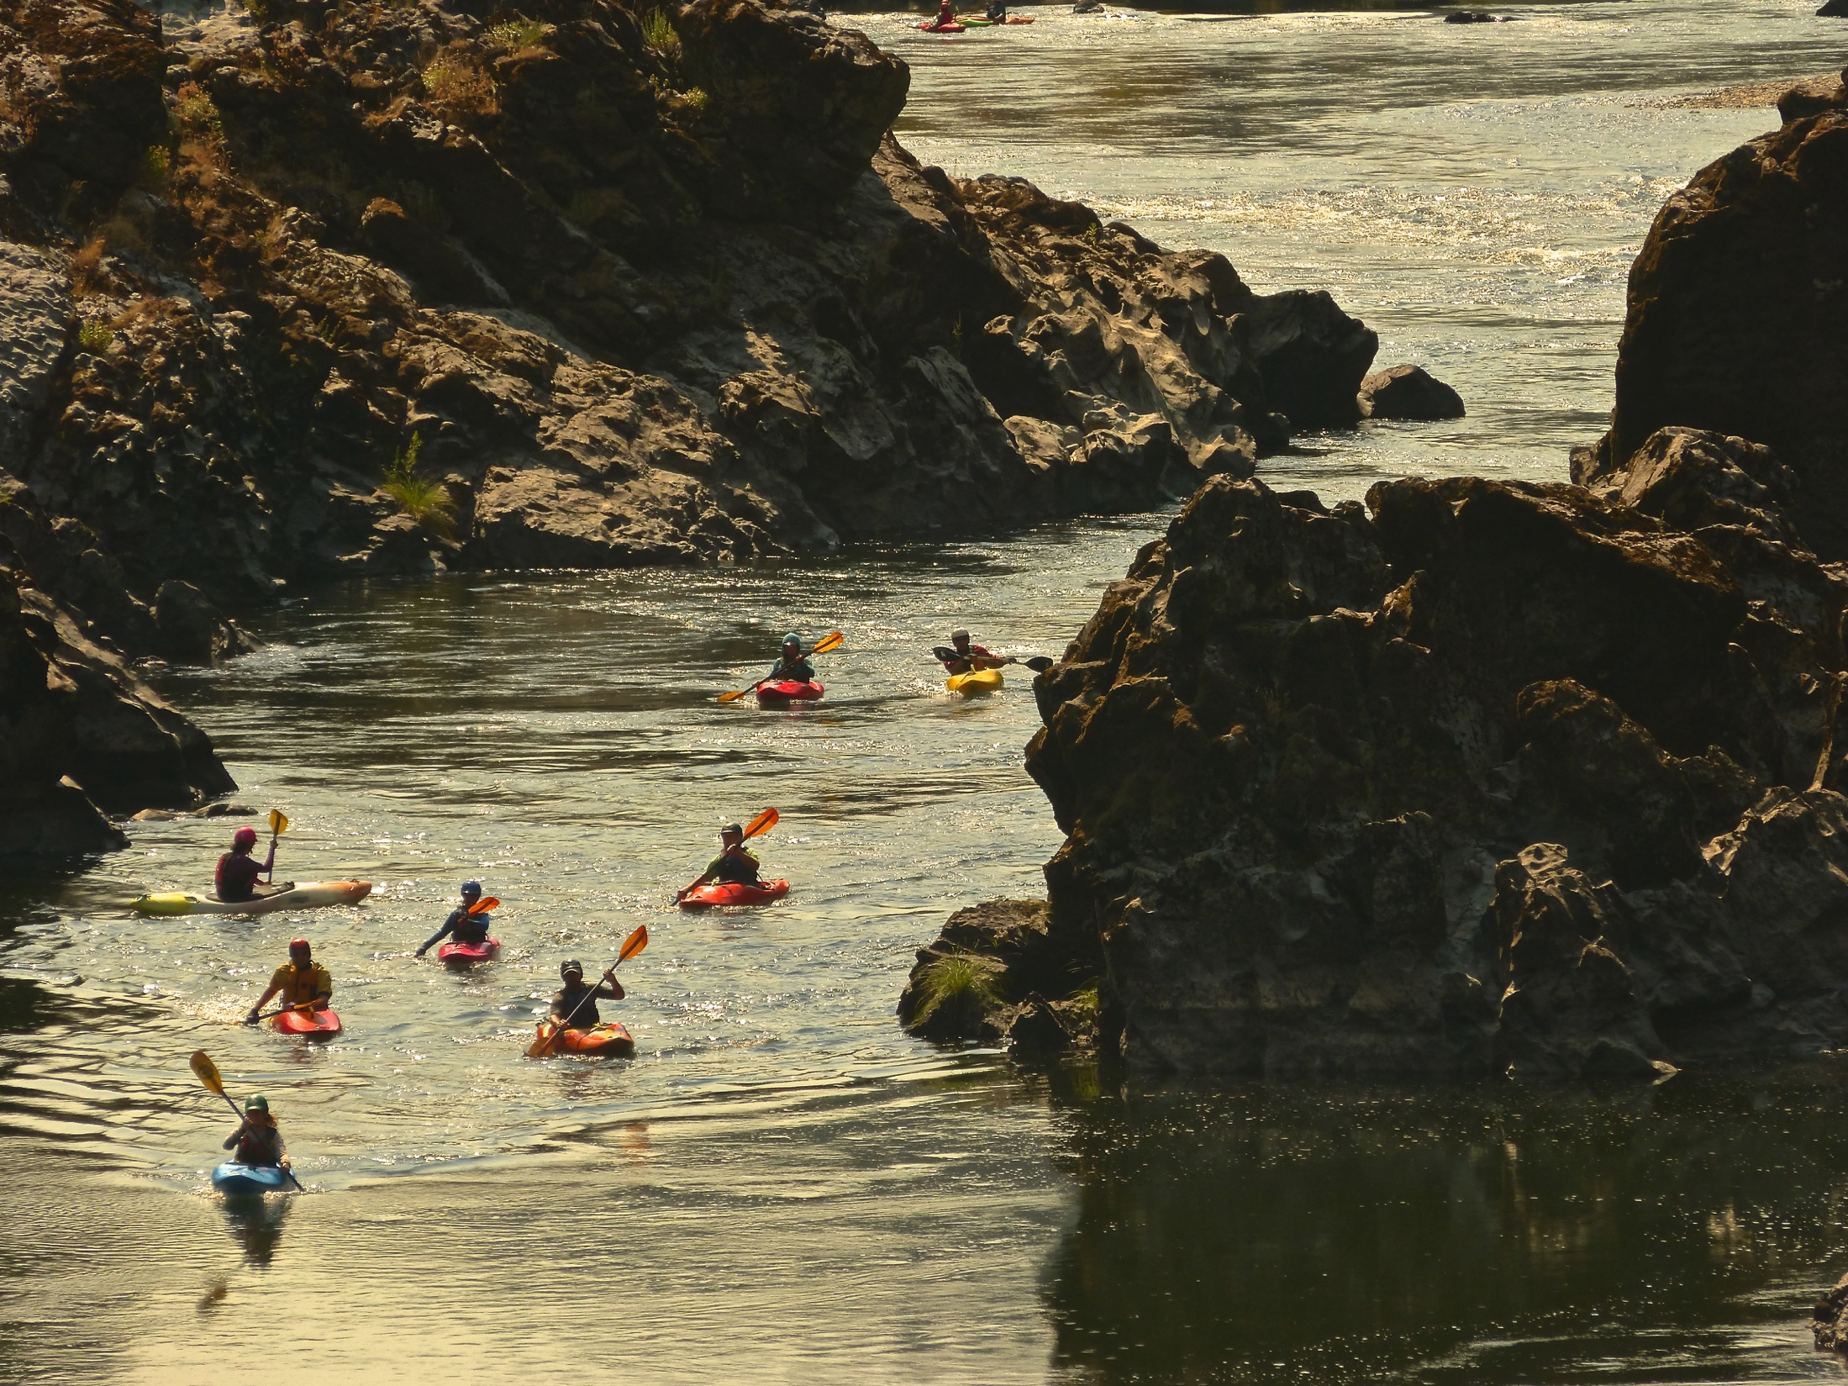
VENUES
OUTDOOR SITES
INDOOR FACILITIES
Uncontrollable environments
Surfing, kayaking, outdoor fitness sessions
Gyms, fitness centres, sport complexes & stadiums
Weather is not an influencing factor
Boundaries & conditions can be controlled

Slide 40
VENUES
AQUATIC FACILITIES
COMMUNITY HALLS
Water based activities such as swimming lessons, water polo, diving & aquatic aerobics
A variety of age groups use these facilities
Injured people may prefer using these facilities as they are non weight bearing activities
Venues used by community groups such as scout halls & community centres, often owned by the local council
Usually cheap to hire
Other additional resources available like kitchens that can be used to prepare food & drinks

Slide 41
CONDUCT THE SESSION
Good interpersonal skills: communication
Ask questions throughout the session to check for understanding
Demonstrations should be completed
Safe and appropriate warm ups and cool downs
Positive feedback

Slide 42
CONCLUDE THE SESSION/EVALUATE THE SESSION
CONCLUDE THE SESSION:
Sufficient time for cooling down
Review skills and content learnt
Collect equipment & check for damage
Supervise participants’ departures

Slide 43
CONCLUDE THE SESSION/EVALUATE THE SESSION
EVALUATE THE SESSION:
Seek & acknowledge feedback from participants
Aids future decision making or changes that may need to be made
Determine parameters (specific criteria you want your target audience to comment on regarding the session) for the evaluation
Following criteria must be considered:
Aims and objectives of the session
Participant satisfaction
Suitability & safety of facilities & equipment
Content, structure & processes of the session
Personal performance

Slide 44
FLASHCARDS
Tap on these instructions or follow the link below to set-up flashcards through Flashcard Hero.
http://flashcardhero.com/c/99Vb4QW46g

Slide 45
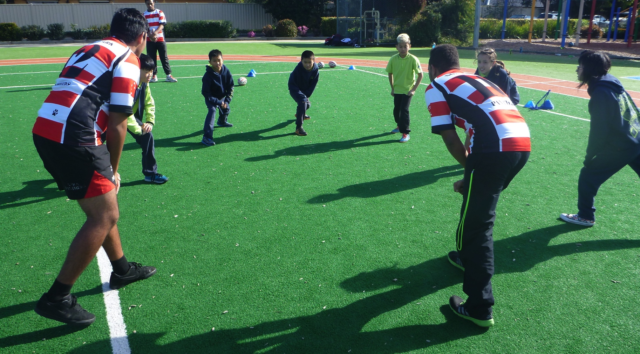
Plan and Conduct Sport and Recreation Sessions
https://youtu.be/oXJ1FZKwI7c

