Slide 1

Chapter 8 – Comparing Global Health
12 HHD
Unit 4
AOS1

Slide 2
Developed & Developing Countries
Developed Countries
Also known as industrialised countries, are countries with well developed industry, mining or agricultural sectors and which therefore, enjoy a healthy economy based on trade.
Developing Countries
Countries that generally have a low Gross Domestic Product (GDP). Being less developed means these countries have less access to technology and have poor industry and limited trade arrangements.

Slide 3
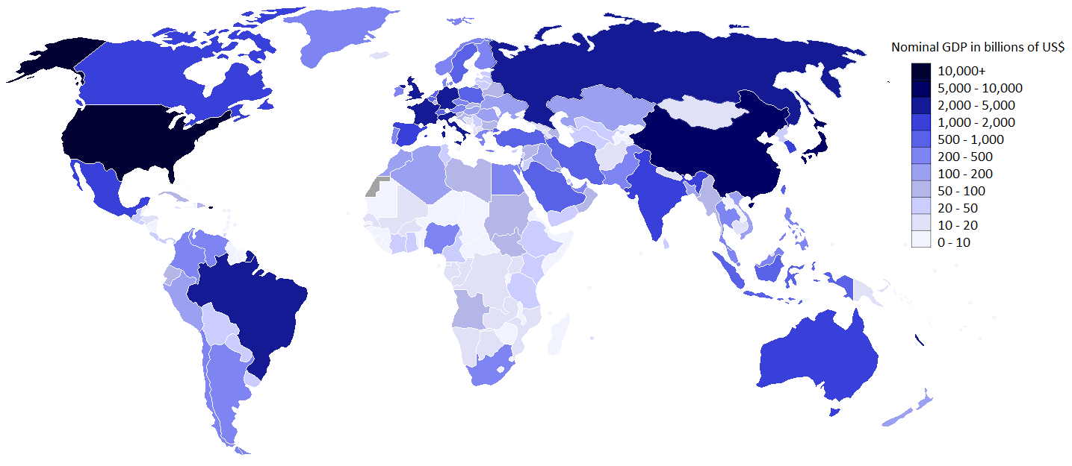
Gross Domestic Product
The total value of goods and services produces by a country in a year.
Used as one indicator that a country is industrialised.

Slide 4
Characteristics of Developed Countries
Characteristics of Developed Countries
High standard of living
High Life Expectancy
High GDP per capita
High Literacy rates
Safe water
Adequate sanitation
Accessible Healthcare
High participation in education
Social security system
Low U5MR
Adequate food supply
Well-developed industry
Adequate shelter
Slow population growth
Technically developed
High rates of lifestyle caused by affluence

Slide 5
Definitions of Developed and Developing Countries
Developing Countries
High mortality
Low LE
Poor industry, limited trade
Low GDP, high rates of povert
Limited healthcare and education
Developed Countries
Low child and adult mortality
Longer LE
Well developed industry
High GDP
Established healthcare and education system

Slide 6
WHO Stratum
WHO has divided the member states into 5 Mortality Strata…
A. Very Low child mortality, Low adult mortality
Australia, Japan, Germany, USA, UK
B. Low child mortality, Low adult mortality
Mexico, Indonesia, Turkey, China
C. Low child mortality, High adult mortality
Estonia, Hungary, Latvia
D. High child mortality, High adult mortality
Guatemala, Peru, Afghanistan
E. High child mortality, Very High adult mortality
Botswana, Zimbabwe, Mozambique

Slide 7
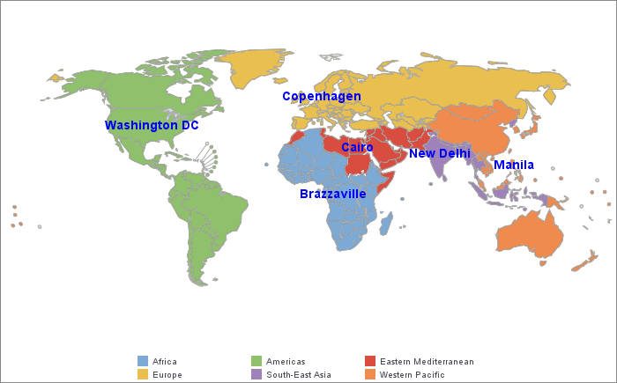
6 WHO Regions

Slide 8
Influences of Colonisation,
Trade and Debt
Colonisation:
Exploit raw materials and resources – mining (gold), planted cash crops, cheap labour…
Decreased self-sufficiency and led to food shortages, urbanisation and disease.

Slide 9
Influences of Colonisation,
Trade and Debt
Trade:
Market controlled by wealthier nations.
Poor weather, crop disease, trade restrictions, taxes and global market price fluctuations can limit profits.

Slide 10
Influences of Colonisation,
Trade and Debt
Debt:
Some developing countries have borrowed large amounts from agencies such as the World Bank.
Leaders did not spend money wisely on infrastructure, (eg weapons and buildings).
Now many pay more on “repayments” than essential services.

Slide 11
Comparing Australia to Developed Countries
Similarities and differences in health between developing countries and Australia
When comparing the health status between Australia and developing countries you will need to consider the following:
LIFE EXPECTANCY
MORTALITY
MORBIDITY
BURDEN OF DISEASE
HUMAN DEVELOPMENT INDEX

